Slide 1

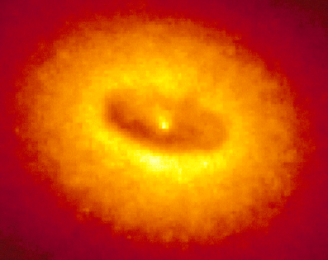
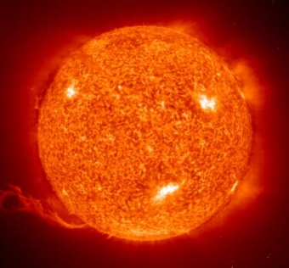
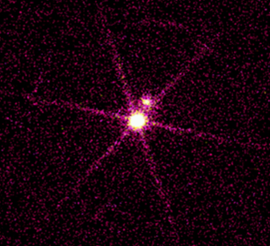
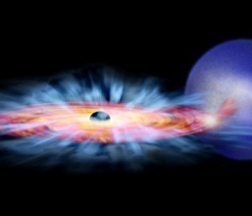
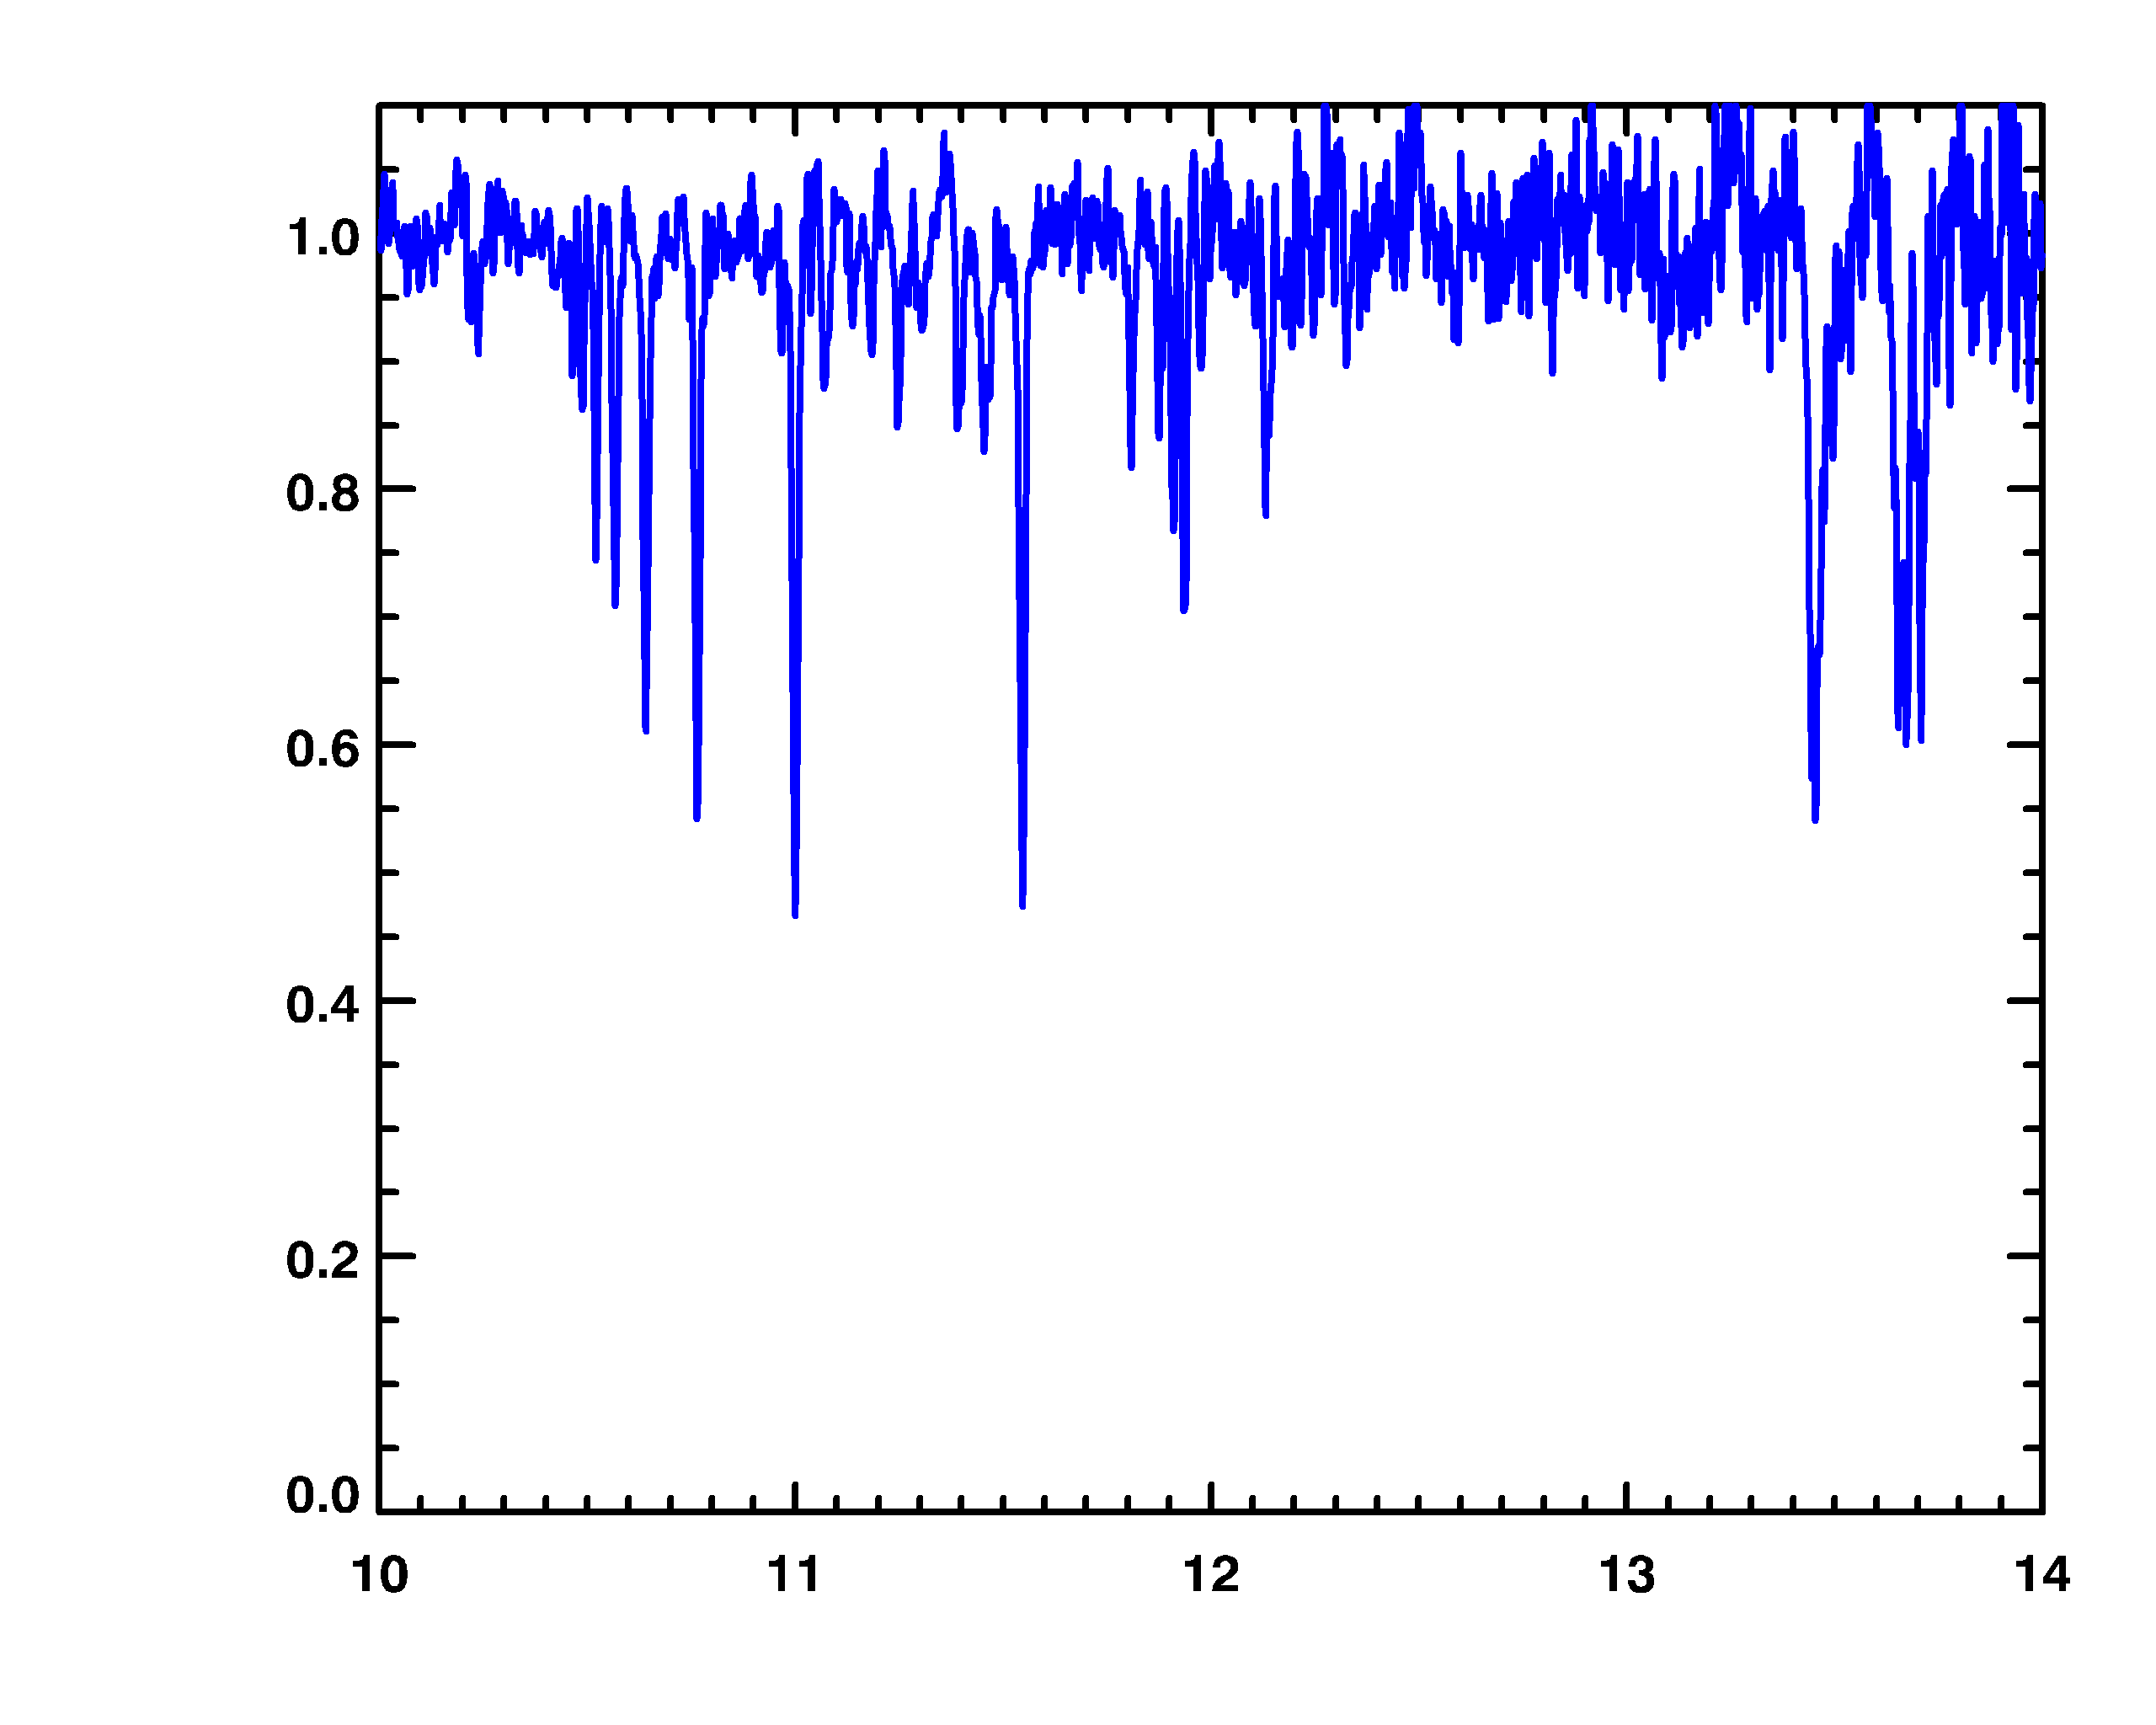
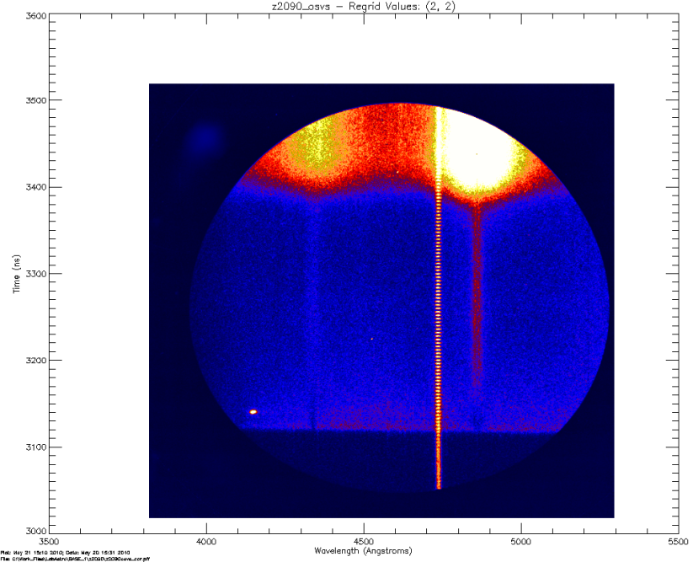
S a n d i a N a t i o n a l L a b o r a t o r i e s
ZAPP: THE Z ASTROPHYSICAL PLASMA PROPERTIES COLLABORATION
Jim Bailey
HEDLA
Tallahassee, Florida
May 1, 2012
Sandia is a multiprogram laboratory operated by Sandia Corporation, a Lockheed Martin Company,
for the United States Department of Energy’s National Nuclear Security Administration under contract DE-AC04-94AL85000.

Slide 2
The ZAPP collaboration involves universities, U.S. national labs, a private company, and the French CEA laboratory
J.E. Bailey, G.A. Rochau, S.B. Hansen, C. Ball, A.L. Carlson, M. Kernahan, G.S. Dunham, M.R. Gomez, G. Loisel, T. Nagayama
Sandia National Laboratories, Albuquerque, NM, 87185-1196
C.A. Iglesias, D. Liedahl
University of California, Lawrence Livermore National Laboratory, Livermore, CA, 94550
M.E. Sherrill
Theoretical Division, Los Alamos National Laboratory, Los Alamos, NM 87545
J.J. MacFarlane, I. Golovkin, I. Hall
Prism Computational Sciences, Madison, WI, 53703
R.C. Mancini, T. Durmaz, T. Lockard, D. Mayes
University of Nevada, Reno, NV
C. Blancard, Ph. Cosse, G. Faussurier, F. Gilleron, J.C. Pain
CEA, DAM, DIF, F-91297 Arpajon, France
D. Cohen, J. MacArthur,
Swarthmore College, Swarthmore, PA, 19081
A.K. Pradhan, S.N. Nahar, M. Pinsonneault
Ohio State University, Columbus, Ohio, 43210
D.E. Winget, M.H. Montgomery, R.E. Falcon, J.L. Ellis
University of Texas, Austin, Texas

Slide 3
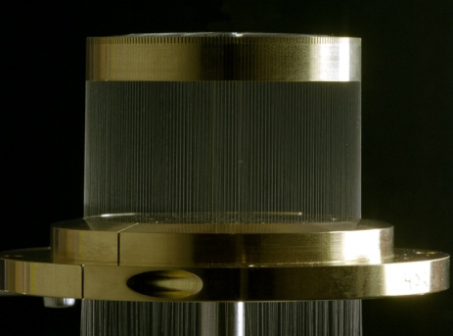
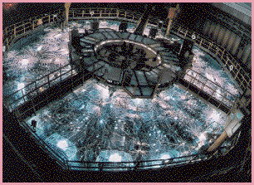

The 26 million Ampere current on Z provides access to new laboratory astrophysics regimes
Z accelerator
tungsten
wire array
4 cm
Current 2.6x10⁷ Amps
B-Field
40 m
Z generates electrical power ~5x larger than the combined output of all the worlds power plants.
We use this to make large magnetic fields or large x-ray fluxes to create extreme environments
JxB Force
X-ray image

Slide 4
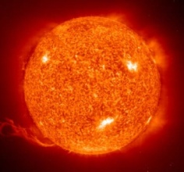

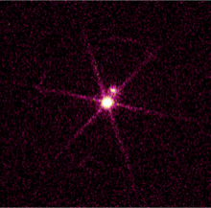
ZAPP experiments exploit megaJoules of x-rays to simultaneously address four separate astrophysics topics
Atomic kinetics in warm absorber photoionized plasmas
Stellar interior opacity
Resonant Auger destruction in accretion powered objects
Spectral line formation in white dwarf photospheres
Fe/Mg foil
Ne
gas
cell
Si
exploding
foil
Z x-ray source
1-2 MJ; 2·10¹⁴ W
H gas cell
Multiple samples are exposed to Z x-rays on each shot
Crucial for progress on oversubscribed MJ-class facility

Slide 5
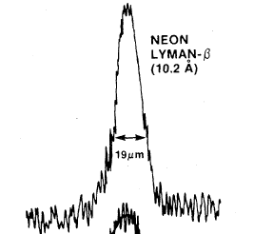
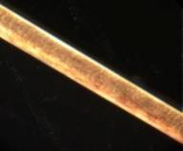

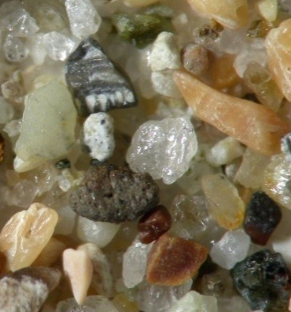
What is new:
Mega-Joule class facilities create macroscopic enough quantities of astrophysical matter for detailed studies
High Energy Density experiments have reached extreme conditions for many years
But small size, spatial structure, and short duration hampered material property measurements
Typical size scale ~ human hair
laser fusion capsule (Yaakobi, PRL, 1977)
300 eV, 0.26 g/cc
19 μm
Z opacity samples are similar in size to a ~ 1 mm sand grain
Z White Dwarf samples are similar in size to a phone
(~ 100 cm³)
Creating mm-scale replicas of cosmic matter will strengthen the laboratory foundation of astrophysics

Slide 6
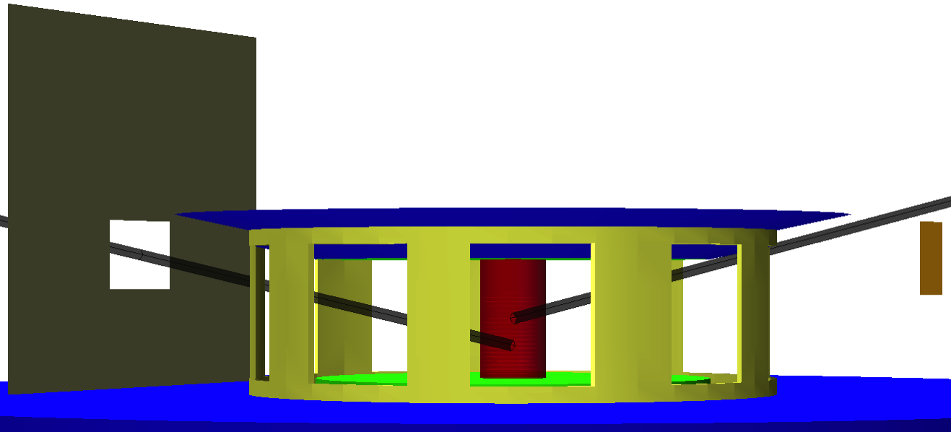
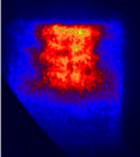
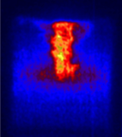
The radiation driving each sample is inferred from a combination of x-ray diagnostics
Samples are exposed to x-rays from the pinch and the surrounding apparatus
Source contributions measured with absolute power diagnostics and a gated imager with three photon energies (hν=277 eV , hν=528 eV and hν>1keV)
A view factor code is used to infer the spectral irradiance at the sample
X-ray power
x-ray power diagnostics
Multi-wavelength
imager
t=-1.6ns
t=+0.3ns
sample
monochromatic images
at 277 eV

Slide 7
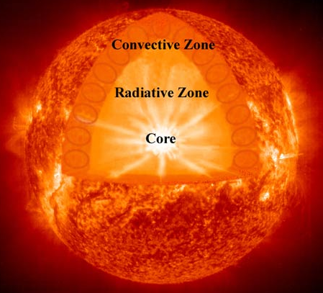
Does opacity uncertainty cause the disagreement between solar interior models and helioseismology?
Discrepancies in CZ boundary location, C_{s} (r), and ρ(r)
Models depend on:
element abundances
EOS
opacity
Discrepancies for other stars are appearing as asteroseismology matures
NASA
focus: iron at convection zone base
{190 eV, 9e22 e/cc}

Slide 8
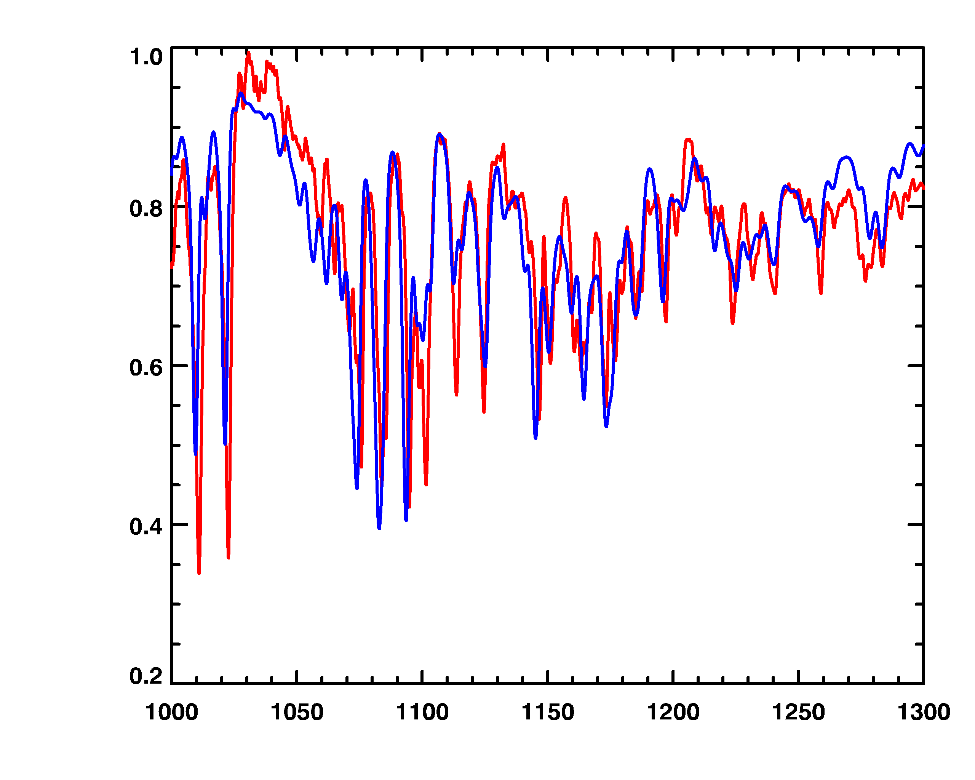
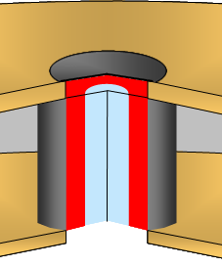
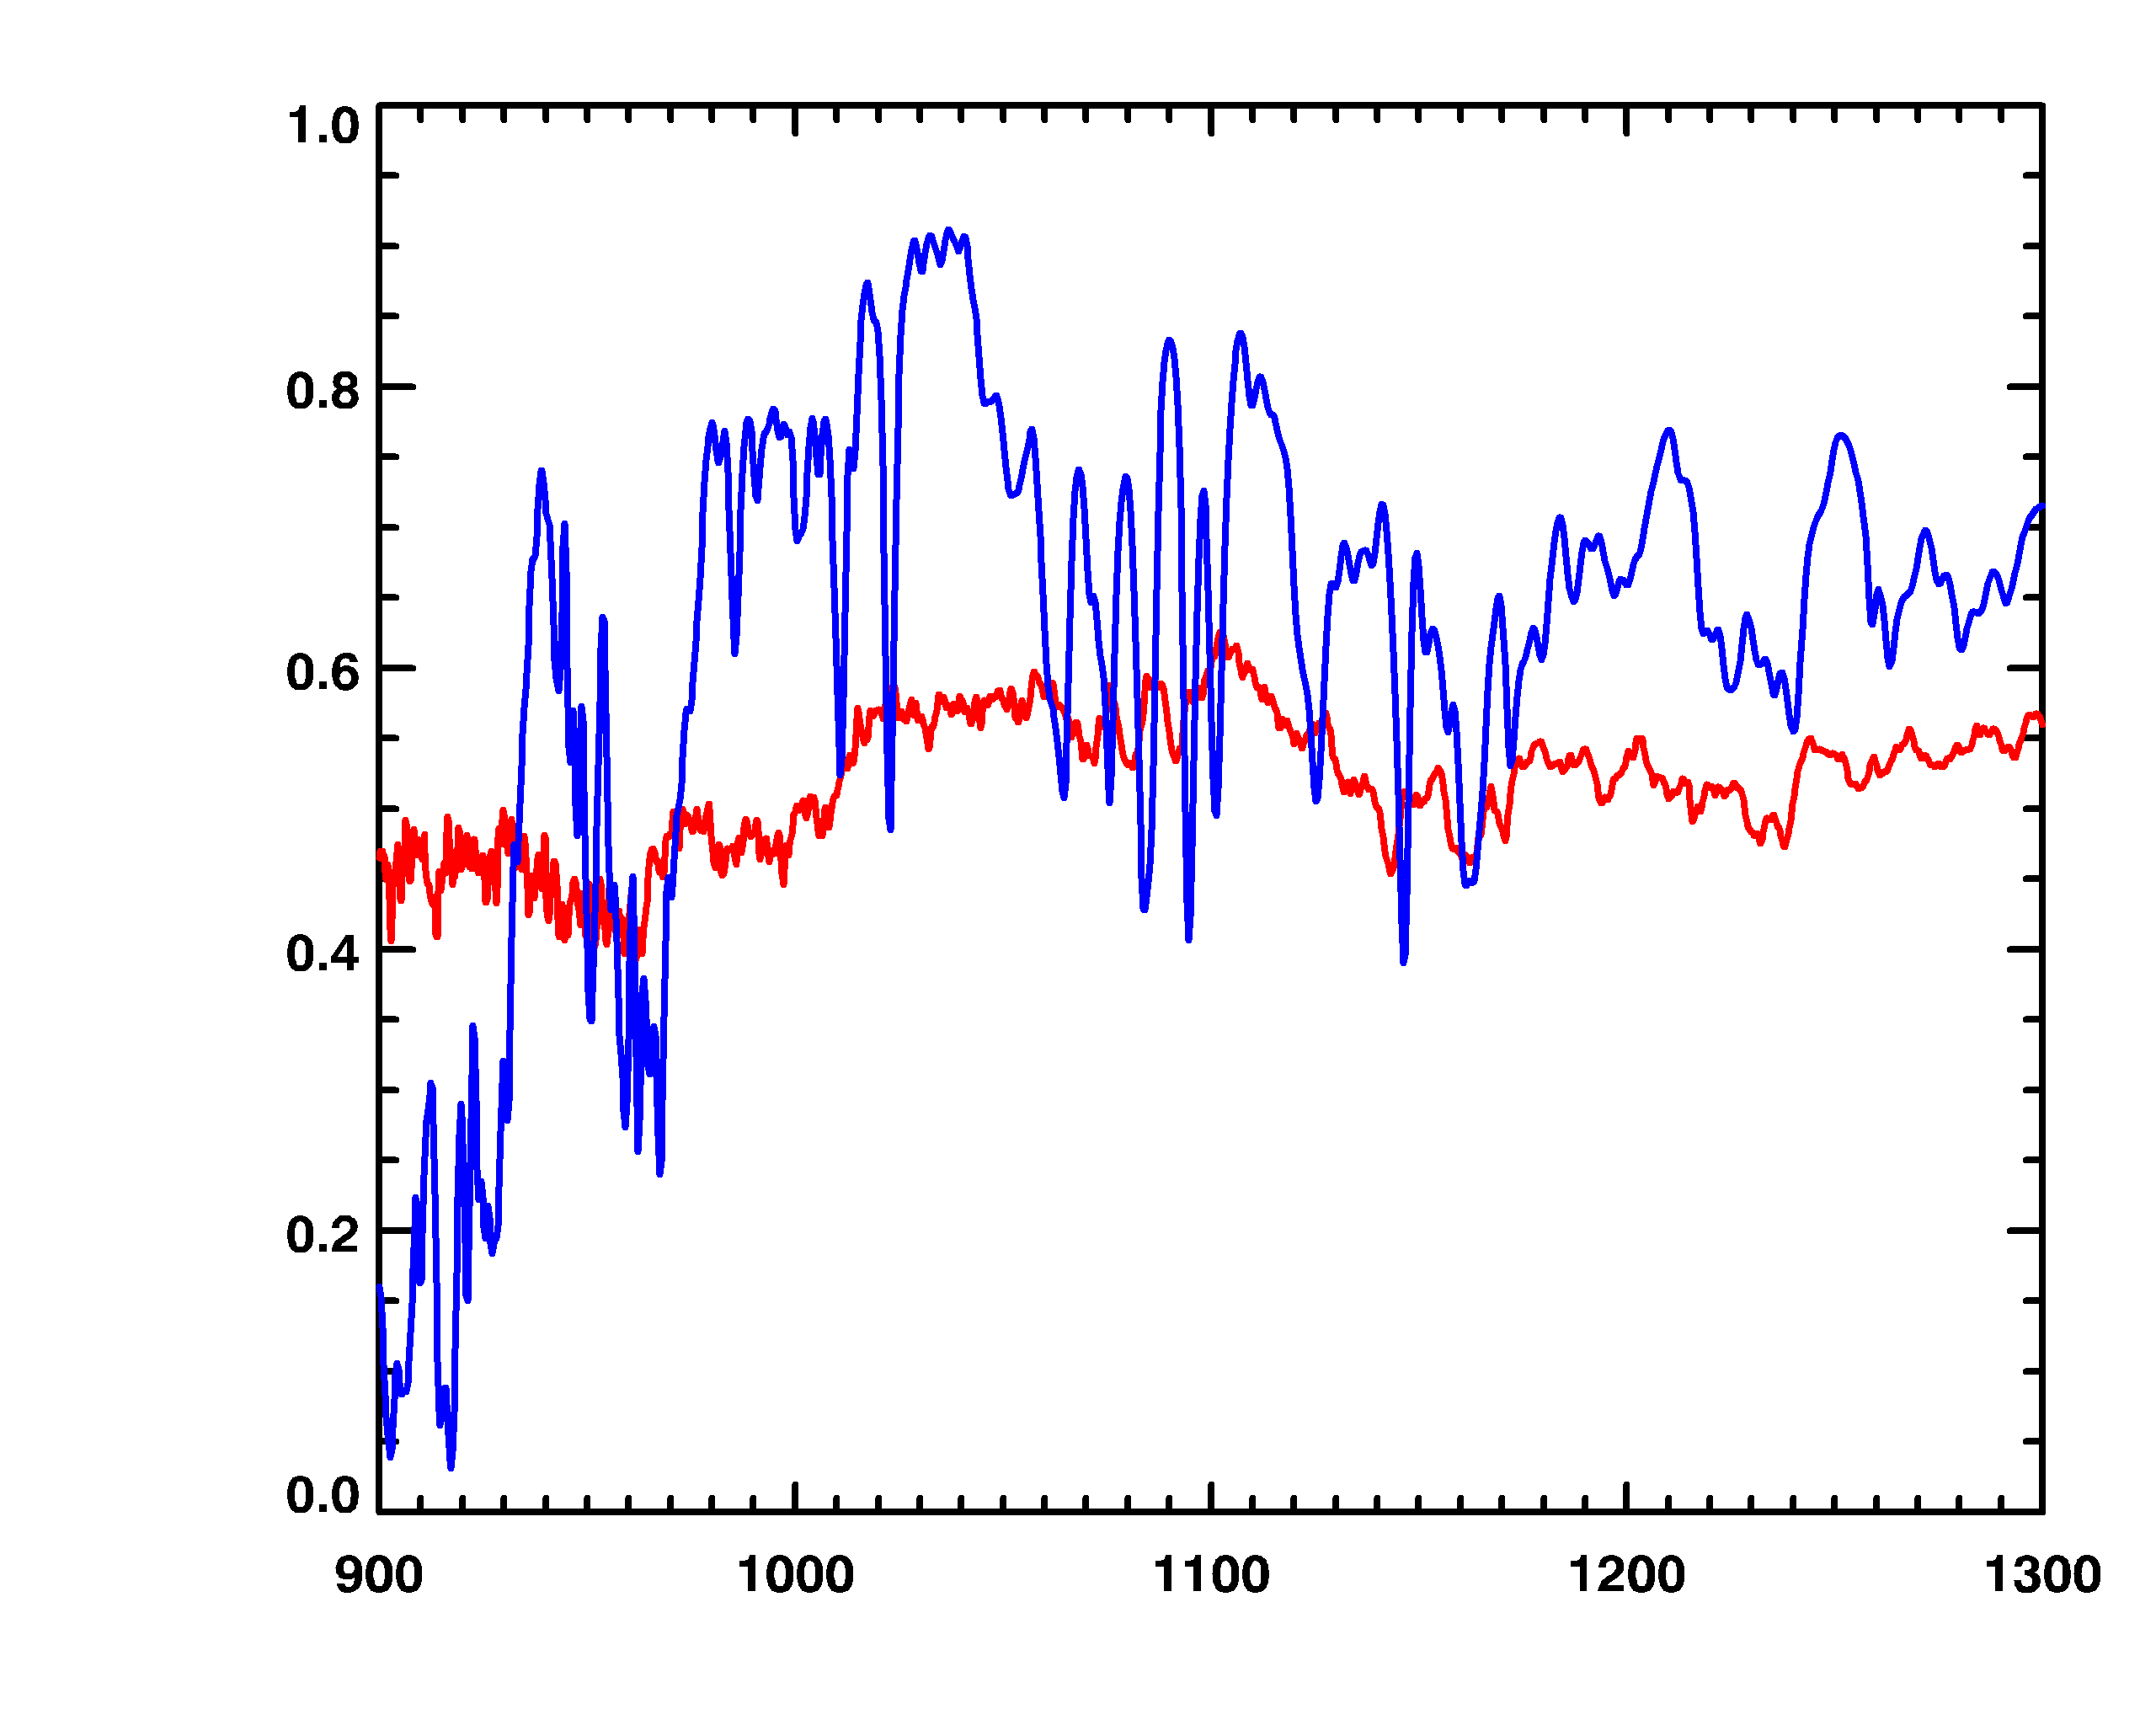
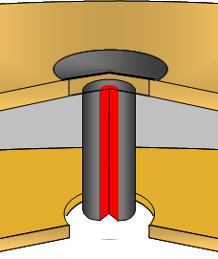
Preliminary measurements at solar conditions indicate the next year should be exciting for stellar opacity research
1
Foil is heated by dynamic hohlraum
Opacity
Foil
transmission
Z data
150 eV, 8e21 e/cc
calculation
(OPAS)
Foil is backlit
at stagnation
transmission
2
Z data
190 eV, 7e22 e/cc
calculation
(PrismSPECT)
1000
1100
hν (eV)
1200
1300
OP model used in stellar research disagrees with data for all Z experiments
Best effort models agree at lower n_{e}/T_{e}, but disagree significantly at stellar interior conditions
More experiments needed to confirm this result
Bailey et al., POP (2009)

Slide 9
How accurate are spectral synthesis models used to infer warm absorber conditions?
Chandra / XMM
view
Active Galactic Nucleus NGC 5548
J.S. Kaastra et al. , A&A 354 L84 (2000).
Ne IX
Ne X
warm absorber
photoionizing x-rays
Mg XII
O VII
N VII
C VI
O VIII
Spectra arise from plasmas dominated by photoionization
Nearly all laboratory plasmas are dominated by collisions:
Photoionized plasma models used to interpret observations are essentially untested
disk
torus
BH

Slide 10
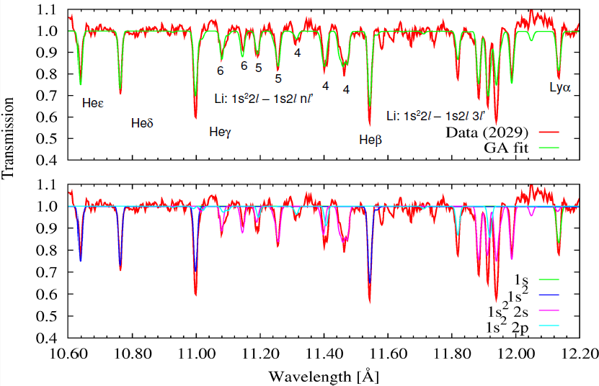
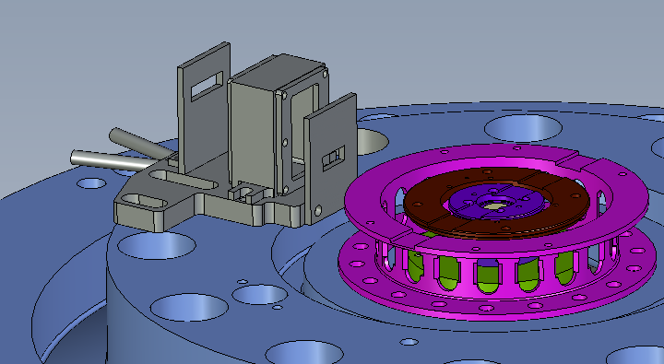
Comparing ionization predictions to observations at various ξ values will be a severe test for models
spectrometer
view
1.5 μm mylar
pinch
gas
supply
transmission
gas cell
10.6
11.0
11.4
11.8
12.2
wavelength (Angstroms)
photoionization parameter ξ = L/nr² {L= source luminosity, n=density, r=distance}
Ionization predictions by astrophysics models exhibit some disagreements with measurements, but experiment uncertainty determination remains in progress
Models appear to over predict T_{e}, but whether this impacts astrophysics depends on the cause
Presentations by: R.C. Mancini, T. Durmaz, T. Lockard, D. Mayes

Slide 11
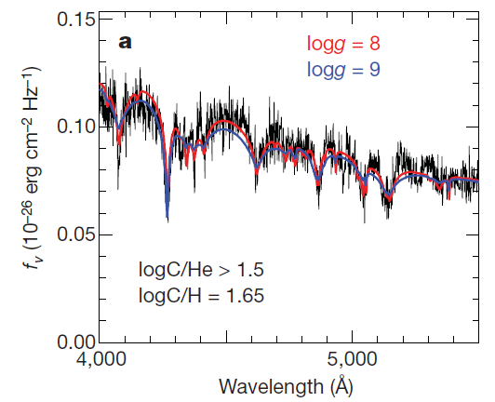
Are spectral line profile errors responsible for the unphysical high mass inferred for older white dwarf stars?
WD ages can be inferred from their temperature and mass
Inferred ages depend on WD photosphere spectra
P. Dufour, J. Liebert, G. Fontaine, N. Behara
Nature 450, 522 (2007)
log g = 8
log g = 9
0.10
f_{ν} (10⁻²⁶ ergcm⁻²Hz⁻¹)
0.05
4000
wavelength (Å)
5000
The inferred mass of older stars is ~ 2x higher than younger WD, a result believed unphysical (Kepler 2007; Falcon 2010)
A leading hypothesis is that line profile models are not accurate enough
(H, He, C at n_{e} ~ 10¹⁷ - 10¹⁹ cm⁻³ and T ~ 1 - 4 eV

Slide 12
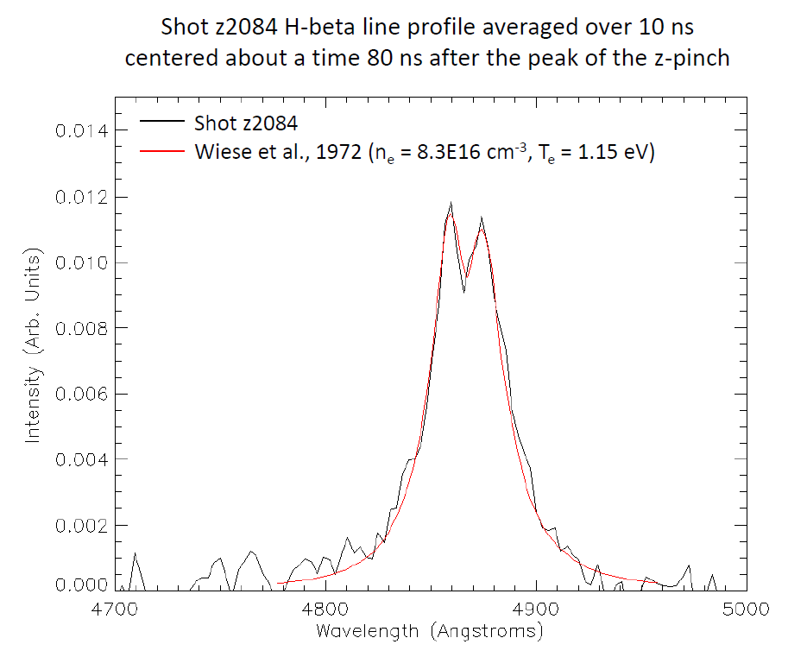
Radiatively heated gas cells are attractive for optical lineshape benchmark experiments
Precisely known atom density
X-ray heating is volumetric
  small gradients
  low probability of turbulence
Gas Cell
Z Hβ data
12 cm
Wiese et al
n_{e}=8.3e16 cm⁻³, T_{e} = 1.15 eV
Z Pinch
35 cm
Optical
Spectrometer
Proof of principle measurements show:
  We can create the plasma
  We can measure lineshapes
Near term strategy:
  Use Hβ to infer n_{e}, evaluate high-n line profile accuracy
  Use measurements as a function of cell length to evaluate accuracy
  Presentation: R. Falcon

Slide 13
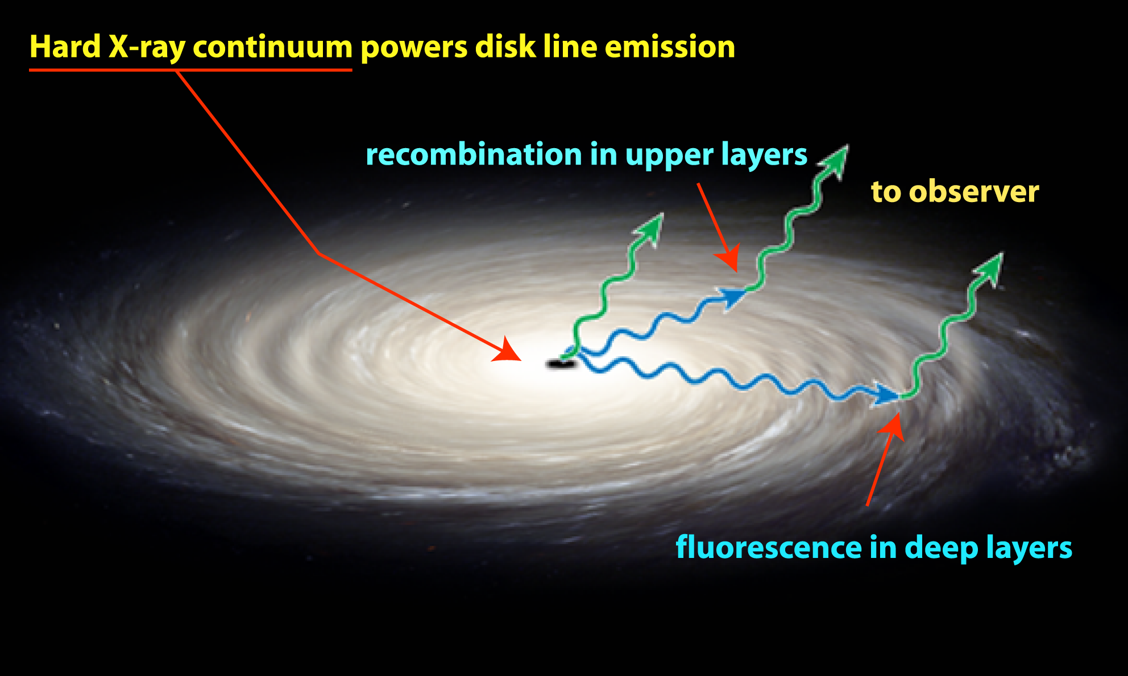
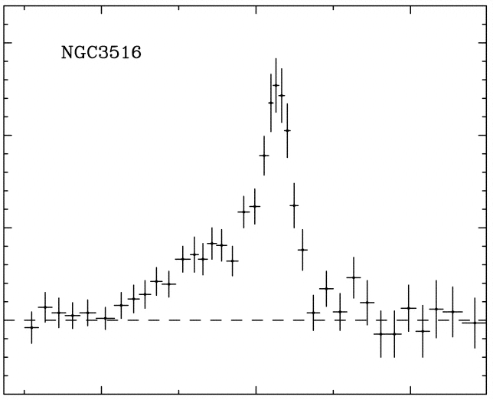
What quantitative role does Resonant Auger Destruction play in accretion powered object emission spectra?
Nandra, et al., ApJ 1999
4
6
8
hν (keV)
The iron Kα red shift is believed to arise from general relativity – a unique opportunity to learn about matter in a regime where gravity dominates
The lines from L-shell iron ions are not observed.
Resonant Auger Destruction is a proposed explanation.
But Si L-shell lines are observed from accreting x-ray binaries.
Experiments are needed to ensure we understand this potential puzzle

Slide 14
Silicon photoionized plasma spectra with controlled optical depth variations can test L-shell spectral synthesis models
sample
Absorption data shows relevant charge states can be produced
Emission spectra are needed to test astrophysical models
pinch
absorption
emission
Si absorption lines Z2309
λ/δλ ~ 3000
He-like
C-like
Li-like
B-like
Be-like

Slide 15
ZAPP experiments exploit megaJoules of x-rays to simultaneously address four separate astrophysics topics
Atomic kinetics in warm absorber photoionized plasmas
Stellar interior opacity
Resonant Auger destruction in accretion powered objects
Spectral line formation in white dwarf photospheres
Fe/Mg foil
Ne
gas
cell
Si
exploding
foil
Z x-ray source
1-2 MJ; 2·10¹⁴ W
H gas cell
Multiple samples are exposed to Z x-rays on each shot
Crucial for progress on oversubscribed MJ-class facility

