Slide 1
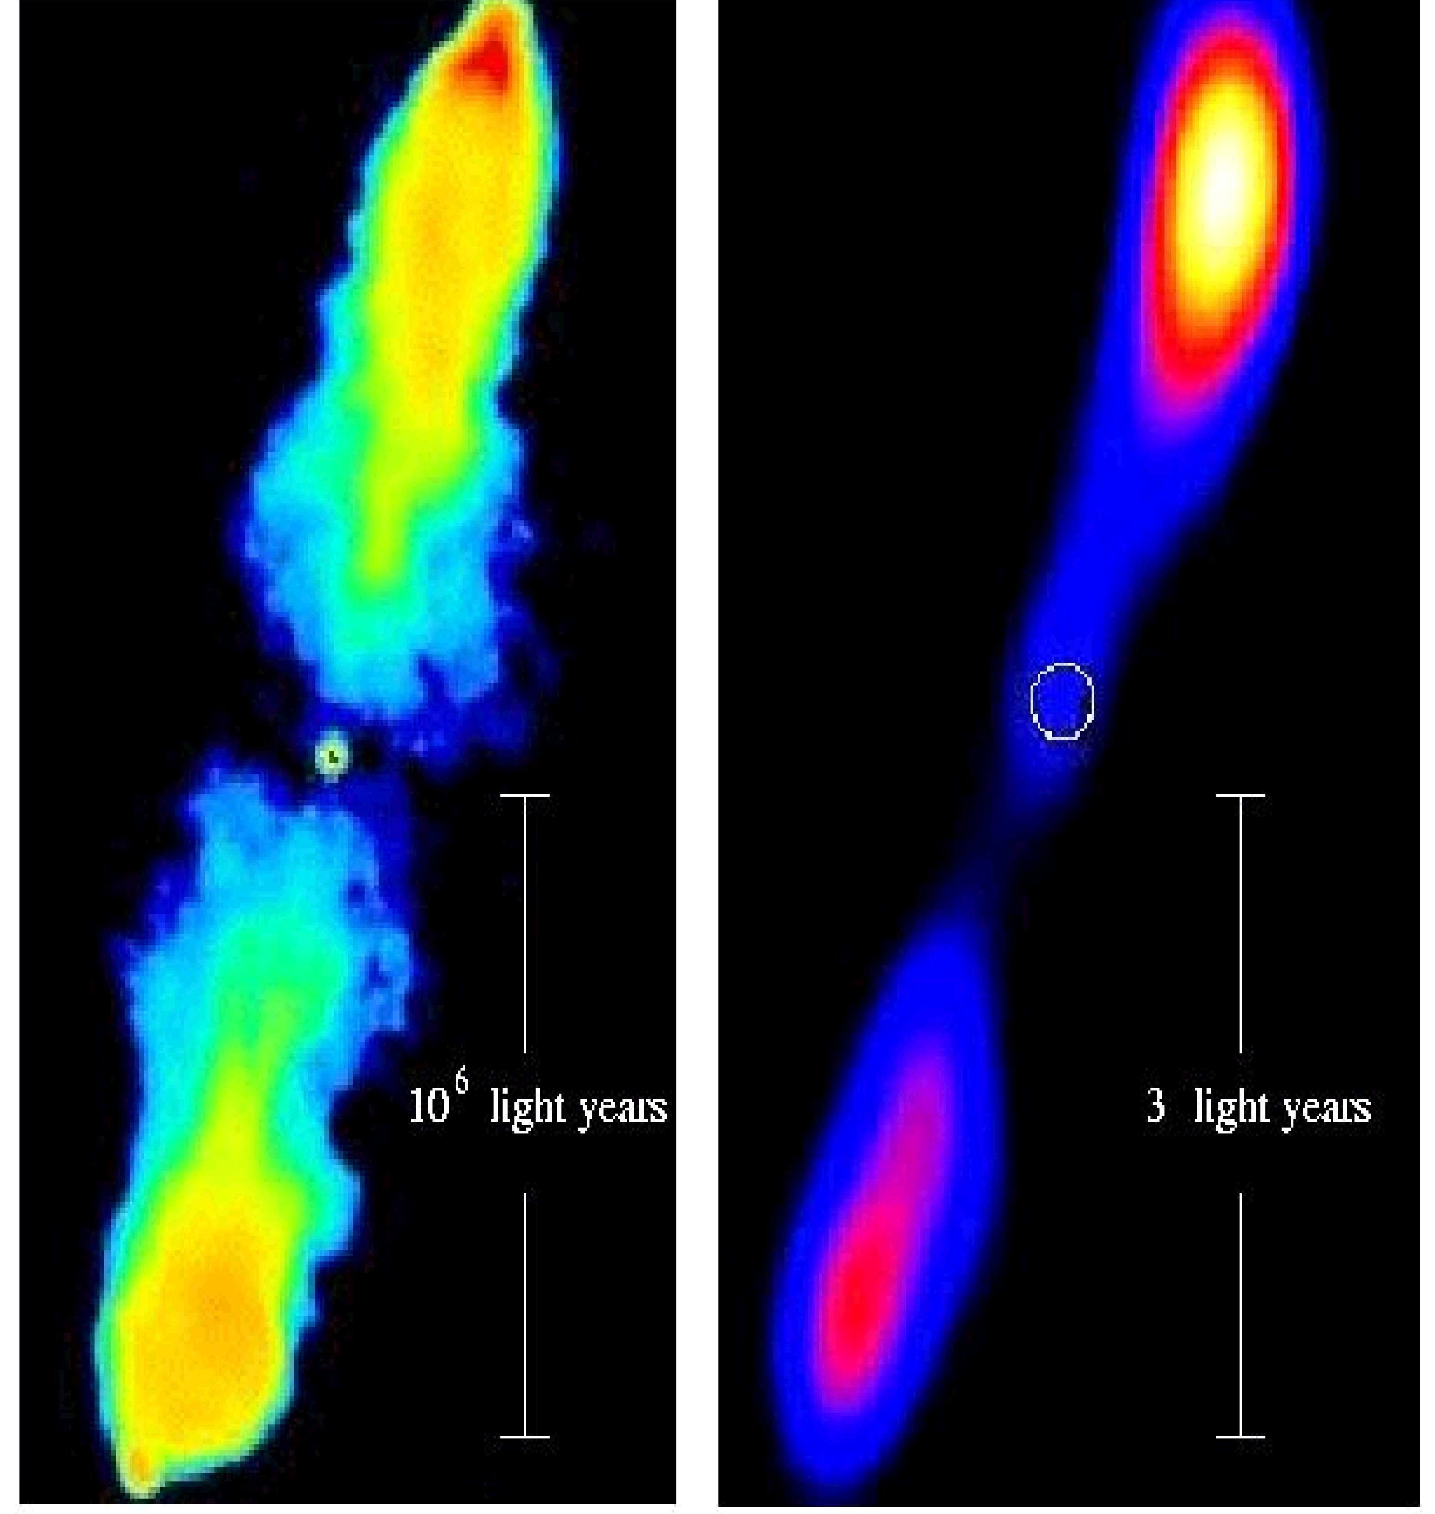
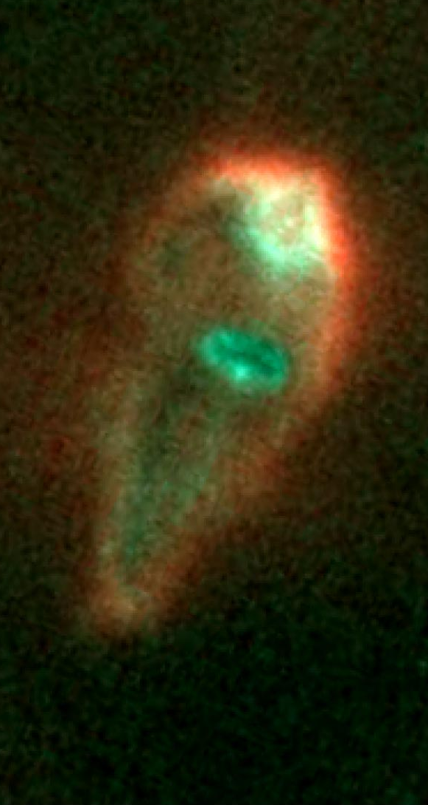


What does it take to launch jets from accretion discs ?
Jonathan Ferreira
Institute of Planetology and Astrophysics of Grenoble, France
Collaborators:
R. Deguiran, C. Zanni, C. Dougados, S. Cabrit, G. Murphy, C. Combet, P. Garcia, F. Casse, P.O. Petrucci, G. Henri, G. Pelletier

Slide 2

Outline
1- Overall properties of YSO jets: why disc-winds ?
(real and synthetic observations, model comparison)
2- Physical conditions to launch jets from discs (JEDs) ?
(analytics, MHD simulations)
3- Interaction with the central object
(analytics, MHD simulations)
4- Large scale field in Jet Emitting Discs: a « chicken and the egg » problem ?
(analytics, MHD simulations)

Slide 3
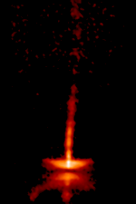
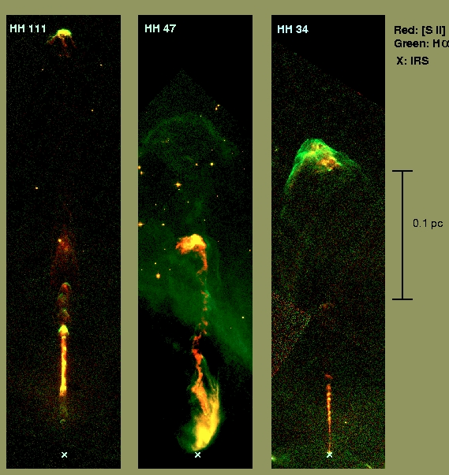
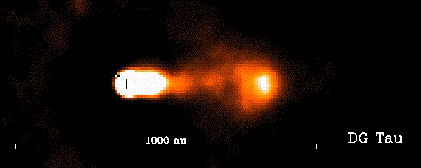
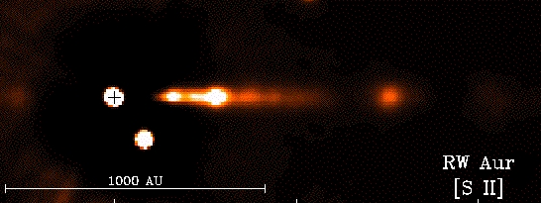
1- Jets from Young Stellar Objects (YSO)
HH30
1000 au

Slide 4
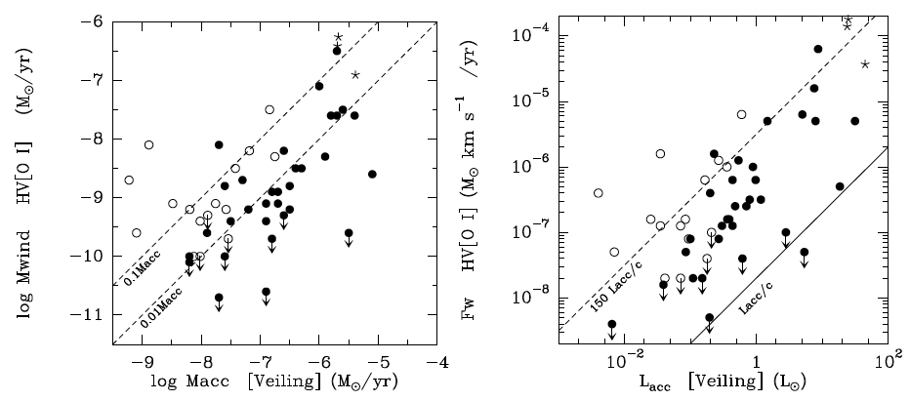
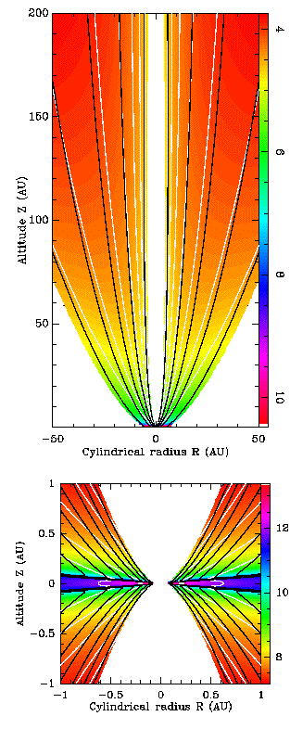
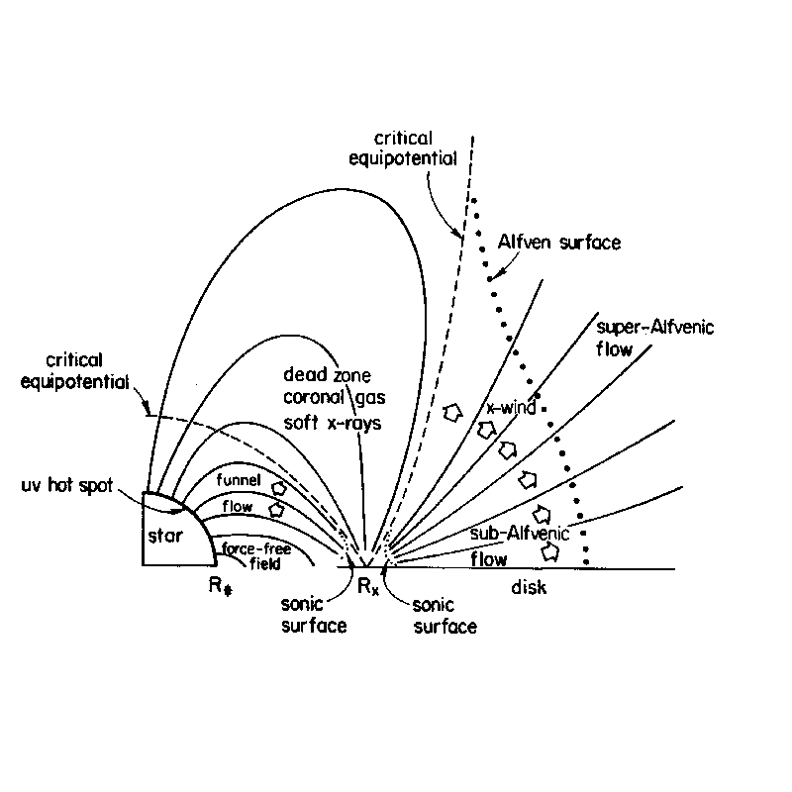
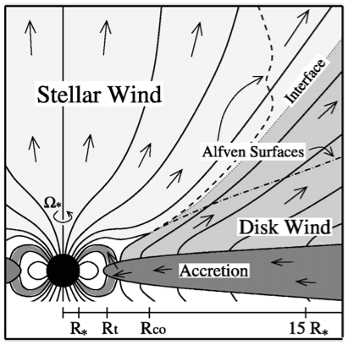
Classes of stationary accretion-related jet models
Ferreira et al 06
Cabrit 07
Extended disc winds
X-winds
Accretion Powered Stellar Winds
Blandford & Payne 82
Ferreira & Pelletier 93, 95
Shu et al 94, Cai et al 08
Matt & Pudritz 05

Slide 5
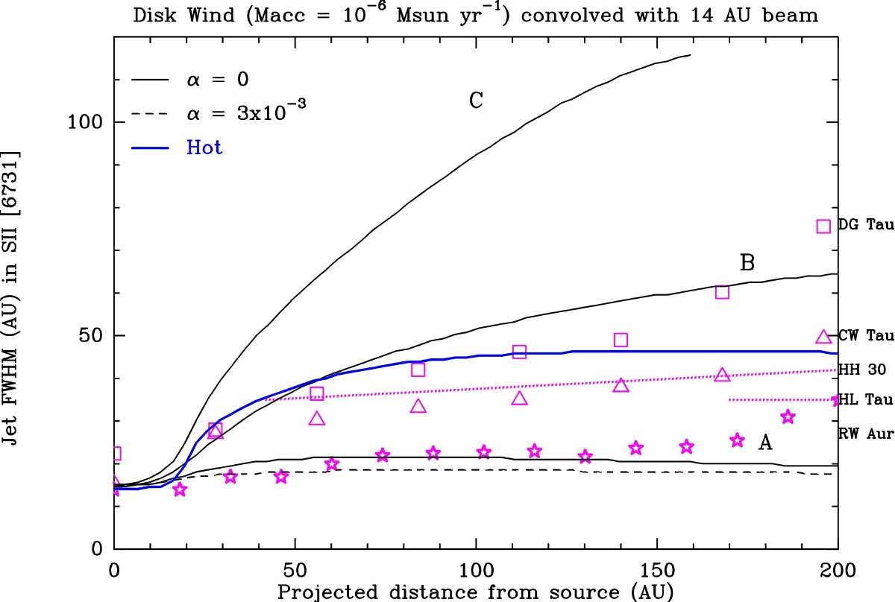
Evidences for extended disc-winds (1): global view
Garcia et al 01, Pesenti et al 03,04
Cabrit 07, Ferreira et al 06
}Cold ξ=0.005-0.01
Warm ξ=0.07
Dense wind models with ξ ~ 0.03 to 0.1 from R_{o} 0.1-few AU consistent with most YSO optical jet diagnostics:
    jet mass flux, jet velocity (PV diagrams), power
    jet collimation scales

Slide 6
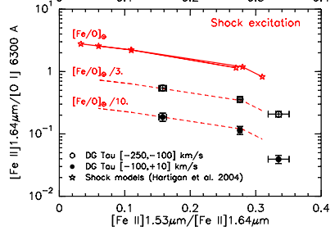
Evidences for extended disc-winds (2): dust
Studies of collimation regions (z=10-1000 AU) of jets from solar mass T Tauri stars (ages < 5 Myrs, M★=0.5-2 M)
HRA spectro-imaging studies 0.1’’
  Gas phase Fe abundance reduced with respect to solar values by a factor 10 at velocities below 100 km/s (Podio et al. 2009, 2011)
  => DUSTY flows, incompatible with X-winds, stellar winds
Agra-Amboage et al. 2011
Fe+ flow in DG Tau

Slide 7
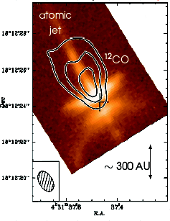
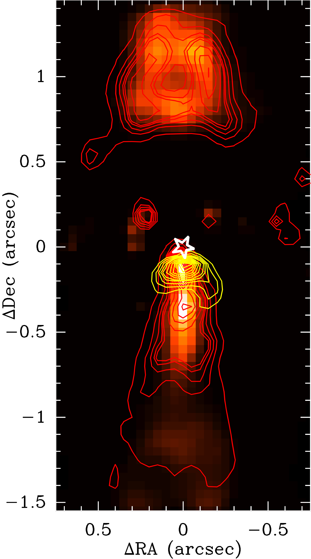
Evidences for extended disc-winds (3): molecular jets
H₂ in DG Tau
SINFONI/VLT (R=4000,0.1’’)
CO in HH 30 IRAM/PdBI
Pety et al 2006
Contours: ¹²CO(2-1) (V< 4 km/s and v > 11 km/s)
Coulors: Image HST (630,675 nm) (Burrows et al 1996).
Detection of small scale (z< 100 AU), low velocity (v < 10km/s) molecular flows surrounding optical jet:
  consistent with disc-winds from 0.1 to ~ 10 AU
  or outer photo-evaporated winds ?
Couleurs: [Fe II] v > 150 km/s
______ : [Fe II] v < 150 km/s
______ : H₂ |v| < 50 km/s
★ Continuum
Agra-Amboage in prep

Slide 8
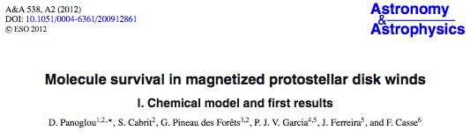
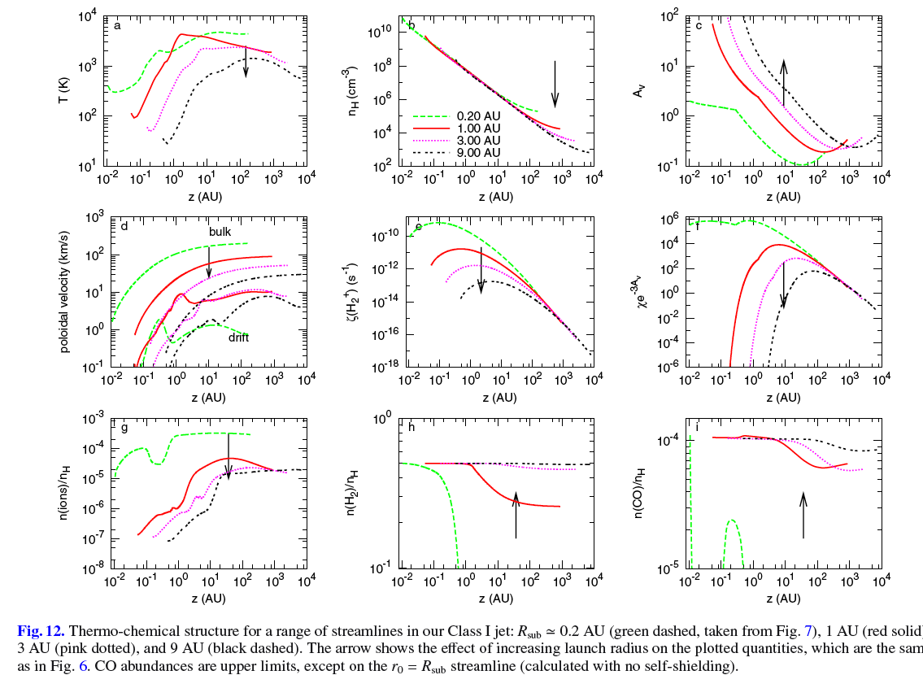

Slide 9
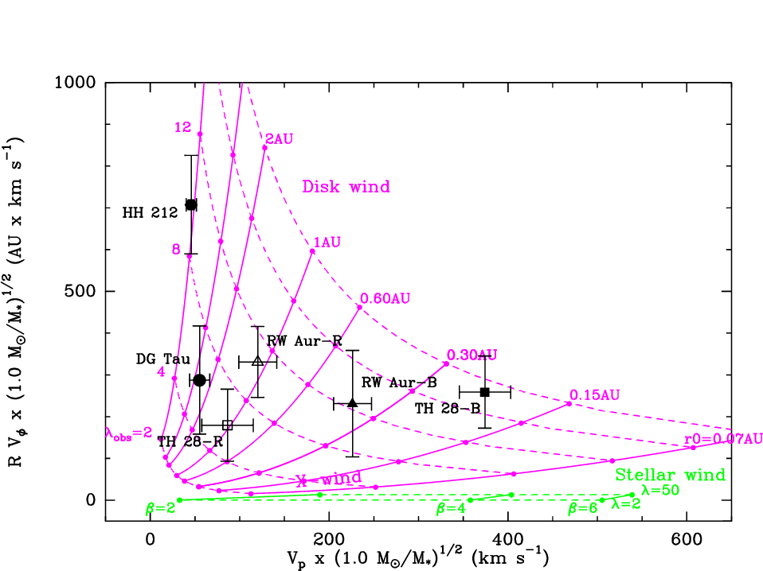
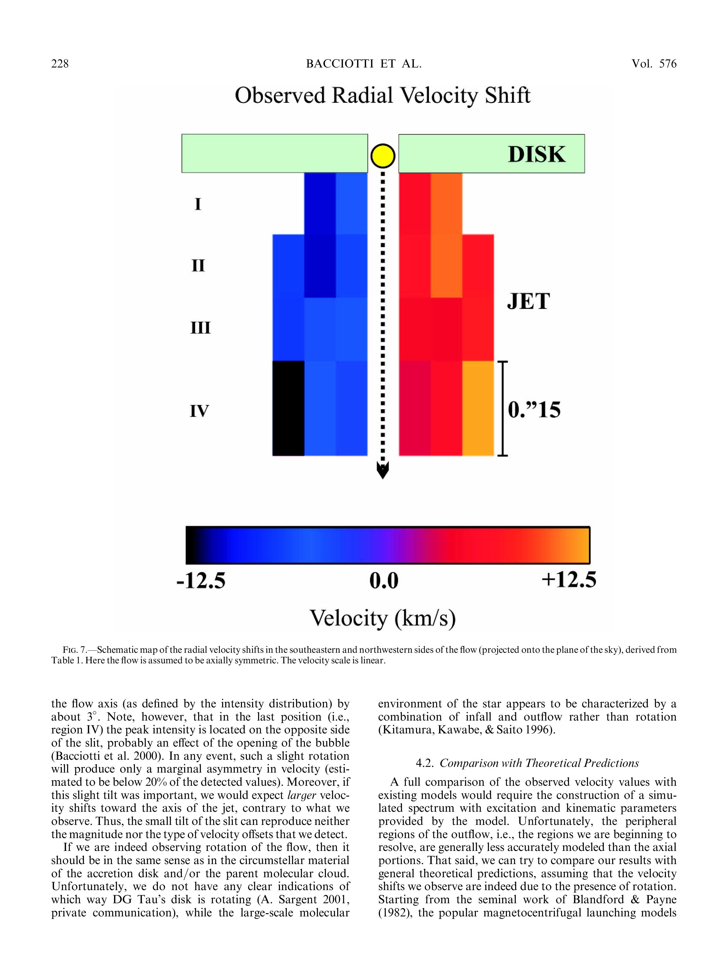
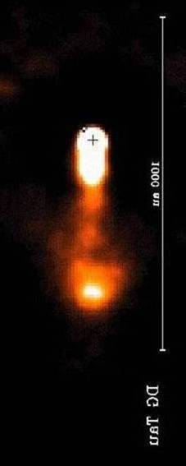
Evidences for extended disc-winds (4 ?): rotation
Bacciotti et al 02, Pesenti et al 04, Woitas et al 05, Coffey et al 12
Anderson et al 03, Ferreira et al. 06
Rotation signatures detected in several jets: Vϕ ≤ 10-15 km/s
Consistent with dense disc wind component: R_{JED} = 0.15 - 3 AU
If velocity shifts are rotation: But RW Aur case (Deirdre et al 2012)
  rules out X-winds and stellar winds as dominant wind components
  requires warm disc winds with λ= (r_{A}/r_{o})² ~10 or ξ~ 0.03

Slide 10
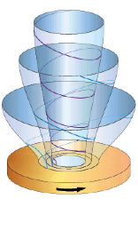

2- BP jets from Jet Emitting Discs (JEDs)
- Steady-state
- Axisymmetric jets : nested magnetic surfaces of constant magnetic flux
Blandford 76, Lovelace 76 Blandford & Payne 82
Single fluid MHD description
Non-relativistic equations
Transition from resistive & viscous disc to ideal MHD jet: local α prescriptions for MHD turbulence
A complex interplay between disc and jets is determining the disc ejection efficiency ξ
=> NEW MHD flow model where parameter space is constrained by smoothly crossing critical points

Slide 11
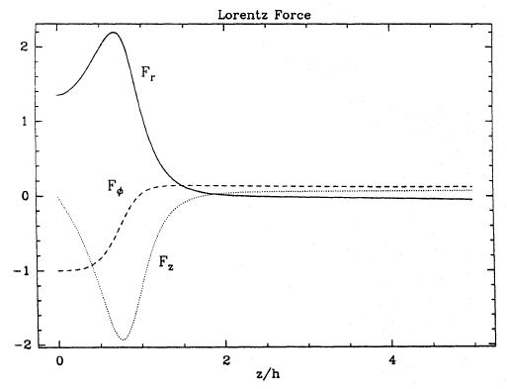
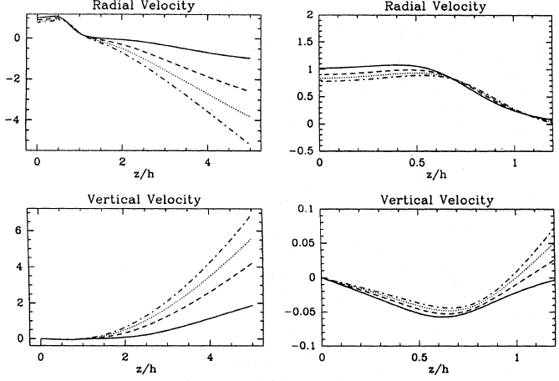
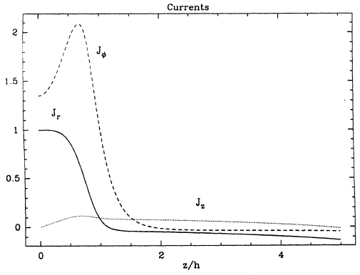
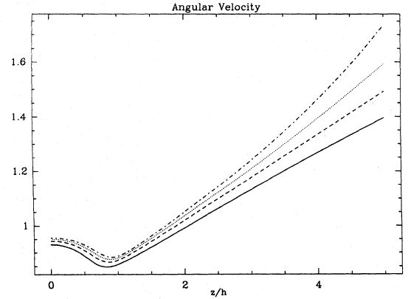
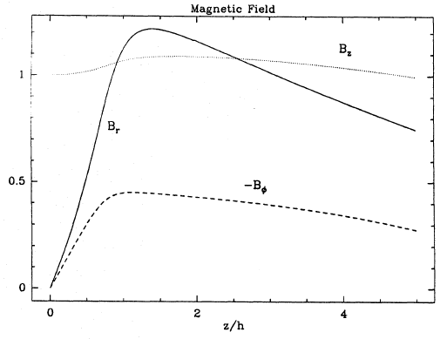










Self-similar models: disc + jets
Ferreira & Pelletier 93, 95
Ferreira 97, Casse & Ferreira 00
Ferreira & Casse 04
disc magnetization ~ 0.1 to 1, close to unity !

Slide 12
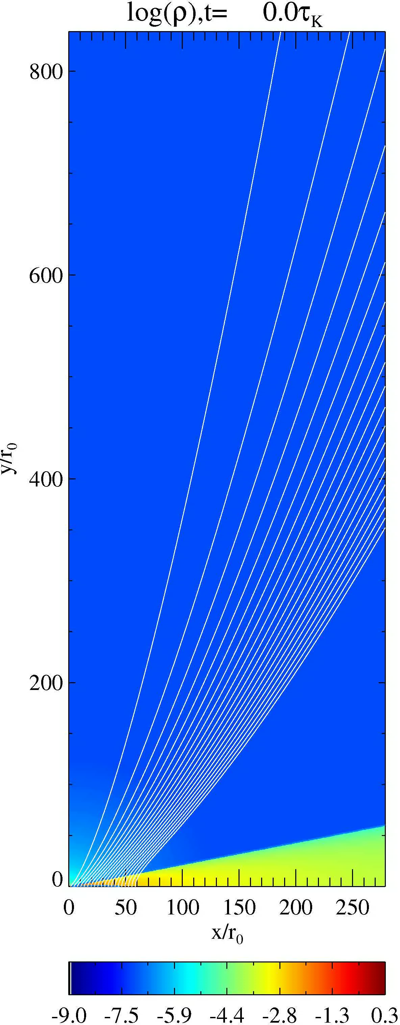
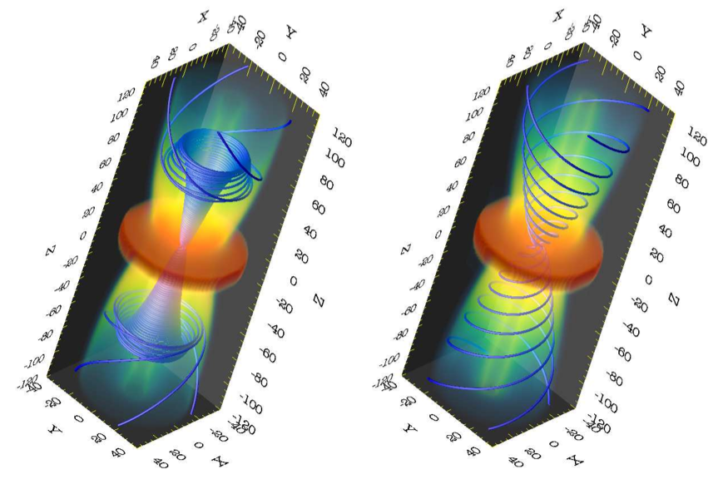
2.5D Numerical experiments
Main self-similar results have been confirmed with several MHD codes, using α-discs:
Steady ejection only for near equipartition B_{z} field: Tzeferacos et al 09
Viscous torque negligible: Meliani et al 06
Large diffusivity (ν_{m}~ V_{A}h ) required with some anisotropy: Zanni et al 07, Tzeferacos et al 09
BUT, jet mass losses found in MHD simulations NOT reliable: Murphy, Ferreira, Zanni 10
Murphy et al 10
Zanni et al 07, Tzeferacos et al 09

Slide 13

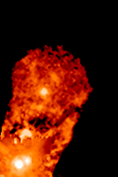
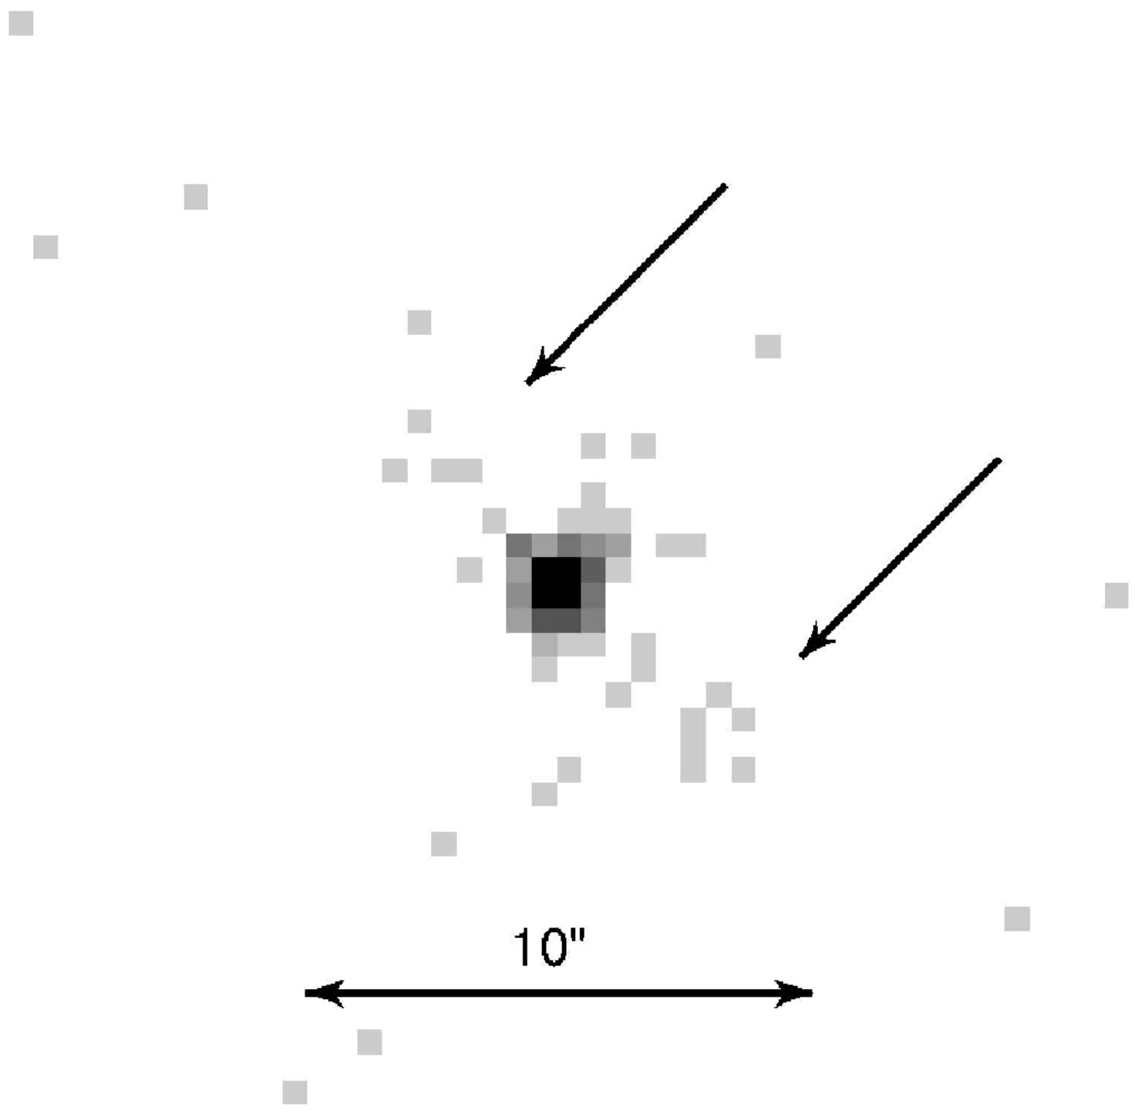
But YSO jet phenomenology is more complex…
Variability ? timescale of knot ejection in DG Tau 2.5-5 yrs yrs (Agra-Amboage et al. 11)
Jet asymmetry ? same mass flux but terminal velocities differing by up to a factor 2 (Podio et al 11,Melnikov et al 09)
Hot inner wind: deep blueshifted absorptions seen in HeI lines (Edwards et al 03)
X ray emission at the base of jets with a close component (z a few 10AU) maybe stationary ? (Güdel et al 05, Skinner et al. 11, Schneider et al. 11)
=> Need for other wind component(s):
Stellar wind and/or wind from star-disc interface
HH 30
XZ Tau
DG Tau X-ray jet ?
(Bonito et al 11)

Slide 14
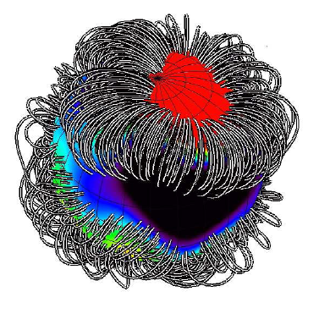
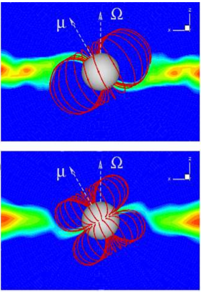
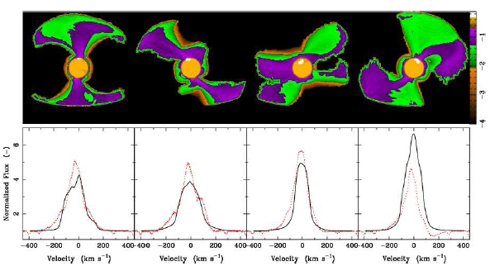
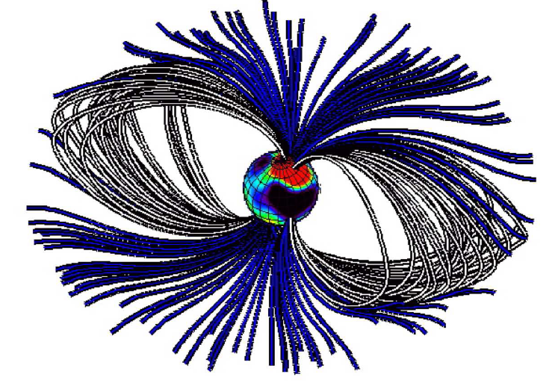
3- Interaction with the central object
Zeeman-Doppler imaging of TTS => B reconstruction => 3D MHD simulations
MAPP collaboration (PI: Donati): 20 TTS monitored => dipole + octopole components
Line formation: Kurosawa et al 11
Observations: Alencar et al 12
Long et al 05,06 Romanova et al 09, 11, 12
Donati et al 07, 10
Jardine et al 07
Hussain et al 09

Slide 15
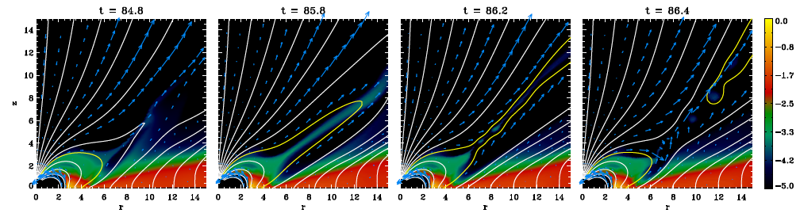
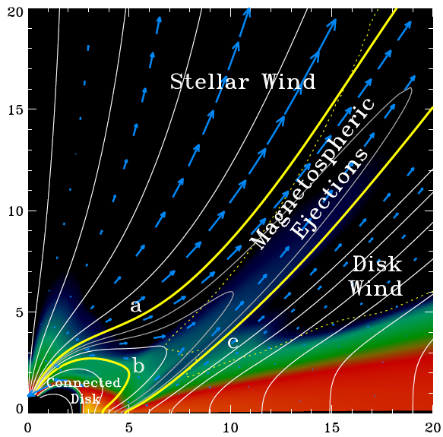
Unsteady Magnetospheric Ejections
Zanni & Ferreira, subm
MEs + stellar wind provide efficient spin-down of the star
MEs are time-dependent and depend on stellar field structure (variability, asymmetry)
Collimation depends on outer disc wind

Slide 16
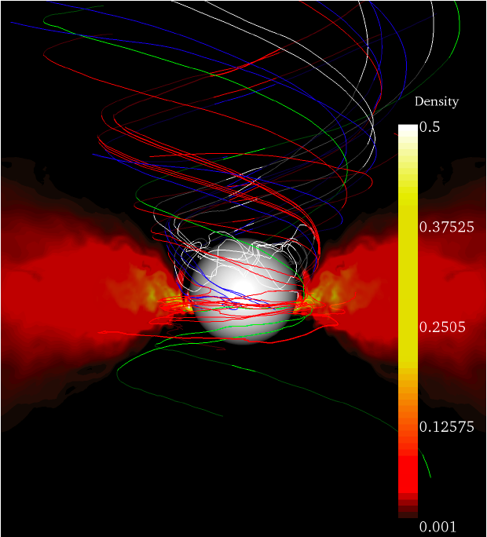
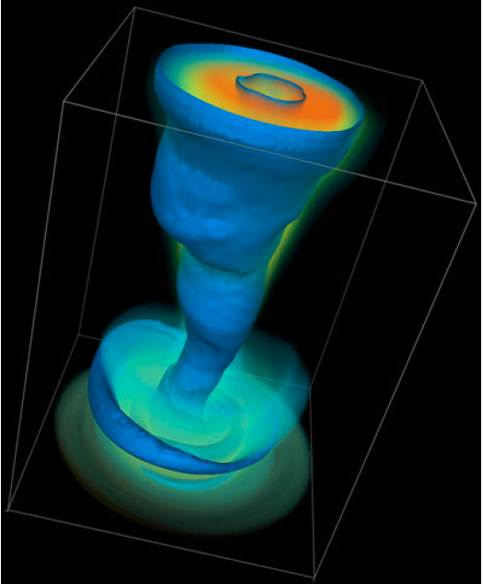
Around black holes ? global 3D MHD simulations
Punsly, Igumenshchev & Hirose 09
McKinney & Blandford 09
Main results:
Blandford-Znajek jets: a low power disc-wind but no Blandford-Payne jet
BZ jets require a large scale B_{z} field (MRI does not generate it) @ t=0
Open issues:
What determines/controls Bz field @ black hole vicinity?
if BZ jets are THE jets, why similar jets from neutron stars (X-ray Binaries)?

Slide 17


BZ versus BP jet power
Power carried by Blandford & Znajek jets (Livio et al 99, Pelletier 04 (astro-ph/0405113) :
Power carried by Blandford & Payne jets (Ferreira 97, Petrucci et al 10):

Slide 18
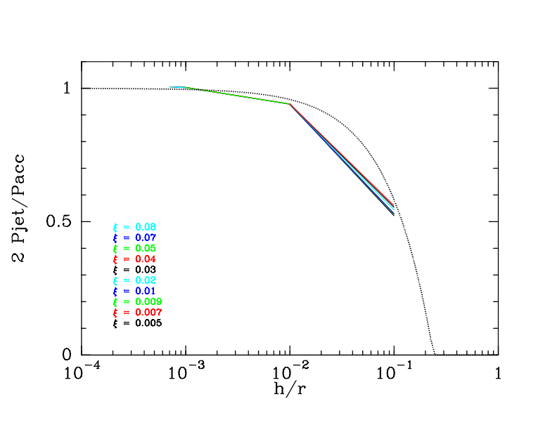
Power of « Blandford & Payne » jets
Ferreira & Petrucci 10
Isothermal solutions from Ferreira 97
The thicker (hotter) the disc, the less powerful the jets
=> Thick (ADAF-like) discs (h/r > 0.3) cannot drive powerful jets, only thermal winds…

Slide 19

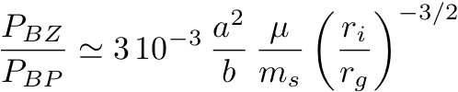
BZ versus BP jet power
Power carried by Blandford & Znajek jets (Livio et al 99, Pelletier 04 (astro-ph/0405113) :
Power carried by Blandford & Payne jets (Ferreira 97, Petrucci et al 10):
Introducing disc magnetization μ and sonic Mach number m_{s}
For a=1, r_{i}=r_{g} and typical JED values (b ~ 0.5, μ ~ m_{s} ~ 1)
P_{BZ} a few percent P_{BP} => two-component flows also in AGN

Slide 20
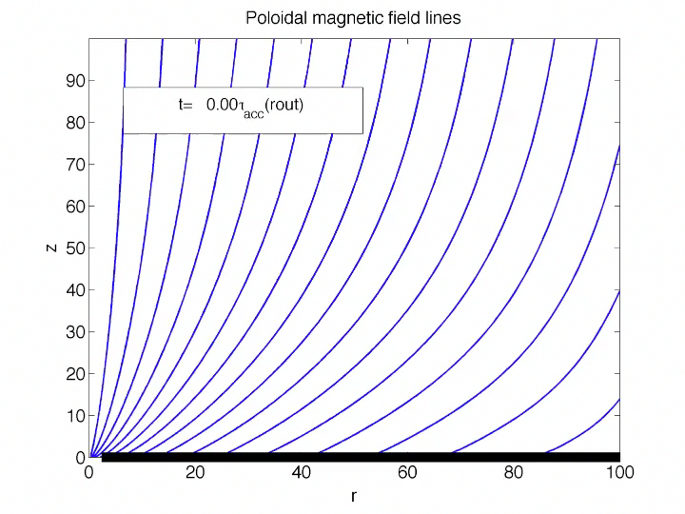
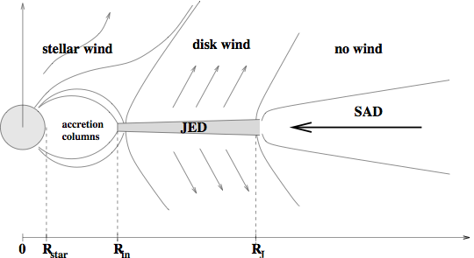
4- Magnetic field in α discs
Large scale field important for jets but no large scale dynamo ever observed in global MHD simulations in discs.
=> suggests that might be effect of Initial Conditions…
Lubow et al. 94a, Heyvaerts et a 96
Reyes-Ruiz & Stepinski 96 Ogilvie & Livio 98, Shu et al 07
Rothstein & Lovelace 08, Lovelace et al 09
Bz diffusion in a SAD, with P_{m}=1
Deguiran et al, in prep

Slide 21
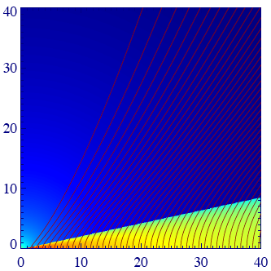
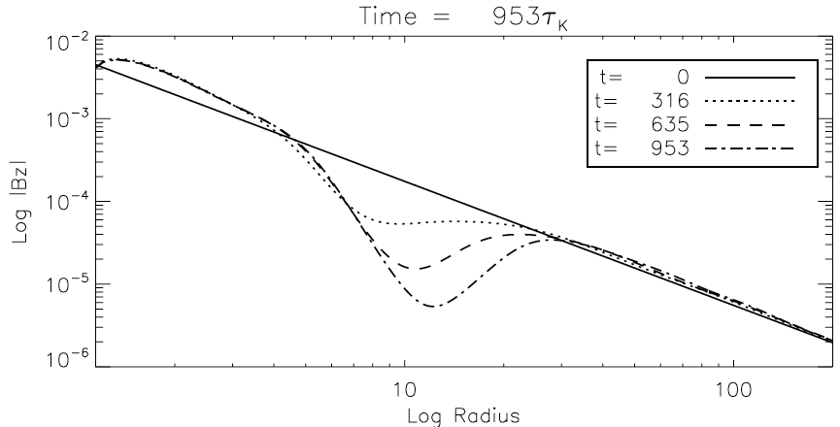
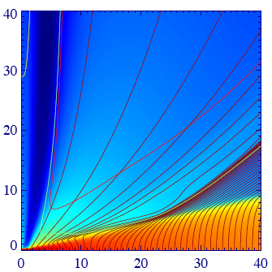
Magnetic field redistribution
Murphy et al 10
Murphy, Ferreira & Zanni, in prep
t=0
t=953
Field advection in ejecting zone, field diffusion in outer non-ejecting disc.
Long (accretion) time scales involved: disc magnetic field never reaches a steady state
=> In astrophysical accretion discs, B_{z}(r,t) is probably reminiscent of initial and boundary (companion feeding) conditions

Slide 22
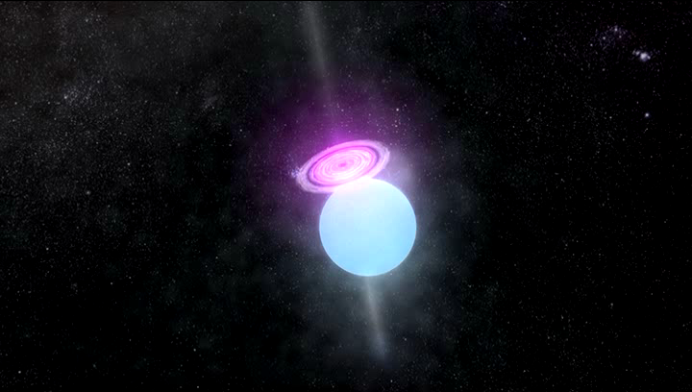
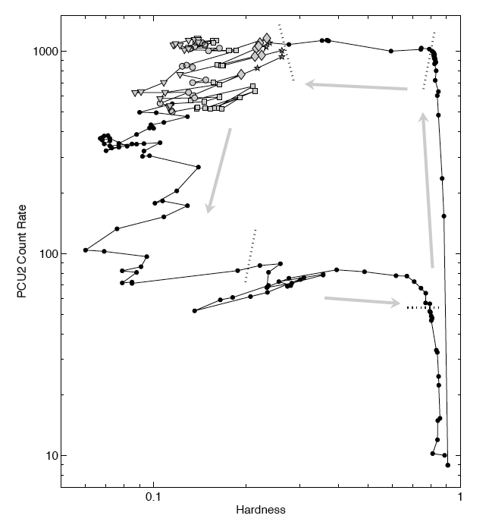
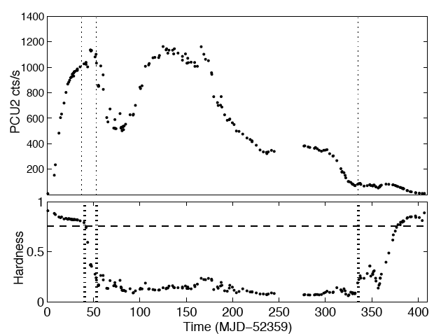
LMXrB hysteresis: GX 339-4
Belloni et al 05
C
B
B
C
D
D
A
A
Secular variations on ~ outer accretion time scales or longer

Slide 23
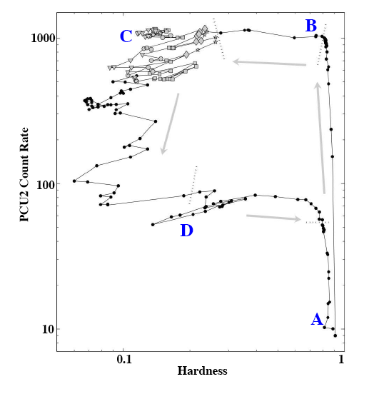

LMXrB hysteresis: magnetic tides/floods ?
Possible mechanism for LMXrBs long term variability = B field is second independent variable (Ferreira et al 06)
- accretion rate M(t)
- available magnetic flux Φ(t)
SAD
JED
JED in its hot, optically thin branch with harder spectrum (Petrucci et al 10)
JED-to-SAD and SAD-to-JED transitions triggered by variations in local disc magnetization μ (Petrucci et al 08)

Slide 24
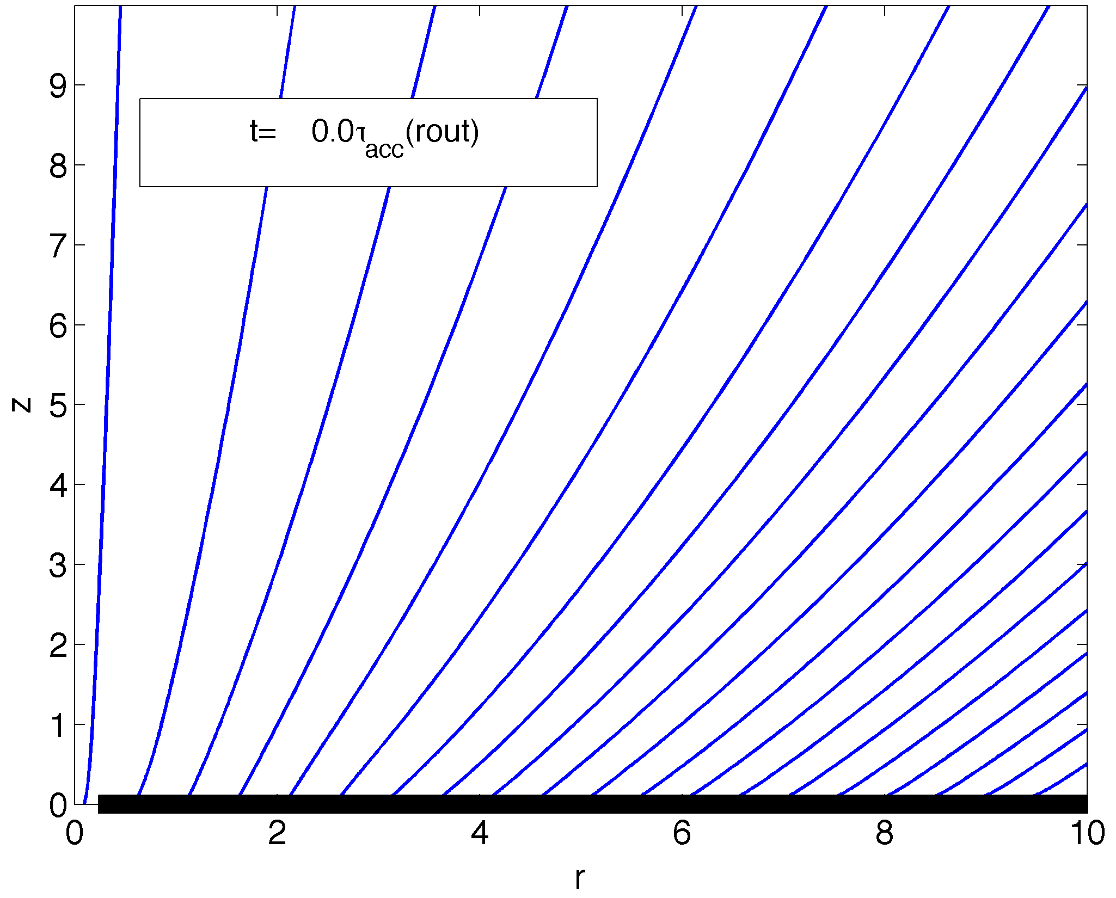




SADs and JEDs: radial transitions
Deguiran et al, in prep
Jet Emitting Disc: β = 5/4 and μ ~ 1
Standard Accretion Disc: β ~ 0 and << 1
with and k=1/2 in MRI (Pessah et al 07, Lesur & Longaretti 07)
If μ∼1 in innermost zones => JED remains (Murphy et al)
If μ<< 1 in innermost zones => SAD, and B_{z} diffuses outwardly
=> outerzones could be in a JED state : radial SAD-JED transition.
Will this outer JED structure be advected ?
=> depends on effective magnetic Prandtl number P_{m}= ν_{v}/ν_{m}
(Ubiquitous disc winds in XrBs ? Ponti et al 12)
R_{t}

Slide 25
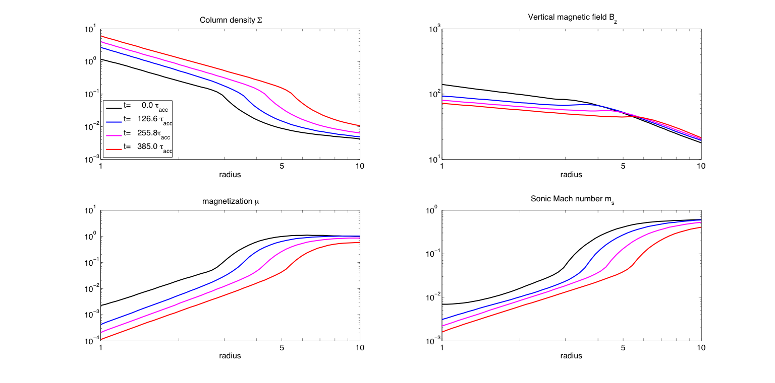
Evolution of the SAD-outer JED transition
R_{t}
P_{m}= ν_{v}/ν_{m} = 2
Deguiran et al, in prep

Slide 26

Evolution of the SAD-outer JED transition
R_{t}
P_{m}= ν_{v}/ν_{m} = 4
Deguiran et al, in prep

Slide 27

Conclusion
Self-confined jets from Keplerian accretion discs are
    well understood within α-disc theory
    globaly consistent with main YSO jet features
But:
challenge for MHD turbulence in discs (global 3D simulations)
Real (observed) jets are multi-component flows (impact on jet dynamics?)
-> stellar winds/magnetic towers, BZ jets?
-> MEs from interface (spin down)
(3) Relies on equipartition large scale vertical field:
reminiscient of Initial and Boundary Conditions ?
depends on field advection and object history
radial extent of JEDs may differ from
- one object to another
- one outburst to another (in XrB)
Ubiquitous outer disc winds (YSO, AGN, XrB) ?

