Slide 1
Proton Imaging of Collisionless Shock Experiments at OMEGA EP
HEDLA Conference
April 30, 2012
Nathan Kugland
On behalf of the ACSEL collaboration
LLNL-PRES-552332

Slide 2
Outline
Astrophysical collisionless shocks
  Physical picture and motivation
Our laboratory model with laser plasmas
Experimental results
  Beautiful and surprising proton images
  Optical caustics mean strong deflection (strong fields)
Possible interpretations

Slide 3
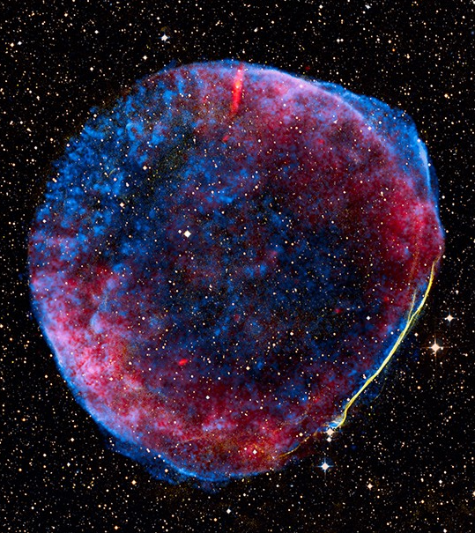
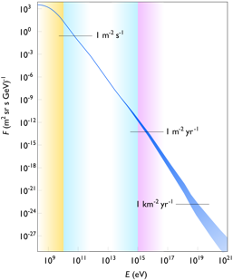
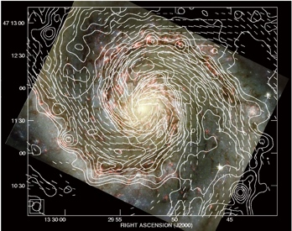
Fast Astrophysical Flows Often
Generate Collisionless Shocks*
*Also see Anatoly Spitkovsky’s talk later today (4:45 PM), F. Fiuza (Tues.), D. Ryutov (Wed.), Y. Sakawa and H.-S. Park (Thurs.)
Supernova 1006 remnant (10⁴⁴ J)
Characteristics
Shock formation
  Irreversible dissipation
  Heating & entropy generation
Non-local, non-binary (no viscosity)
Long-range particle/field interactions
Associated with cosmic ray acceleration and generation of magnetic fields
v_{flow} = 3x10⁸ cm/s
n = 1 cm⁻³
+
+
λ_{mfp} = 40 LY
Shock
Shock is 400x thinner than the collisional mean free path!
Cassam et al ApJ 2008
Bamba et al ApJ 2003
Hubble/NASA
Wikimedia commons

Slide 4
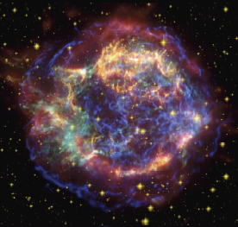
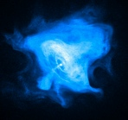
High Energy Density Plasmas Can Model Exotic Astrophysical Collisionless Shocks
Non-Relativistic
(e-ion plasmas)
Relativistic
(pair plasmas)
Magnetization
(Magnetic E/KE)
1
Directly measured
Solar
SNR
PWN
SNR Cassiopeia A
10⁻³
AGN
Jets
Laser Driven
Plasmas
10⁻⁶
OMEGA
Long-Pulse
(today’s talk)
PW Lasers
GRB
10⁻⁹
Crab Pulsar Wind Nebula
10⁻⁴
10⁻²
1
10²
Normalized Momentum
A. Spitkovsky CMPD School 2009
F. Fiuza 2012

Slide 5
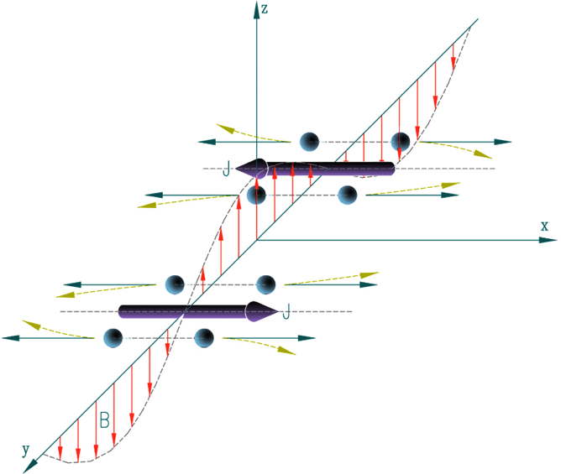
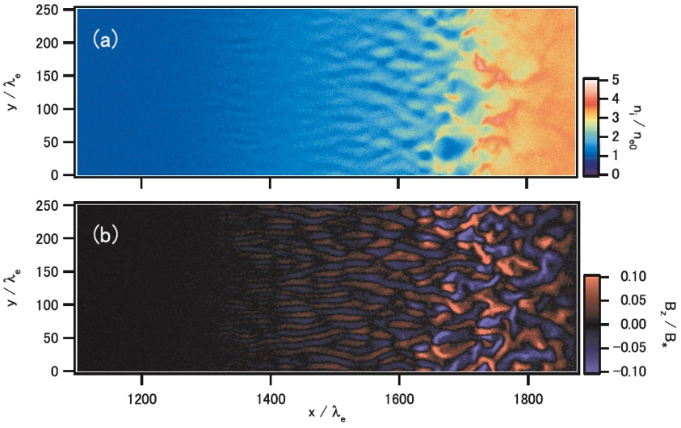
The Ion-Weibel Plasma Instability Is One Goal
Should be the dominant creator of shocks & magnetic fields in non-relativistic electron-ion collisionless plasmas (high saturation)
Relevant for supernova remnants and active galactic nuclei/gamma ray bursts
Needs a lot of room to grow (hard to achieve in the lab!)
Weibel at work:
J
J
B
2D PIC:
Dissipation scale:
Density
Upstream v_{flow} = 0.1c (10⁹ cm/s) →
(artificial ion mass used here)
Ion inertial length
Magnetic field
Medvedev ApJ 1999
T. Kato & H. Takabe, ApJ 2008
R. P. Drake & G. Gregori, ApJ 2012 (accepted)
A. Spitkovsky CMPD School 2009

Slide 6
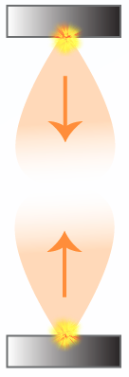
Our Experimental Platform for Ion-Weibel
OMEGA and OMEGA EP
1) Overlap two collisionless plasma flows
CH₂
Shock scale
Laser
Plasma
Inter-flow
ℓ* << ℓ_{int} << λ_{mfp,ii}
2) Hold on to the magnetic field for long enough
D_{L} = 8 mm
TCC
3) Start (mostly) unmagnetized (B₀ ≈ 10 kG)
(quasi-spherical)
plasma
D. D. Ryutov 2010
R. P. Drake & G. Gregori, ApJ 2012 (accepted)
R. P. Drake POP 2000

Slide 7
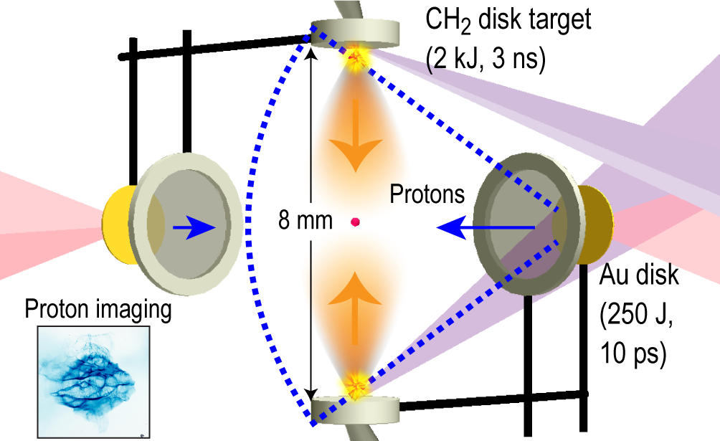
Experimental Setup for Proton Imaging
OMEGA EP
Two each of the following:
351 nm 3 ns laser, 2200 J
100 μm spot, 9 x 10¹⁵ W/cm²
1053 nm 10 ps laser, 250 J
40 μm spot, 2 x 10¹⁸ W/cm²
Side view
N. L. Kugland et al, APS DPP Meeting 2011

Slide 8
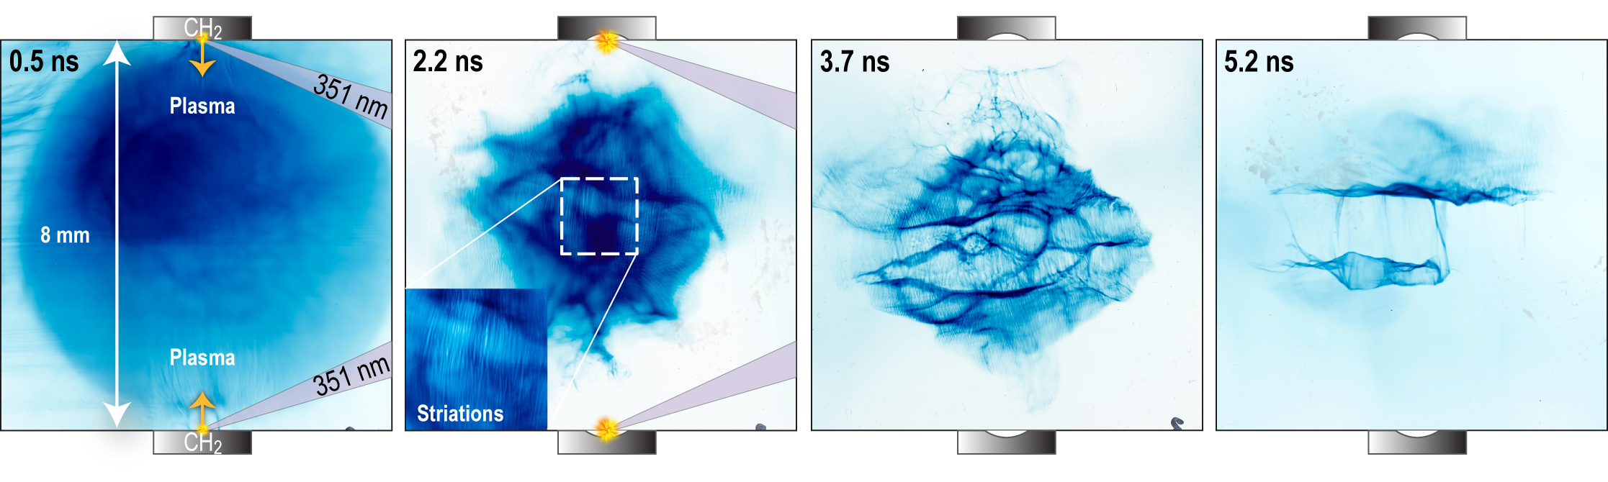
Sudden Onset of Shock-Like Field Structures
OMEGA EP laser ablation: 2.2 kJ in 3 ns
Proton images (0.2 ns “gating”, multi-shot sequence)
8.8 MeV p+
≈ 1 ns
7x magnification
Side-on view
Suddenly appear ~4 ns
Very straight
Standing in place to 4-7 ns
Double bands of caustics
“Ingredients”
  Strong intra-jet collisions
  Weak inter-jet collisions
  Rapid heating
  “Hard ion core”
What field structures might be responsible?
N. L. Kugland et al, APS DPP Meeting 2011

Slide 9
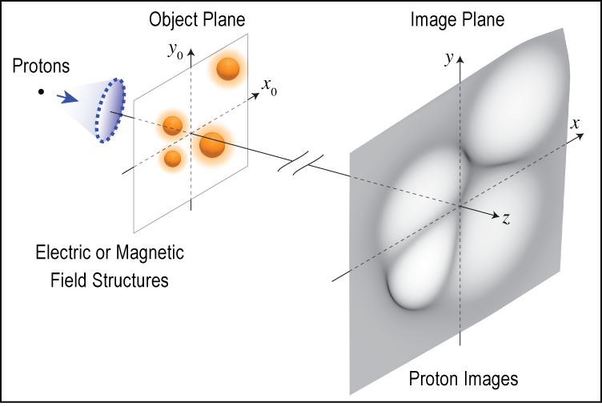
New Analytic Proton Imaging Relations (accepted for review as an RSI Invited Article
Jacobian
Goals: rapid analysis, additional physics understanding
Strange shapes & caustics!
N. L. Kugland, D. D. Ryutov, et al, Submitted to RSI (2012)

Slide 10
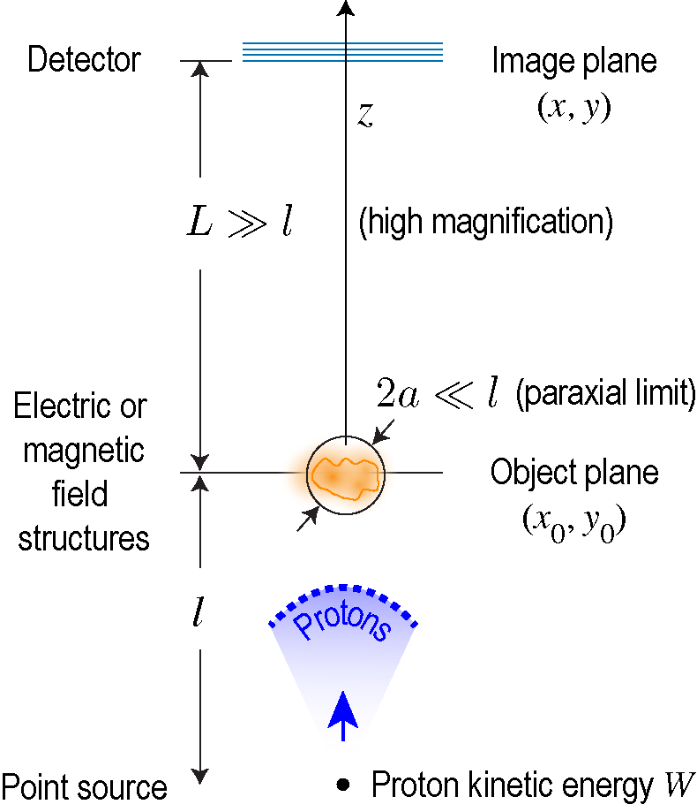
Basic Assumptions for Proton Imaging
x
Jacobian
Quasi-static, paraxial, small-angle model
N. L. Kugland, D. D. Ryutov, et al, Submitted to RSI (2012)

Slide 11

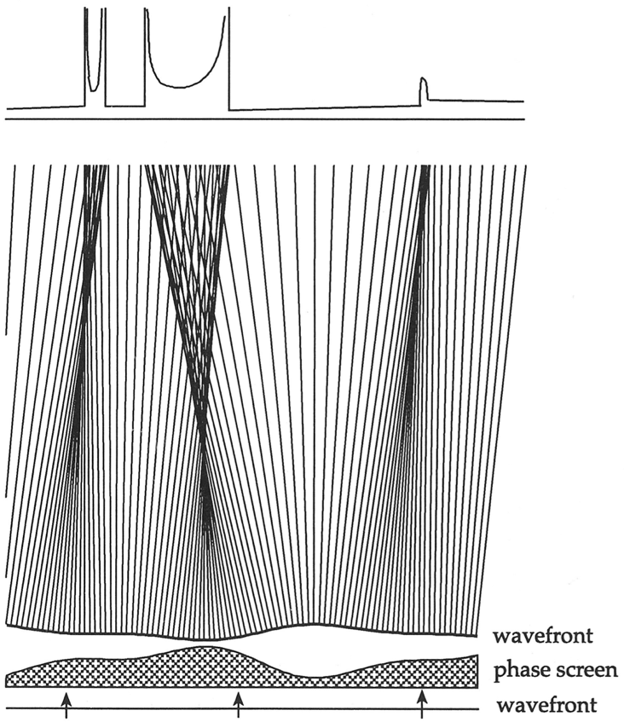
Optical Caustics from Natural Focusing
Caustics from water ripples
strong intensity variation (2x or more)
Image intensity
Formal caustic condition
skeleton
(singularity)
www.mpa-garching.mpg.de
J. F. Nye 1999

Slide 12
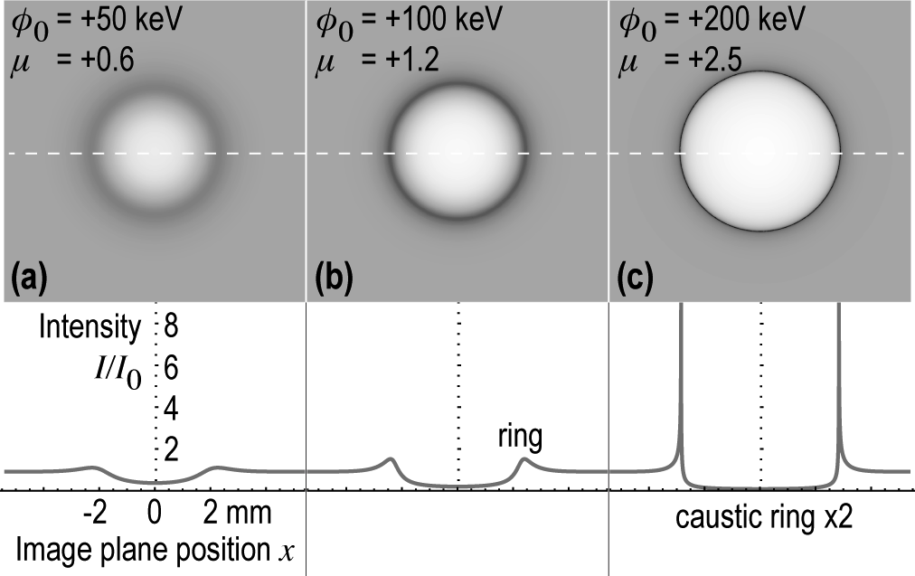
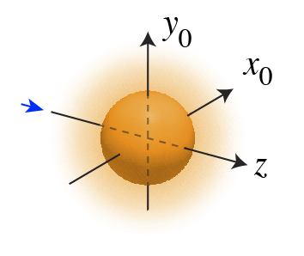
High Fields Make Proton Caustics
Spherical electric potential
(soft Gaussian profile)
unrealistically high
(soft blob)
a = 100 μm
normalized potential
μ > 0 defocusing,
μ < 0 focusing
Caustics → strong deflection → strong field →
high potential OR short scale length
W = 10 MeV, M = 14
N. L. Kugland, D. D. Ryutov, et al, Submitted to RSI (2012)

Slide 13
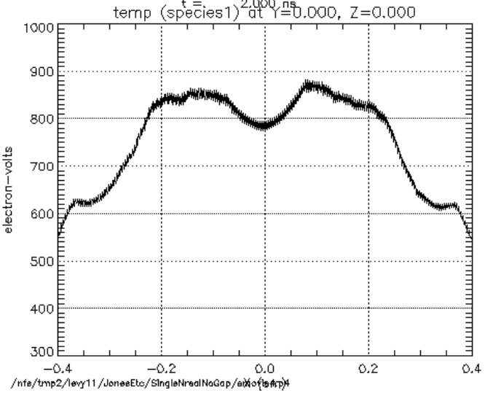
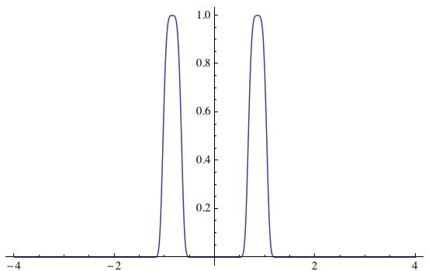
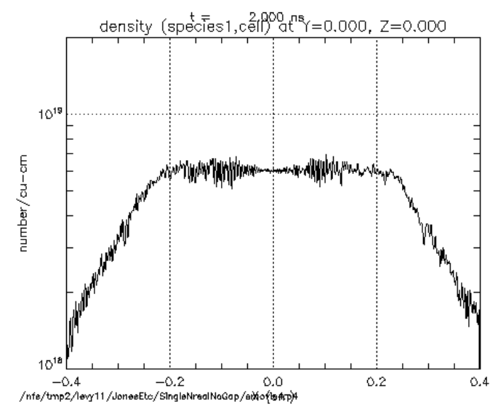
Possibility: Localized Heating, Constant Density
Preliminary 1D LSP Simulations
(hybrid, kinetic ions/fluid electrons)
Possible “final” state:
super-Gaussian electrostatic profiles
Ion Temperature
Ambipolar
φ/φ₀
2.5 mm
200 μm
Ion Density
1.7 mm
Matthew Levy (Rice & LLNL)

Slide 14
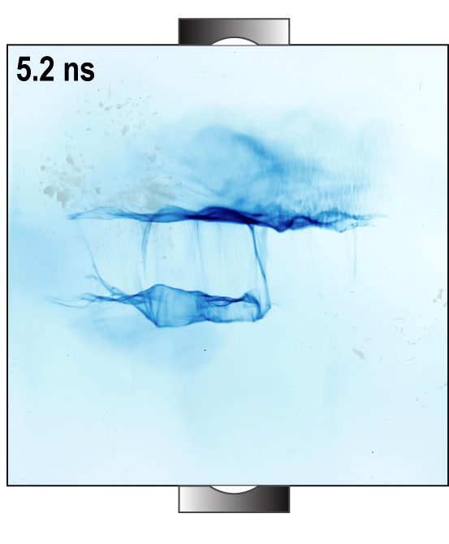

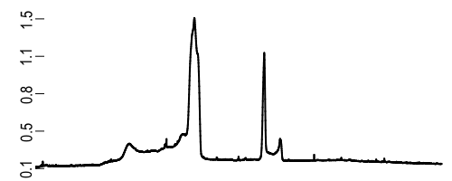
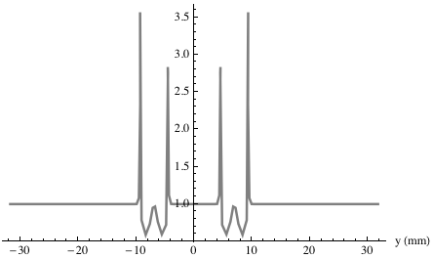

Dual Super-Gaussians Reproduce Some Features
OD
8.8 MeV p+
0.32 mm
1.3 mm
0.46 mm
Dual caustics visible ✔
2.5x intensity increase ✔
2-8x intensity increase
T_{e} = φ₀ = 7 keV X
m = 4
b = 200 μm
a = 2000 μm (transverse extent)
Other curious observations:
Standing feature out to 7 ns
No sensitivity to proton energy

Slide 15
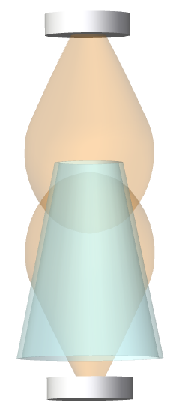
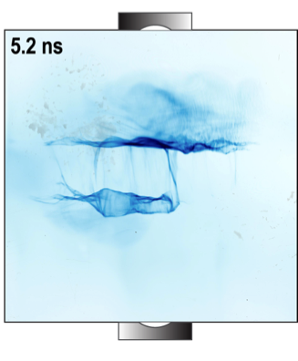
Possibility: Conical Shocks
Slightly tilted view
Weakly divergent conical shock (density jump)
Protons see the opening rim
Moderately robust
(insensitive to viewing angle)
Only visible after electron heating
Angle ≈ 1/Mach #
D. D. Ryutov, manuscript in preparation

Slide 16
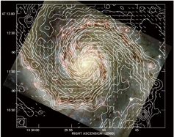
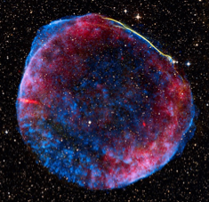
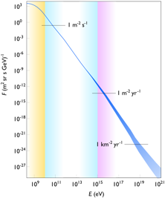
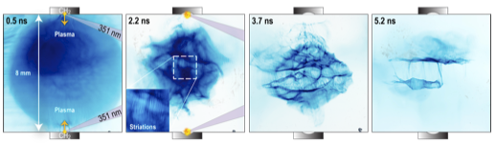
Summary
Astrophysical collisionless shocks are fascinating
  HED plasmas can reach relevant regimes
Platform provides very hot, dense, fast plasma flows
  We are on the path to observe ion-Weibel shocks at NIF
Initial results show fascinating plasma physics
Future
  OMEGA and EP shots; Titan in September; NIF in FY 2013+
  Data interpretation
  Large, realistic simulations with kinetic ions (hybrid)

Slide 17
Thanks to The ACSEL Team
LLNL* (USA) |  | H.-S. Park, N. Kugland, C. Plechaty, B. Remington, J. S. Ross, D. Ryutov
Oxford University* (UK) |  | G. Gregori, A. Bell, C. Murphy, J. Meinecke, B. Reville
Osaka University* (Japan) |  | Y. Sakawa, H. Takabe, Y. Kuramitsu, T. Morita
Princeton University (USA) |  | A. Spitkovsky, L. Gargate, L. Sironi
University of Michigan (USA) |  | P. Drake, C. Kuranz, M. Grosskopf, E. Rutter
LULI (France) |  | M. Koenig, A. Ravasio, A. Pelka, T. Vinci, C. Riconda, R. Yurchak
Univ. of Nevada, Reno (USA) |  | R. Presura
LLE, Univ. of Rochester (USA) |  | D. Froula, J. Knauer, G. Fiskel
York University (UK) |  | N. Woolsey
Rice University (USA) |  | E. Liang, M. Levy, W. Fu
ETH Zurich (Switzerland) |  | F. Miniati
*Founding institutions
We also thank the staff of the OMEGA and OMEGA EP laser facilities.

Slide 18
Appendix

Slide 19
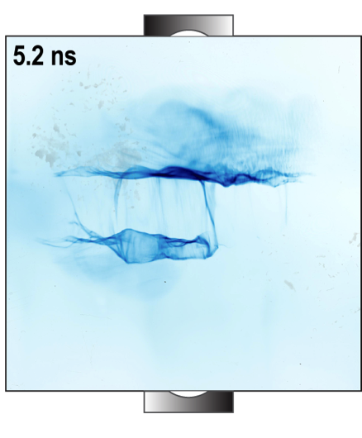
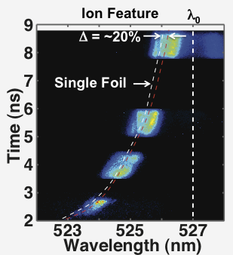
Our Experimental Maxims
Know the plasma state (n, T, v_{flow})
Know the field structure (collective, large-scale)
Independently image the shock
Independently measure the magnetic fields (e.g. Faraday rotation)
Thomson scattering
Proton imaging*
8 mm
*focus of this talk

Slide 20
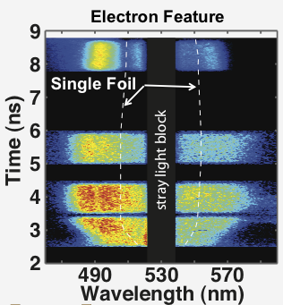
1. Know the Plasma State (Thomson Scattering)
OMEGA (4.5 kJ/target in 1 ns)
300 μm spot
7 x 10¹⁵ W/cm²
In the center (at the ≈ 100³ μm³)
(these depend on position and time)
J. S. Ross, Invited Talk at APS DPP 2011
J. S. Ross et al, Phys. Plasmas 2012

Slide 21
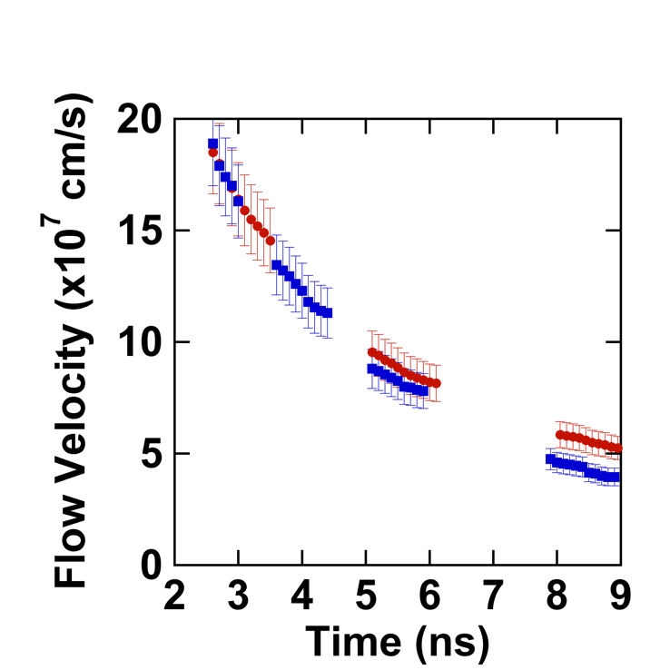
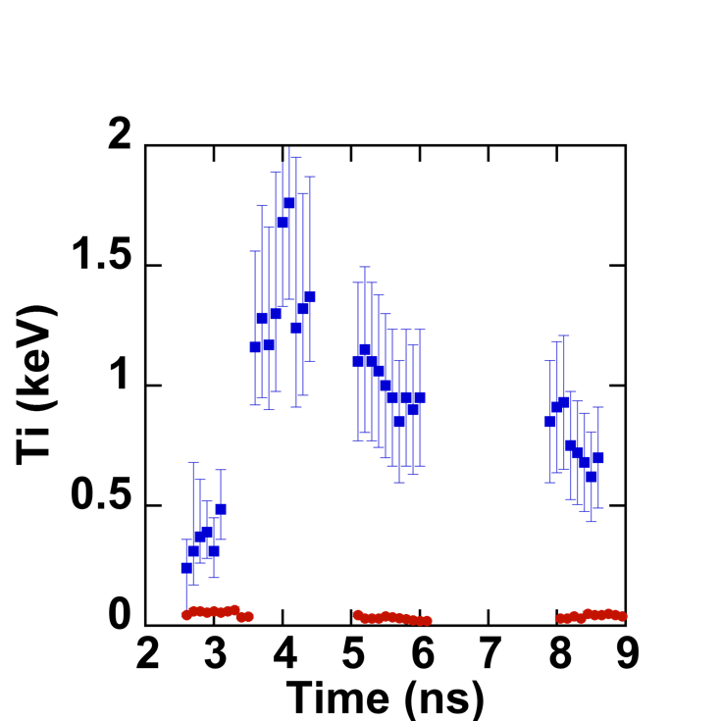
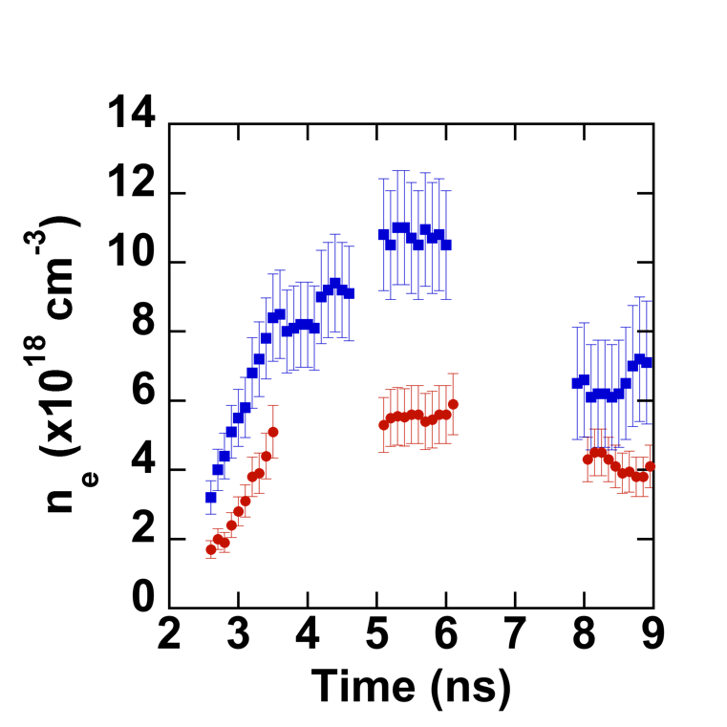
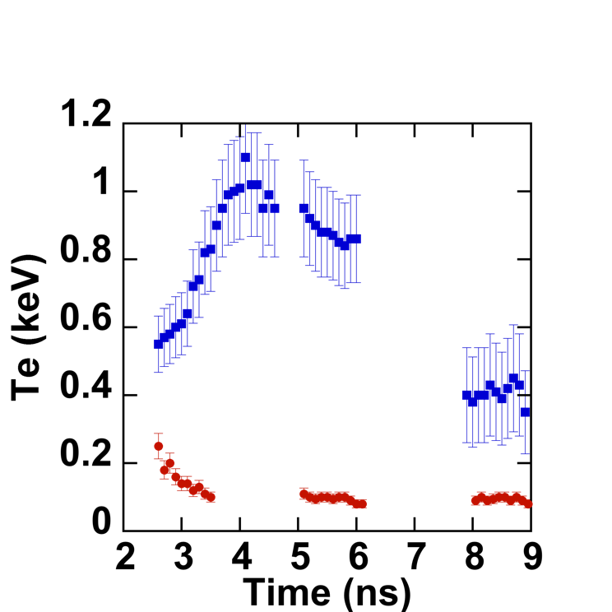
No Stagnation but Rapid Heating at 3-4 ns
v
T_{i}
(plasmas “meet” around 3-4 ns)
Single foil
Double foil
n_{e}
T_{e}
2x ✔
Collisional electron drag can cause this rapid heating
C at 10⁸ cm/s:
W = 60 keV
J. S. Ross, Invited Talk at APS DPP 2011
J. S. Ross et al, Phys. Plasmas 2012

Slide 22
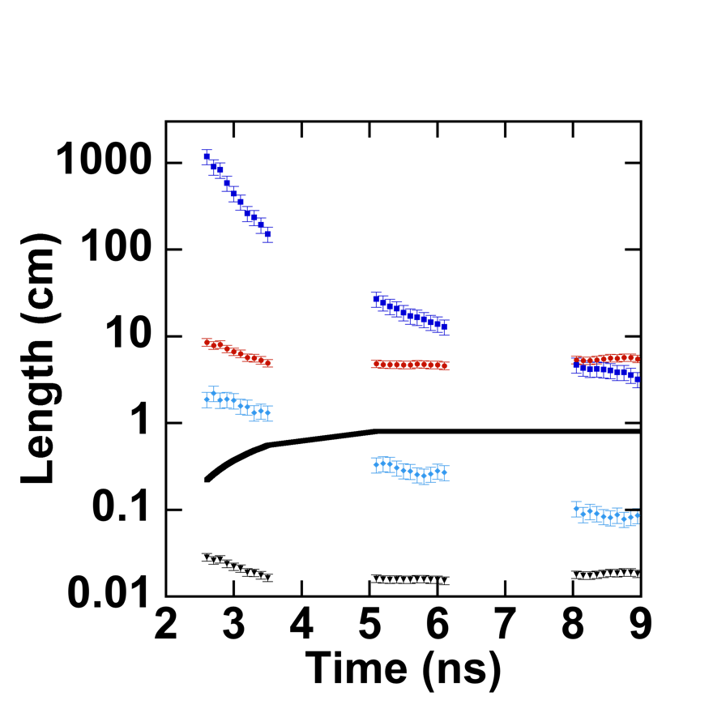
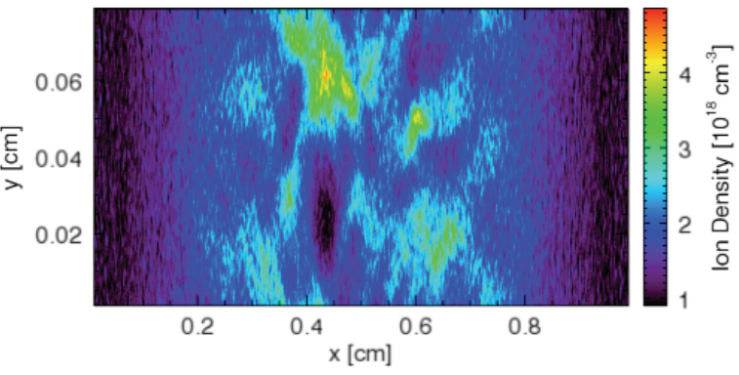
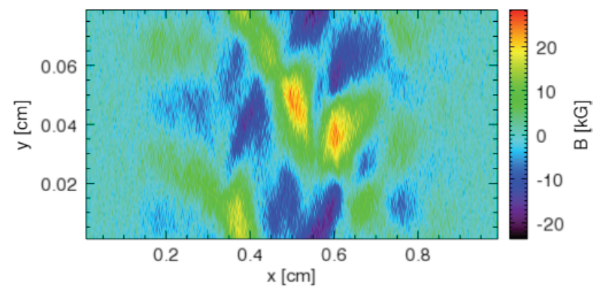
Progress Towards Ion-Weibel Shocks
Partially Satisfied l* << l_{int} << λ_{mfp}
Ion-Weibel Filaments Forming (PIC)
Ion density
t = 4.0 ns
λ_{mfp}
l*_{EM}
l_{int}
l*_{ES}
Magnetic field
c/ω_{pi}
Achieved ~25c/ω_{pi}; a fully formed shock might need 300 c/ω_{pi} (100x more n_{i}) according to PIC results (not experimentally validated)
(ion-Weibel)
(ion-ion two-stream)
A.A. Vedenov & D. D. Ryutov, Rev. Plasmas Phys 1975
A. Spitkovsky, ApJ, 2005; Kato and Takabe, 2008

Slide 23
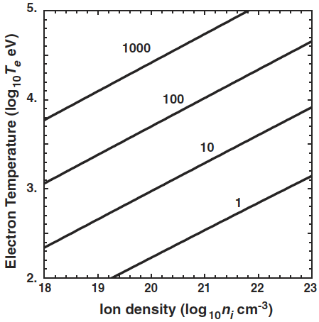
NIF Can Uniquely Study Strong Ion-Weibel Growth
Planned experiments: Gianluca Gregori (Oxford), Youichi Sakawa (Osaka); FY 2013+
NIF is the only facility on earth that can create a large plasma with all of these properties:
High density > 10²⁰ cm⁻³
(well-formed shock, short ion skin depth)
High flow velocity > 2000 km/s
(collisionless)
High temperature T_{e} > 1 keV
(frozen-in fields, R_{M} >> 1)
Goal:
NIF
OMEGA
(for counterstreaming Be plasmas, L = 10λ_{e} )
R. P. Drake & G. Gregori, ApJ 2012 (accepted)

Slide 24
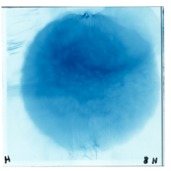
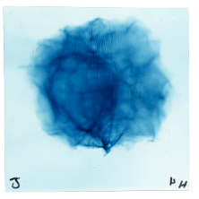
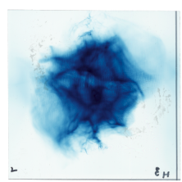
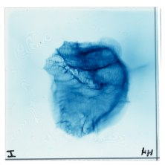
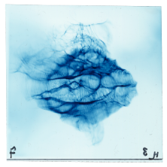
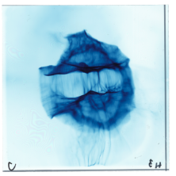
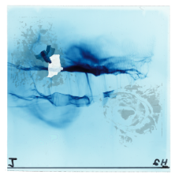
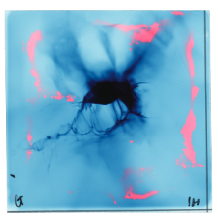
Multi-Campaign Time Sequence
(EPColPlasmas-11D & EP-ACSEL-12A)
10149, 0.5 ns, 8.8 MeV
11412, 2 ns, 10.4 MeV
10151, 2.2 ns, 8.8 MeV
11412, 3 ns, 10.4 MeV
Standing Features
10148, 3.7 ns, 8.8 MeV
11406, 4 ns, 10.4 MeV
10158, 5.2 ns, 7 MeV
11411, 7 ns, 4.7 MeV

Slide 25
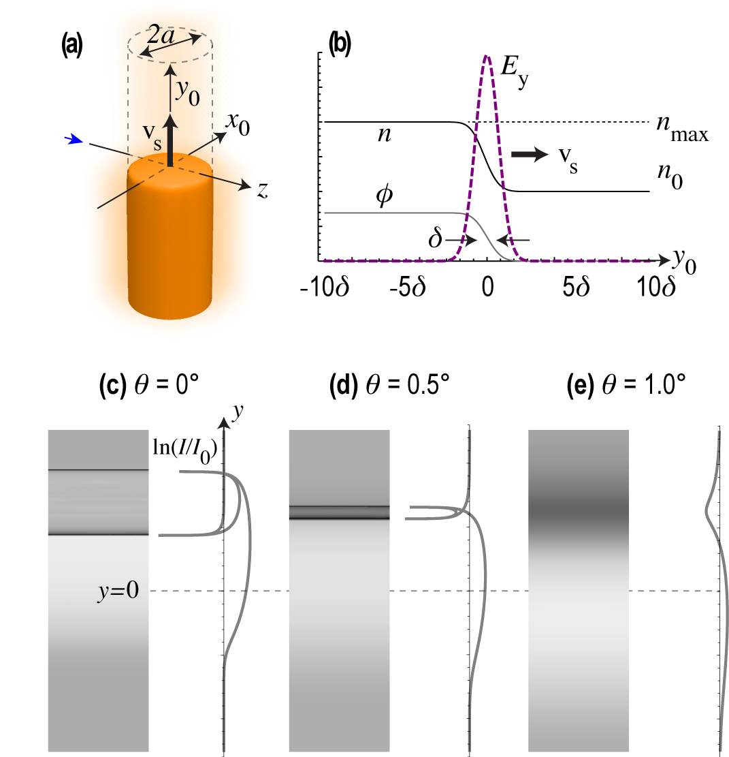
Possibility: Electrostatic Planar Shock
Ambipolar:
Caustics on the upstream side, BUT ONLY when viewed exactly edge-on!
N. L. Kugland, D. D. Ryutov, et al, Submitted to RSI (2012)

Slide 26

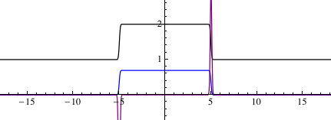
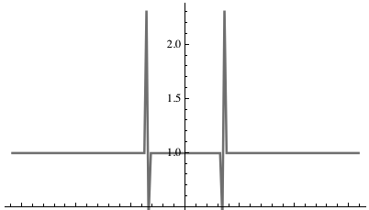
Comparison: Dual Planar Shocks
OD
8.8 MeV p+
n₀
v_{s}
0.32 mm
2n₀
1.7 mm
~1.7 mm
1.3 mm
0.46 mm
n₀
v_{s}
Only single caustics visible X
2-8x intensity increase
2.5x intensity increase
No obvious creation mechanism X
T_{e} = φ₀ = 200 eV ✔
δ = 15 μm ✔ (shock thickness)
λ_{D} ≈ 0.1 μm
A = 2 (shock strength)
a = 2000 μm (transverse extent)

Slide 27
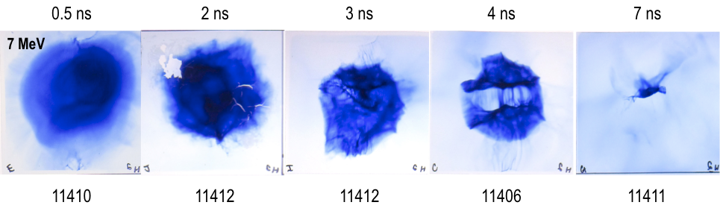



Proton Beam “Erosion” at Late Time
Last campaign
Al washer
Film size (63.5 mm)²
EPColPlasmas-11D
This campaign
EP-ACSEL-12A
Si washer

