Slide 1

Magnetized jets and radiative shocks driven by pulsed power
Sergey Lebedev
in collaboration with
F. Suzuki-Vidal, M.Bocchi, A. Harvey-Thompson, G. Swadling, S.N. Bland,
G. Burdiak, J.P. Chittenden, P. de Grouchy, G. Hall, J. Skidmore,
L. Pickworth, L. Suttle, M. Bennett, S. Patankar, H. Doyle, R. Smith
Imperial College London
A. Ciardi
Ecole Normale Superieure
A. Frank, E. G. Blackman
University of Rochester
R.P. Drake
University of Michigan

Slide 2
Outline
HEDLA challenge - designing experiments with “1-D” initial conditions to study 3-D effects
Radiative shocks in cylindrical geometry
Reverse shocks driven by supersonic collimated flows
Trapped energetic particles in magnetized jets.
Argon, n ~10¹⁷ cm⁻³
s012508
Notes:
“independently control”

Slide 3
Cylindrically converging shock: experimental set-up
Schematic of the experiment
Ar, Xe, N2 gas (~10⁻⁵ g/cc) inside a thin-wall Al liner driven by 1.4MA, 250ns current pulse
6mm diameter, 90μm thick Al liner ( ~ skin depth)
No bulk motion of the liner,
shock is driven by
motion / heating of the inner wall surface
(and / or )
by magnetic field diffusing through the liner wall
Argon, n ~10¹⁷ cm⁻³
Burdiak et al., 2012
Notes:
“independently control”

Slide 4
Cylindrically converging shock: experimental set-up
Diagnostics
Ar, Xe, N2 gas ( 1.4x10⁻⁵ g/cc) inside a thin-wall Al liner driven by 1.4MA, 250ns current pulse
6mm diameter, 90μm thick Al liner ( ~ skin depth)
No bulk motion of the liner,
shock is driven by
motion / heating of the inner wall surface
(and / or )
by magnetic field diffusing through the liner wall
Argon, n ~10¹⁷ cm⁻³
Burdiak et al., 2012
Notes:
“independently control”

Slide 5
Azimuthally symmetric converging shock
Δr ~ 100μm
Small level perturbations are seen behind the shock
Argon, n ~10¹⁷ cm⁻³
Azimuthally symmetric shock / blast wave
Notes:
“independently control”

Slide 6
Azimuthally symmetric converging shocks
1st shock 2nd shock
Argon, n ~10¹⁷ cm⁻³
Azimuthally symmetric shock / blast wave moving at V~20km/s
Second shock, accelerating towards axis
Notes:
“independently control”

Slide 7
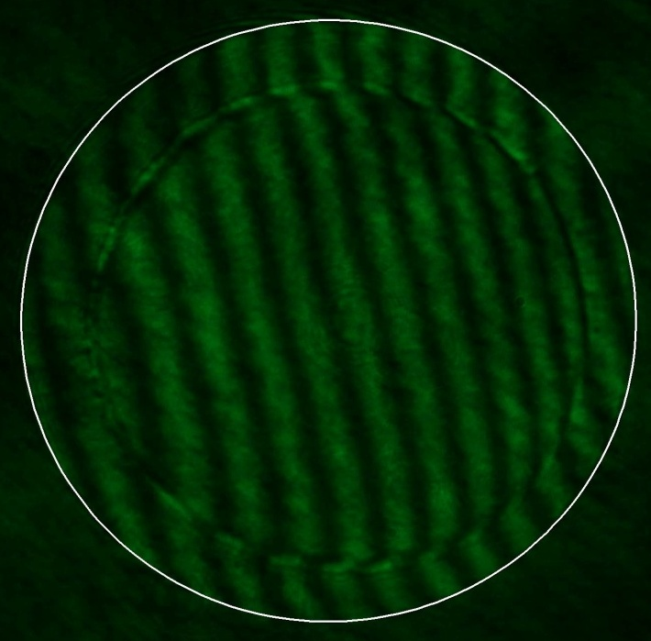
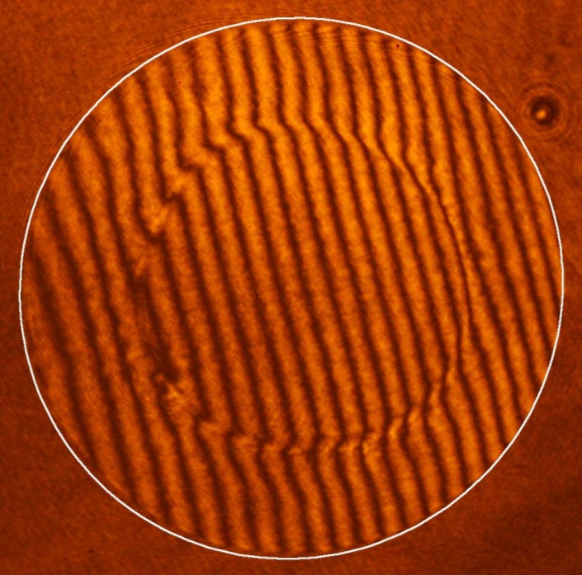
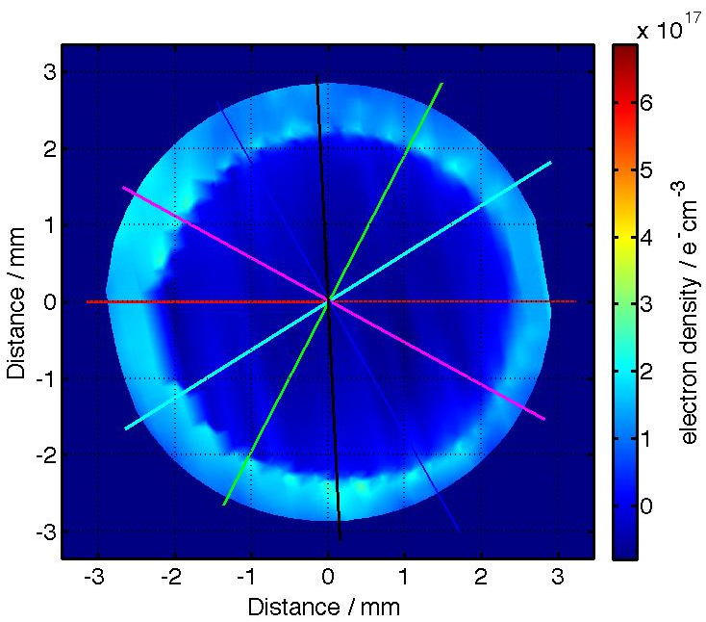
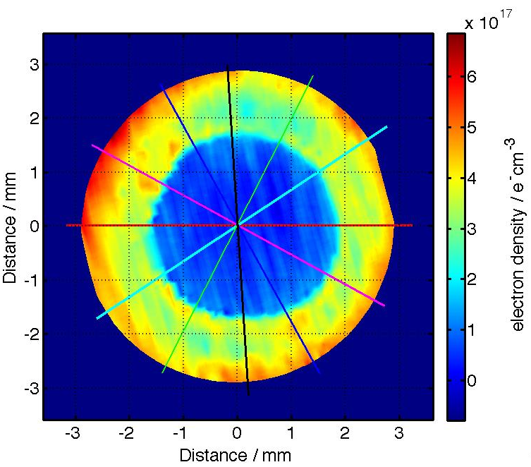
Electron density maps (1st shock)
182ns
210ns
Shock moving radially in
Unshocked material
Shocked material
Initial 6mm diameter (white)
Positions of the shocks are consistent with V~20km/s
Fringe-shift yields electron density distribution
Good azimuthal symmetry
Notes:
“independently control”

Slide 8
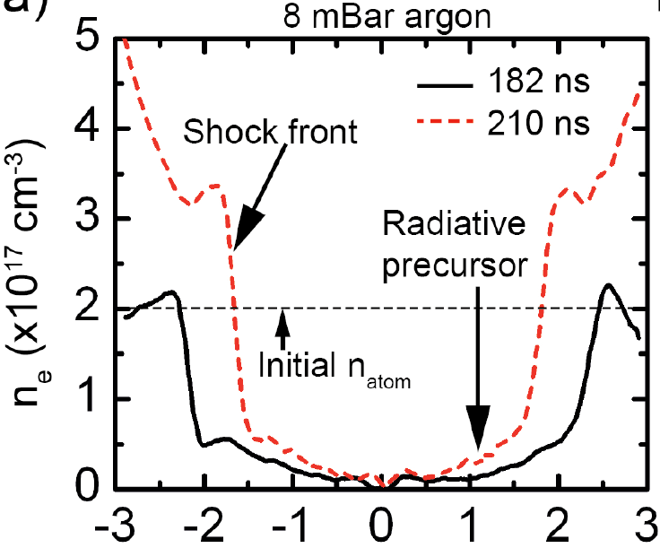
Electron density profiles (1st shock)
Ionisation ahead of the shock – radiative precursor (ne / n0 ~25%)
Post-shock temperature:
Argon, n ~10¹⁷ cm⁻³
TS ~15-8eV (γ = 5/3, Z = 1-3)
Flux of ionising photons exceeds flux of neutral atoms for Ts ≥2eV
λph ~1.5mm (at 15.8eV)
Notes:
“independently control”

Slide 9
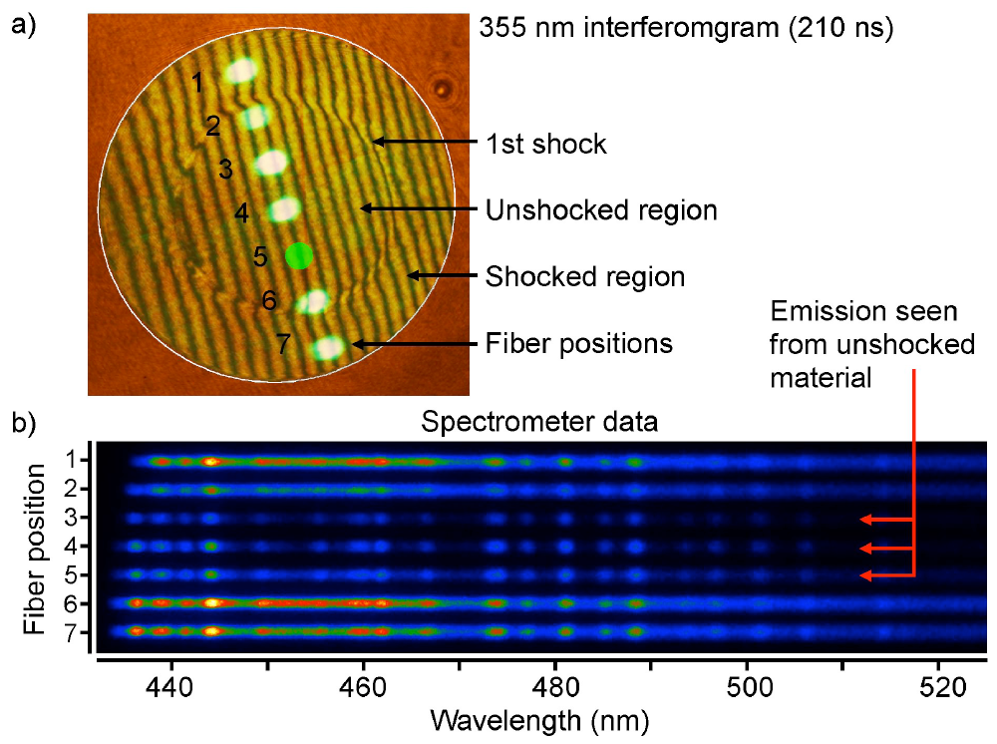
Optical spectra (1st shock)
Optical spectra has only Ar II lines for both the post-shock and precursor, consistent with Te ~ 2eV
Argon, n ~10¹⁷ cm⁻³
Notes:
“independently control”

Slide 10
Optical spectra (1st shock)
Optical spectra has only Ar II lines for both the post-shock and precursor, consistent with Te ~ 2eV
Precursor temperature is close to the post-shock temperature.
(Possible for optically thin up-stream case [see Drake‘s book])
Argon, n ~10¹⁷ cm⁻³
Notes:
“independently control”

Slide 11
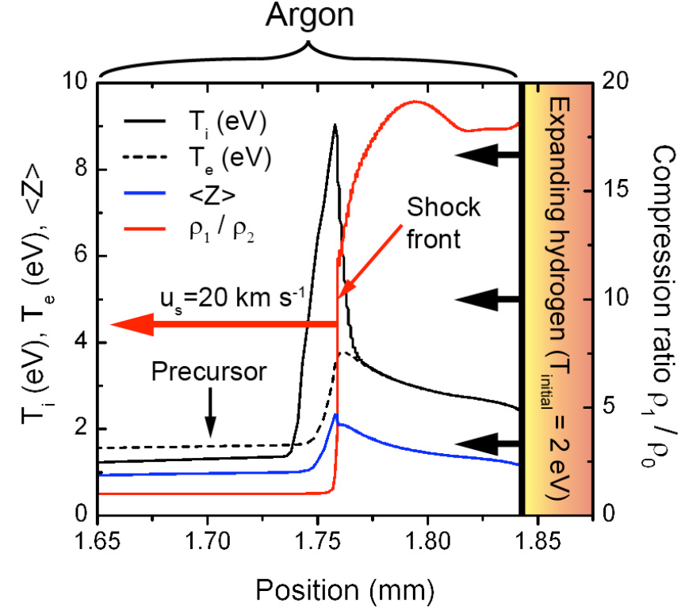
Simulations with HELIOS
Argon, n ~10¹⁷ cm⁻³
Presence of precursor but higher Z, Te and ne jump.
Excitation of bound electronic states as additional energy sink?
[Michaut et al., Eur. Phys. J (2004)]
Notes:
“independently control”

Slide 12
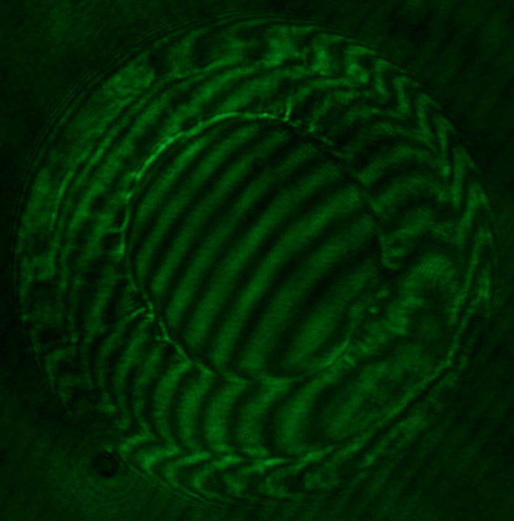
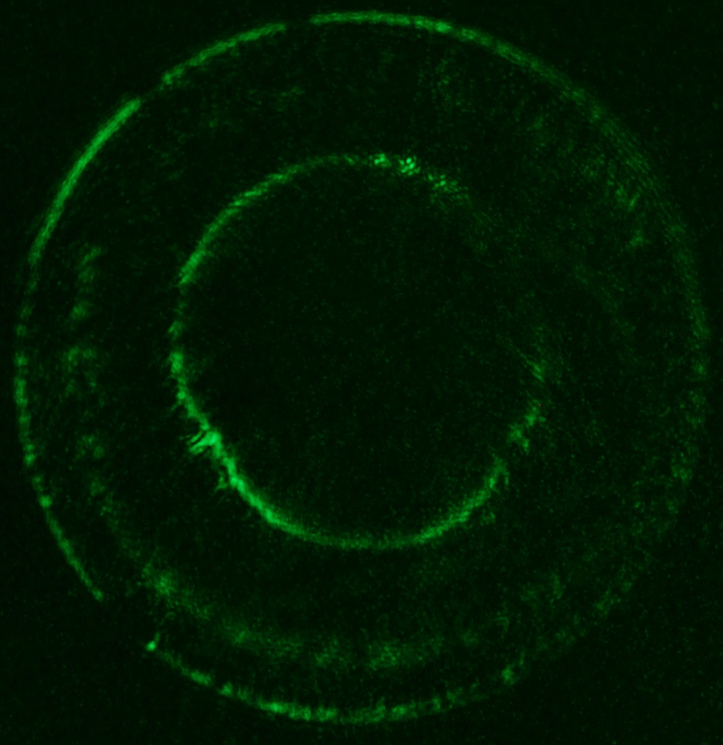
Stability of the shock (Ar)
Argon, n ~10¹⁷ cm⁻³
Development of instabilities behind the shock front in Ar
Notes:
“independently control”

Slide 13
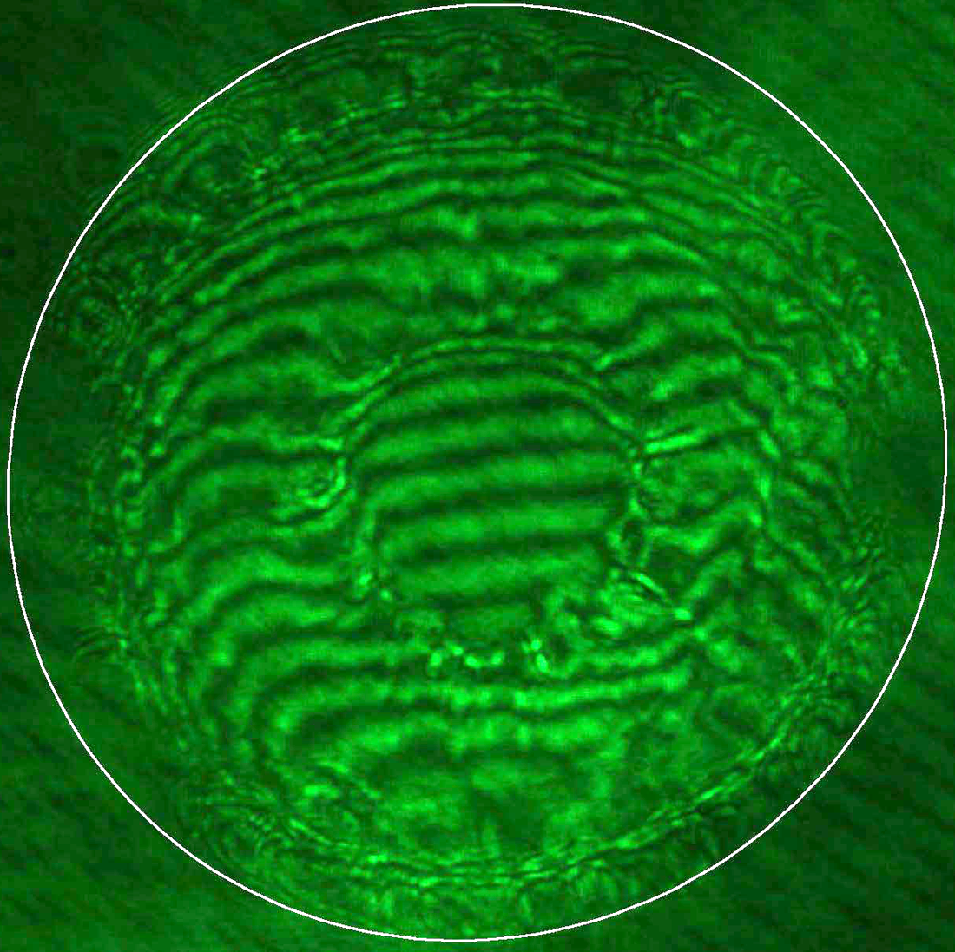
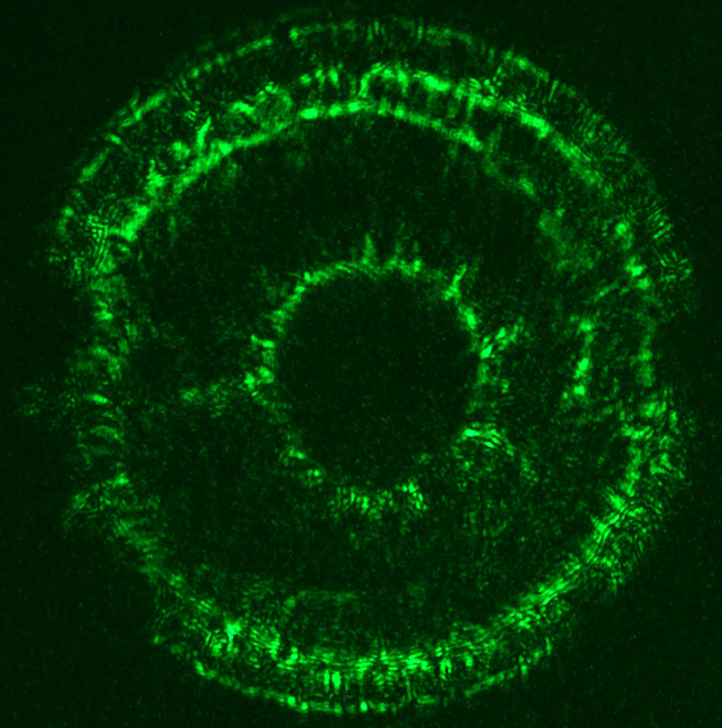
Stability of the shock (Xe)
Argon, n ~10¹⁷ cm⁻³
Development of instabilities behind the shock front in Xe
Notes:
“independently control”

Slide 14
Stability of the shock (Ar versus N2)
Argon, n ~10¹⁷ cm⁻³
High azimuthal symmetry for Ar and Xe
“Corrugations” of the shock front is observed for N2 - chemistry?
Notes:
“independently control”

Slide 15
Outline
HEDLA challenge - designing experiments with “1-D” initial conditions to study 3-D effects
Radiative shocks in cylindrical geometry
Reverse shocks driven by supersonic collimated flow
Trapped energetic particles in magnetized jets.
Argon, n ~10¹⁷ cm⁻³
s012508
Notes:
“independently control”

Slide 16
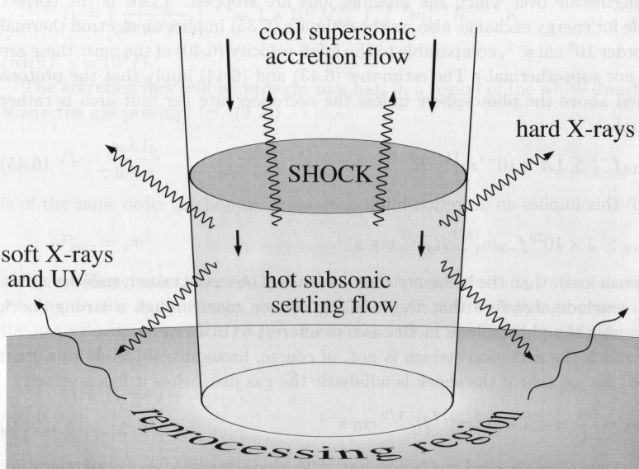
Reverse shock in (magnetized) accretion column
Frank, King, Rain, “Accretion power in Astrophysics”
Accretion shock problem: location, shape, oscillations and stability, x-ray emission, etc.
(see talk by B. Louipias on Friday)
Especially difficult for plasma β ~ unity – challenge proposed by Pat Hartigan at the previous HEDLA meeting in 2010
Argon, n ~10¹⁷ cm⁻³
Orlando et al., AA (2010)
s012508
Notes:
“independently control”

Slide 17
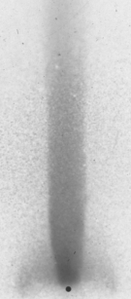
Reverse shock experiment
Metal or CH foil
Bz
Flow parameters of Al plasma jet:
V ~ 50km/s
~ (2-8)x10⁻⁵ g/cc
T ~ 20eV
M ~ 3
Δt ~ 300ns
“wall”
Reverse shock
Supersonic flow (jet)
to diagnostics
Argon, n ~10¹⁷ cm⁻³
Thomson probing laser beam
magnetic field needed to balance ram pressure:
Reverse shock:
s012508
Plasma jet from radial foil
Suzuki-Vidal ,PoP (2010, 2012)
Notes:
“independently control”

Slide 18
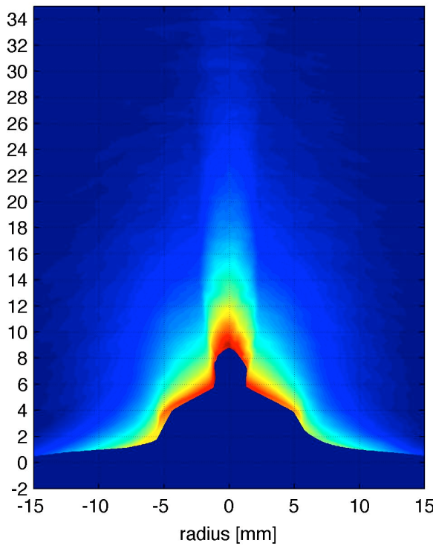
Thomson scattering: jet velocity and temperature
scattered light
Blue-shifted spectrum, Vz from Doppler shift.
Density map
Scattering volumes
Jet is surrounded by lower density plasma moving with the same velocity (Vz~50km/s)
Te =15eV (Z~4), M ~3
Observed opening angle is 2-5⁰, some collimating force is needed
laser shadowgraph, 233ns
Argon, n ~10¹⁷ cm⁻³
k
k_{out}
Thomson laser beam
k_{in}
Notes:
“independently control”

Slide 19
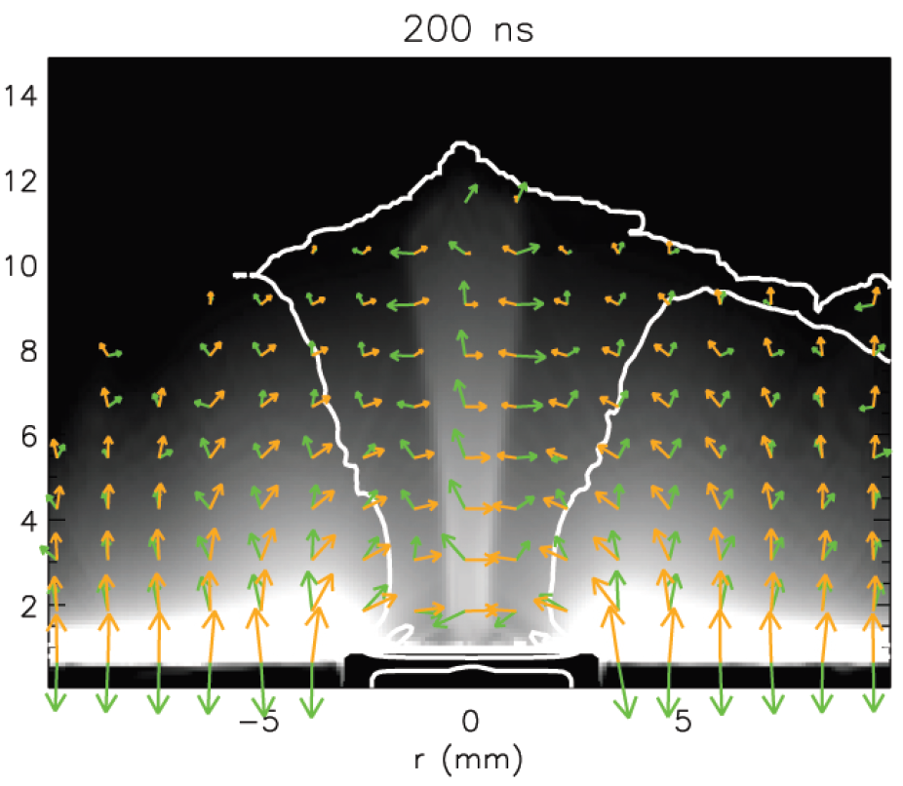
Simulations of jet formation in vacuum
The experiment have been modeled using a 3D resistive MHD code GORGON
Toroidal magnetic field (Bϕ) diffuses through the foil
“Indirect” magnetic collimation:
jzxBϕ force provides redirection of the flow (at r > Rj) towards the axis
Ram pressure of the converging flow confines the dense jet
laser shadowgraph, 233ns
Argon, n ~10¹⁷ cm⁻³
s012508
Notes:
“independently control”

Slide 20
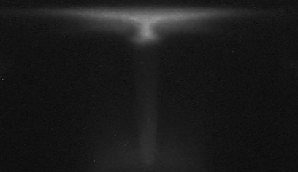
Movies of the reverse shock formation
foil
jet
12 optical images
5 ns exposure time
20 ns separation
Formation of several shock features
“Pinching” of plasma above the shock at early time
s012508
Pickworth et al., 2012
Notes:
“independently control”

Slide 21
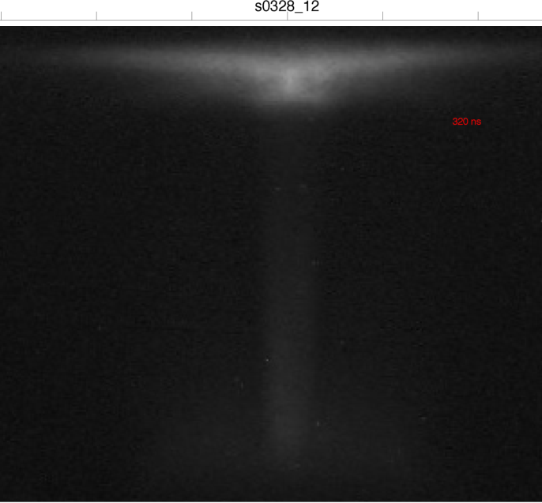
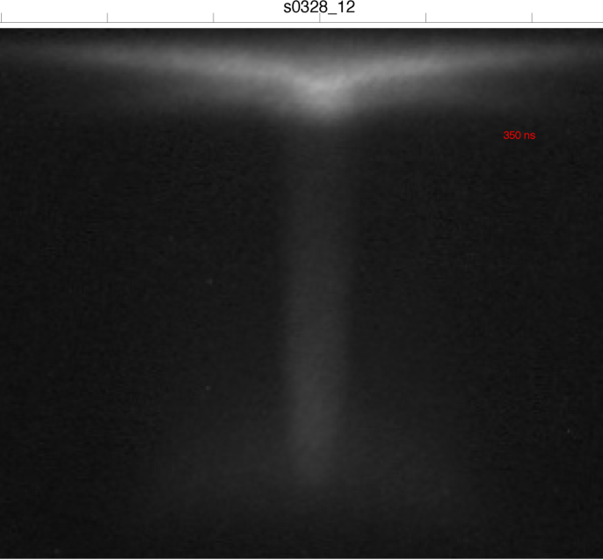
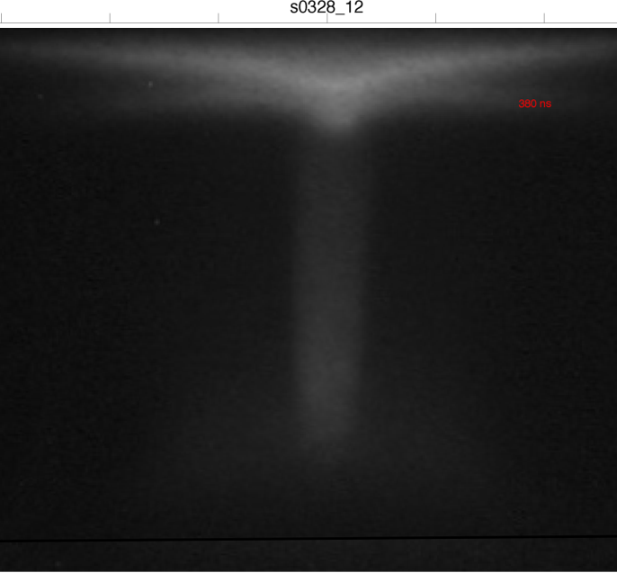
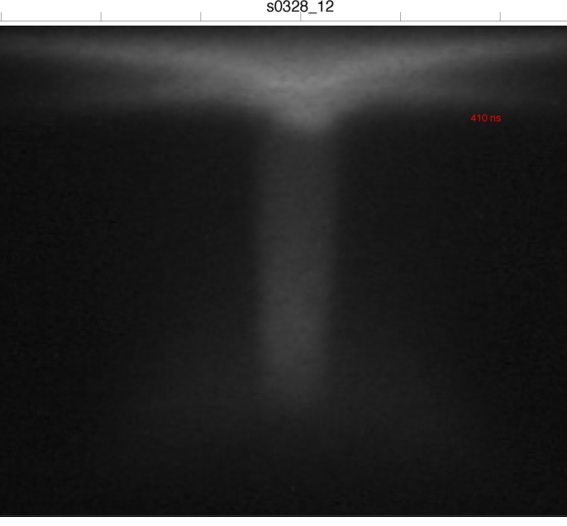
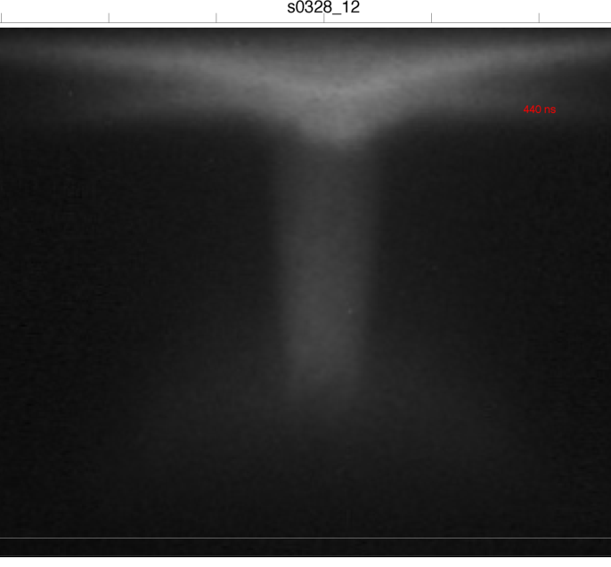
Reverse shock (optical emission)
Argon, n ~10¹⁷ cm⁻³
z=0
s012508
Notes:
“independently control”

Slide 22
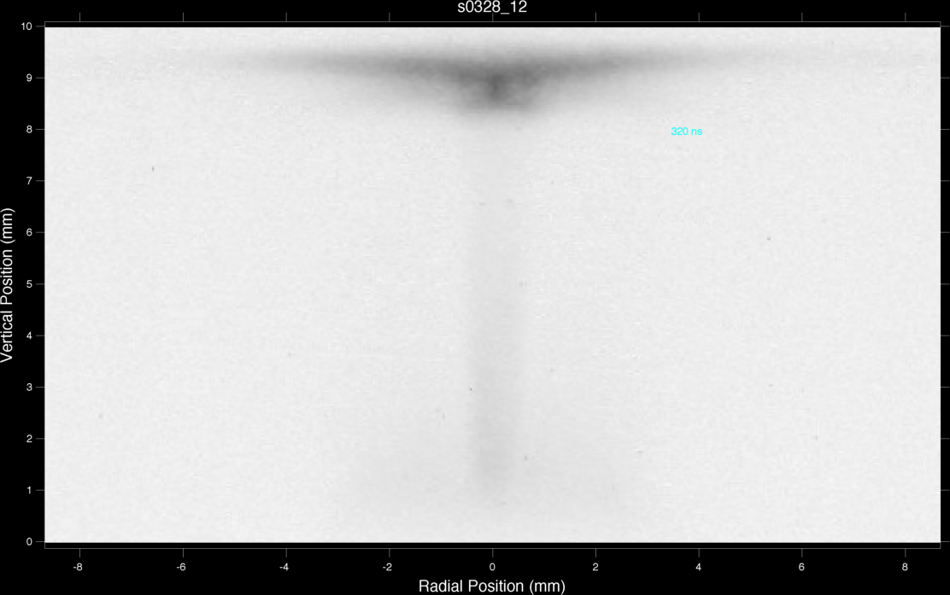

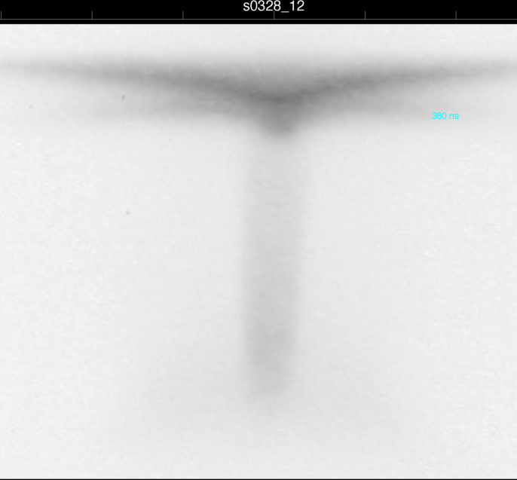
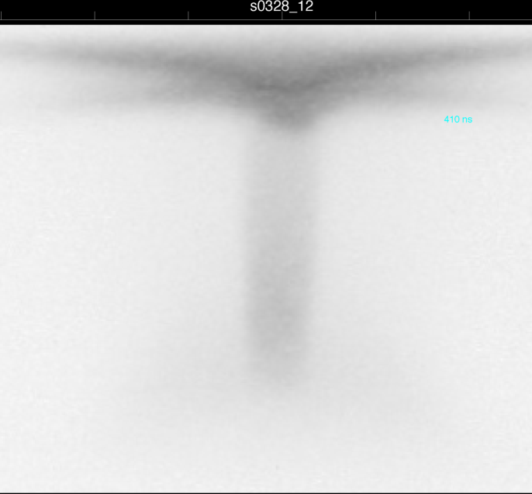
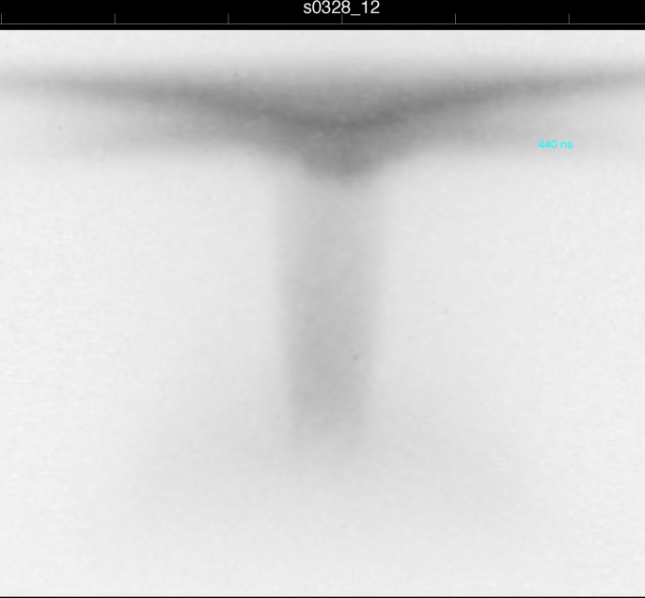
Reverse shock (optical emission)
Argon, n ~10¹⁷ cm⁻³
z=0
s012508
Notes:
“independently control”

Slide 23
Reverse shock (interferometry)
410ns
Axial profile of ne in the jet
S0323B
Measured electron density jump at the shock:
ne2 / ne1 ~ 10
ρ2 / ρ1 ≤ ne2 / ne1
s012508
Notes:
“independently control”

Slide 24
Reverse shock (interferometry)
S0328
Argon, n ~10¹⁷ cm⁻³
490ns
s012508

Slide 25
Reverse shock (interferometry)
S0328
Argon, n ~10¹⁷ cm⁻³
490ns
Measured electron density jump at the off-axis shock:
ne2 / ne1 ~ 5-6
ρ2 / ρ1 ≤ ne2 / ne1
s012508
Notes:
“independently control”

Slide 26
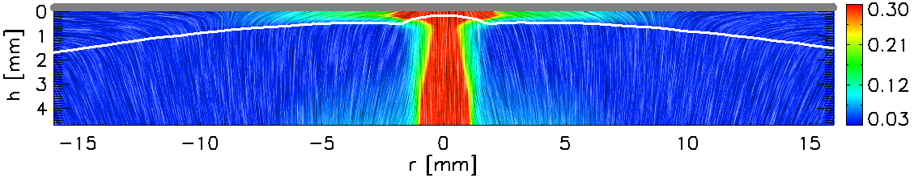
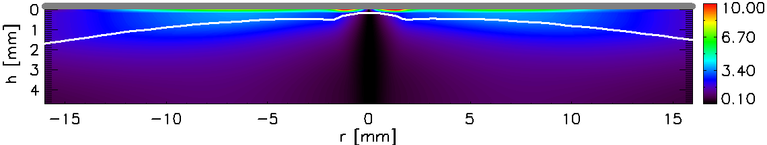
MHD simulations
Density and flow velocity vectors
Kg/m³
Argon, n ~10¹⁷ cm⁻³
Magnetic field
T
Accumulation (compression) of Bϕ advected by the flow
Plasma flow is re-directed towards the axis
s012508
Notes:
“independently control”

Slide 27
Outline
HEDLA challenge - designing experiments with “1-D” initial conditions to study 3-D effects
Radiative shocks in cylindrical geometry
Reverse shocks driven by supersonic collimated flow
Trapped energetic particles in magnetized jets.
Argon, n ~10¹⁷ cm⁻³
s012508
Notes:
“independently control”

Slide 28
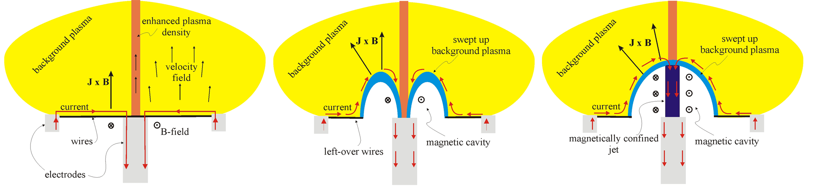
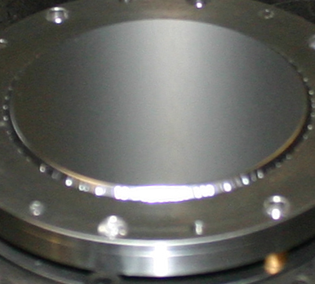
Magnetically driven jets: schematic of the experiment
Magnetically confined jet on the axis of magnetic cavity expanding through ambient plasma
Al 6μm foil
Lebedev et al, MNRAS (2005), Ciardi et al, ApJL (2009), Suzuki-Vidal et al, PoP (2010, 2012)

Slide 29
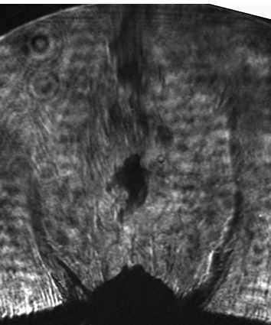
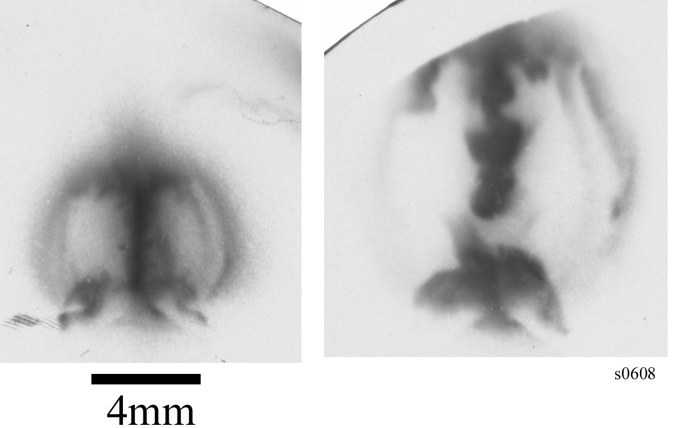
Magnetically driven jet
Laser shadowgraphy
Instabilities produce “clumps” in the jet, but do not destroy collimation
XUV emission
V~200km/s, β ~ 1

Slide 30
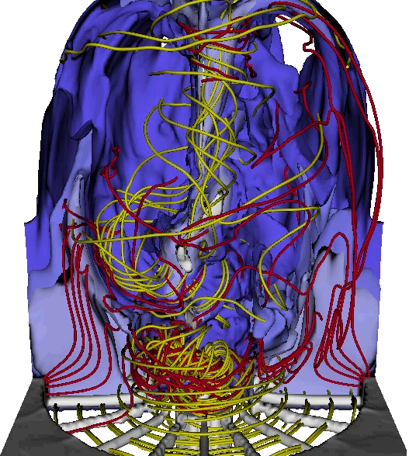
Magnetically driven jet
3-D MHD simulations
Instabilities produce “clumps” in the jet, but do not destroy collimation
XUV emission
Trapped energetic particles?

Slide 31
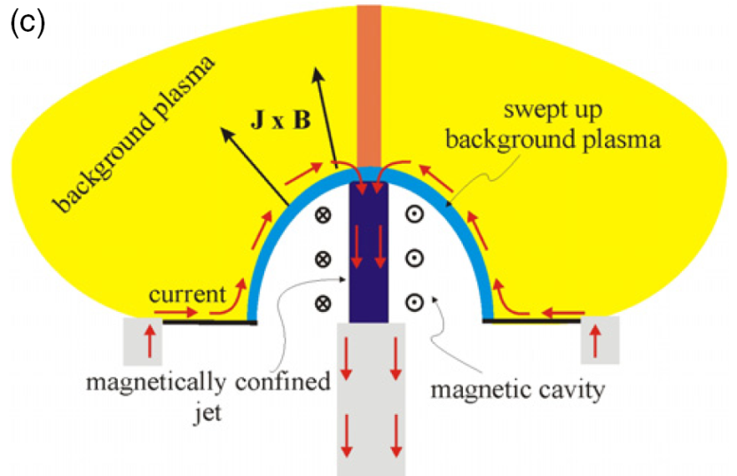
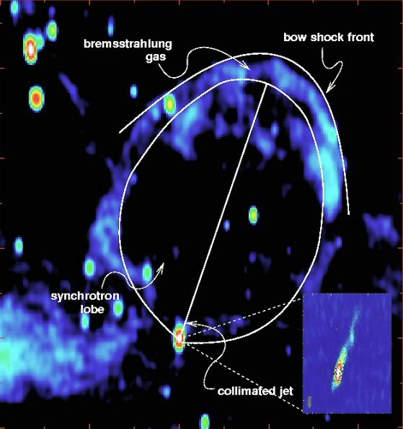
Non-MHD effects (fast particles)
voltage
voltage
High voltage at the base of the jet at the time of the jet formation
Trapping of energetic particles in the magnetic cavity?
~ 200 keV protons, B ~ 0.5 MGs, ρL ~ 1mm
Cygnus X-1 Gallo et al 2005
There is observational evidence of trapped particles in e.g. AGN jets (synchrotron radiation)

Slide 32
Trapped particles – proton emission images
Magnetic spectrometer
Proton pin-hole camera
1 mm pinhole
x (ε)
Electron density map
p
B
CR-39
CR-39
Proton spectrum
100 um pinhole
Presence of proton trapped in the magnetic cavity
S. Patankar, H. Doyle

Slide 33
Summary
HEDLA challenge - designing experiments with “1-D” initial conditions to study 3-D effects
Radiative shocks in cylindrical geometry
Reverse shocks driven by supersonic collimated flow
Trapped energetic particles in magnetized jets.
Argon, n ~10¹⁷ cm⁻³
s012508
Notes:
“independently control”

Slide 34
Electron density profile in the 1st shock
Ionisation ahead of the shock – radiative precursor (ne / n0 ~100%)
x4 jump in electron density
Argon, n ~10¹⁷ cm⁻³
Notes:
“independently control”

Slide 35
Cylindrically converging shock
Optical spectra from both post-shock and precursor are from Ar II and consistent with Te ~ 2eV(?)
Argon, n ~10¹⁷ cm⁻³
Notes:
“independently control”

Slide 36
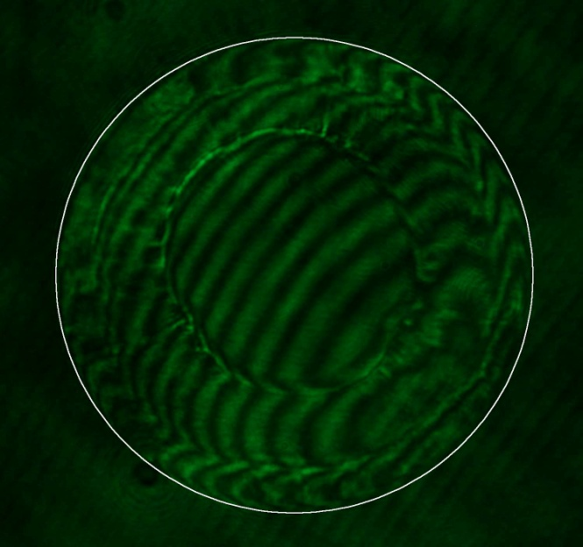
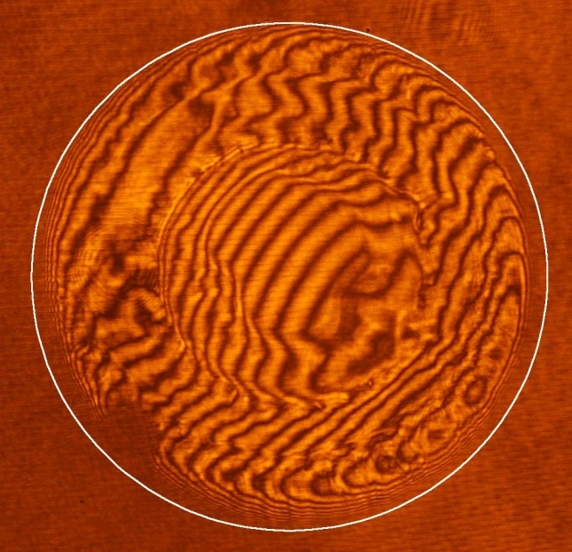
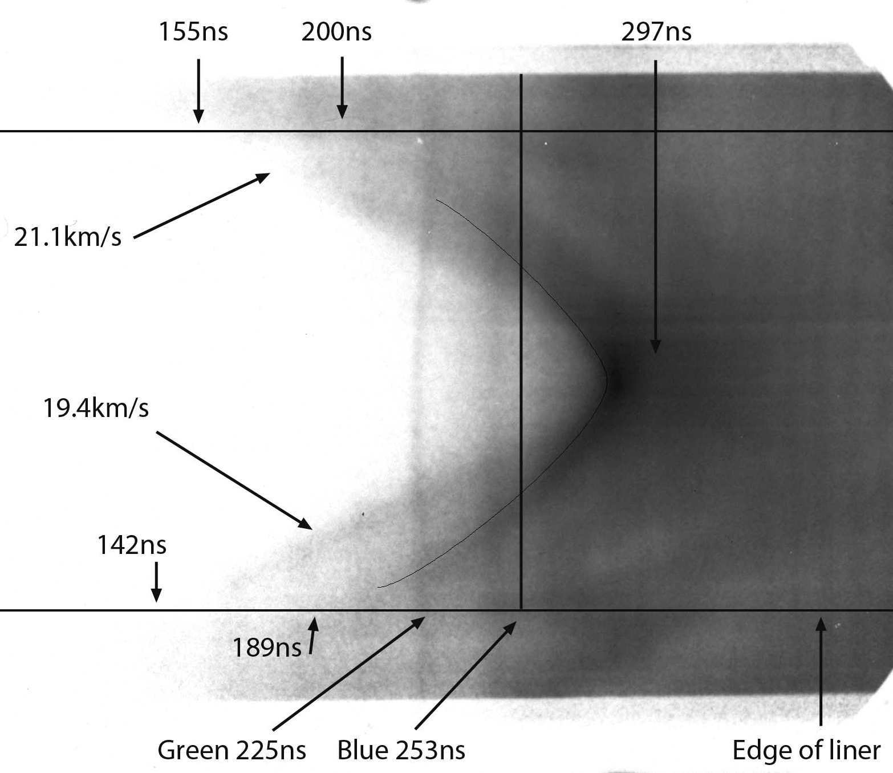
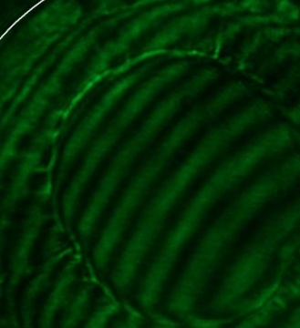
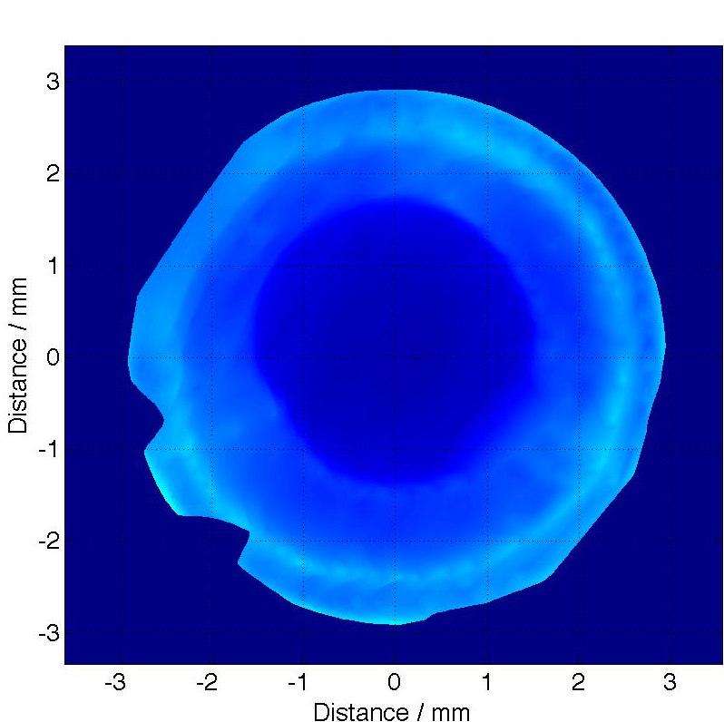
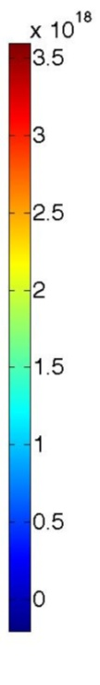
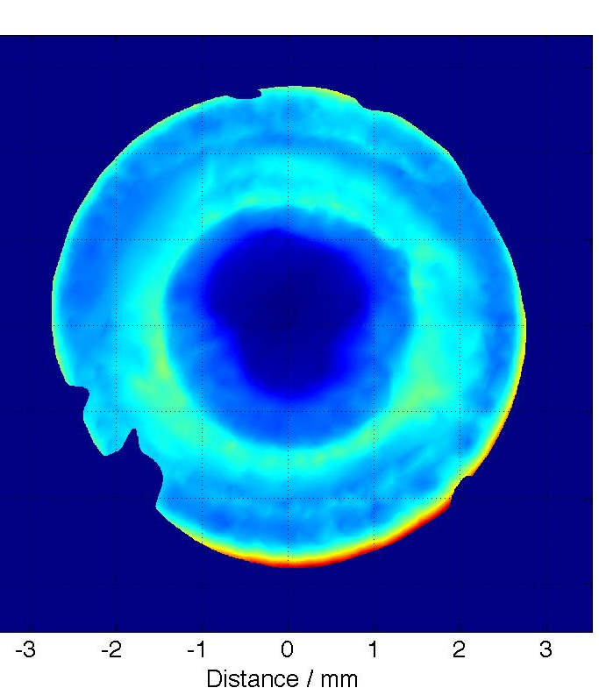
8mBar Ar shot. s0818_11
225ns
253ns
1st shock
2nd shock
3rd?
2nd shock travels through heated, ionised material
Azimuthal symmetry of 2nd shock reasonably independent of conditions ahead of it
Conditions behind 2nd shock are more unstable than behind the first
e⁻cm⁻³

Slide 37
8mBar Ar shot. s0818_11
225ns
253ns
1st shock
2nd shock
3rd?
2nd shock travels through heated, ionised material
Azimuthal symmetry of 2nd shock reasonably independent of conditions ahead of it
Conditions behind 2nd shock are more unstable than behind the first
e⁻cm⁻³

Slide 38
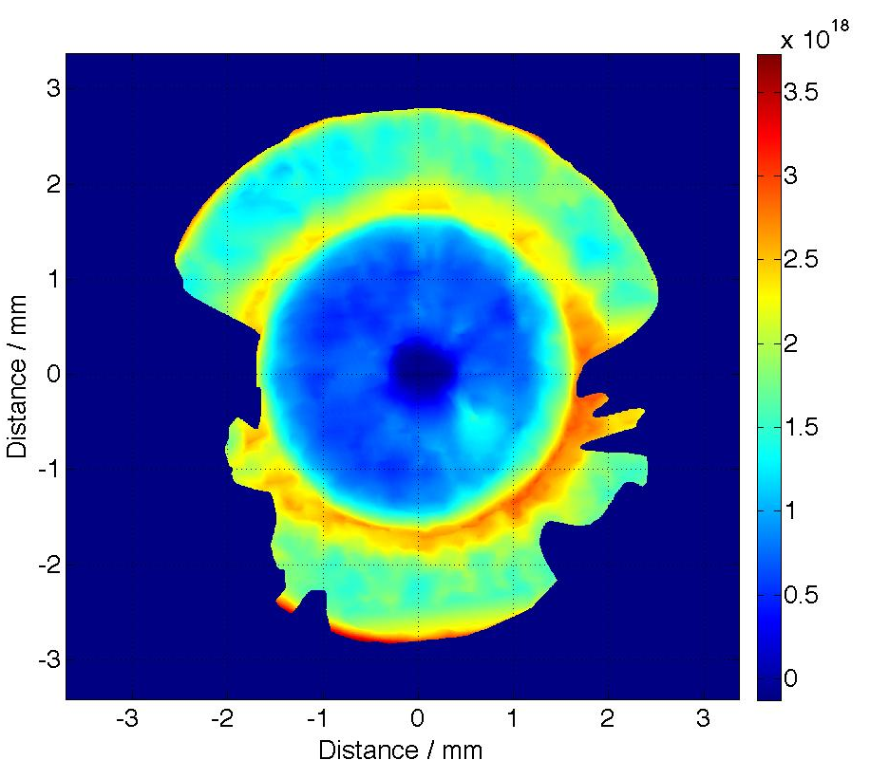
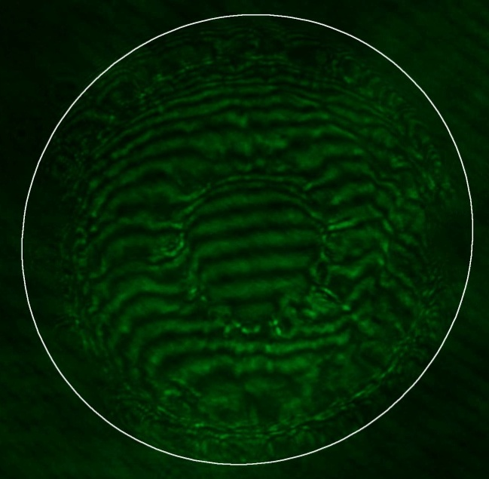
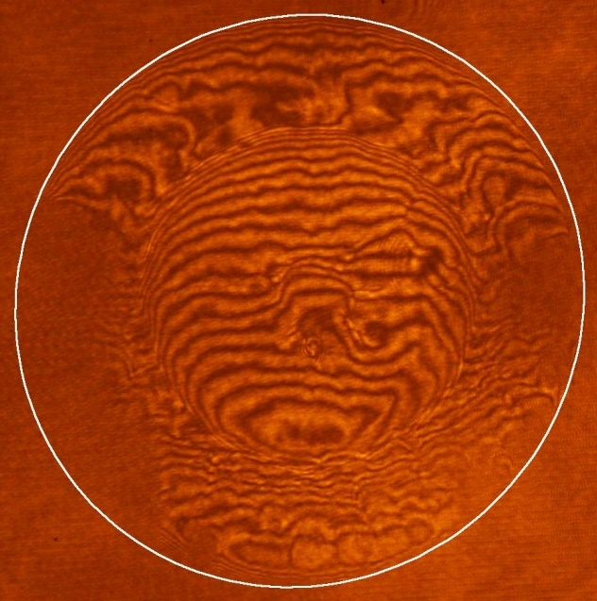
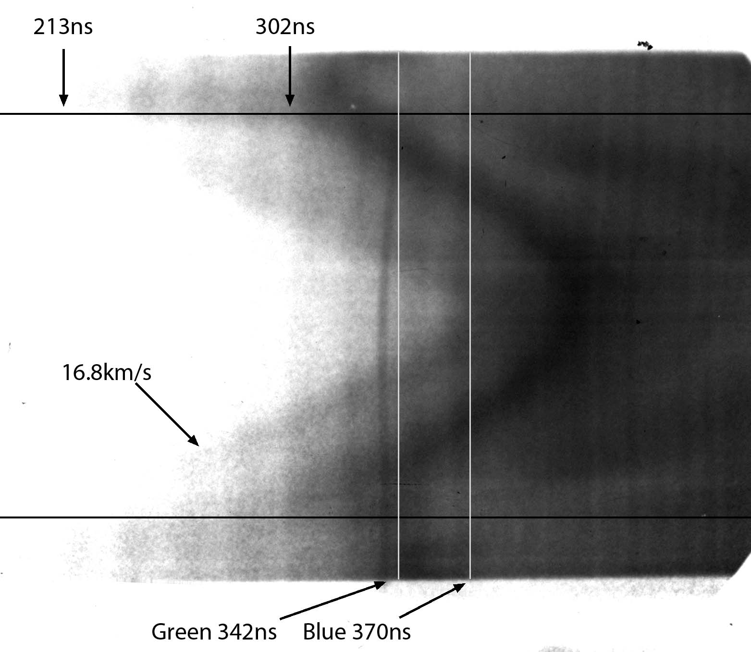
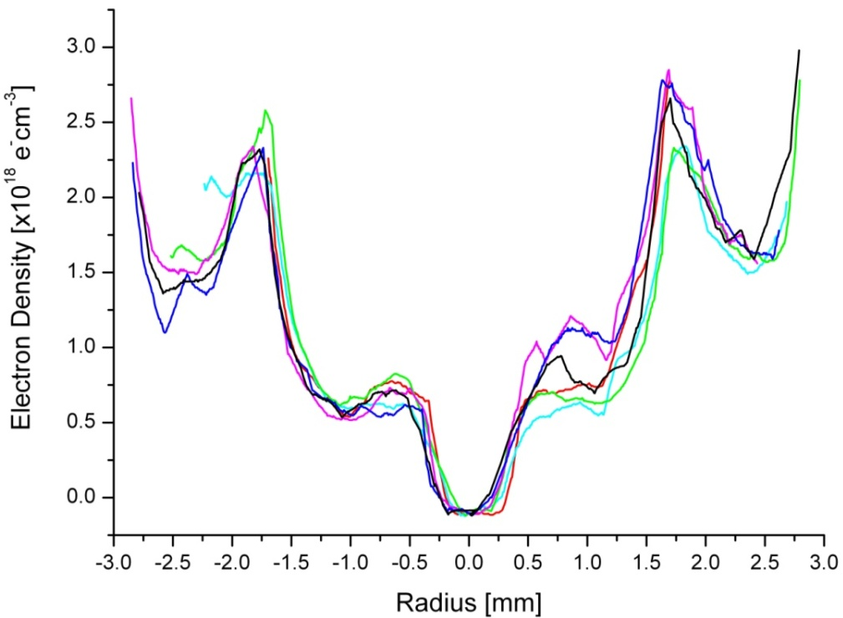
Later time interferometry (Xe)
Data from 2.9mBar xenon
shot. s0816_11
342ns
370ns
1st shock
2nd shock
Leading edge of second shock is uniform despite instabilities in trailing edges
Initial mass of gas in liner: 5.5µg
Mass in shock assuming n_{e} is from XeIII: 14µg – Clearly wrong (unless there is a lot of Al inside) Assuming n_{e} from XeV: 5.5µg – possible
- Need careful analysis of spectroscopic data to determine

Slide 39
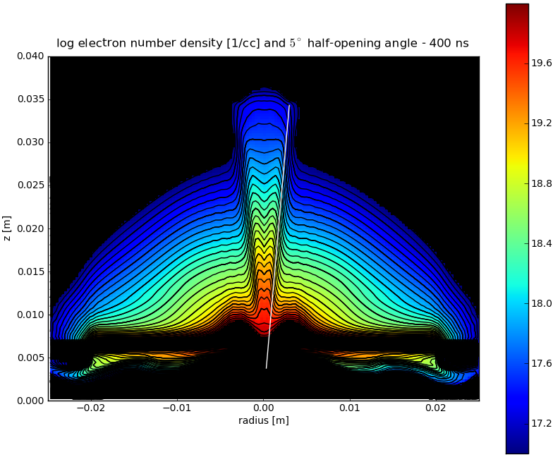
Simulations of jet formation in vacuum
The experiment have been modeled using a 3D resistive MHD code GORGON
“indirect” magnetic collimation of the dense part of the jet
Opening angles:
~5⁰ in simulations
~2⁰ in experiments
Faster radiative cooling and higher internal Mach number in experiments?
Simulations underestimate magnetic field and current in the jet?
laser shadowgraph, 233ns
Argon, n ~10¹⁷ cm⁻³
s012508
Notes:
“independently control”

Slide 40
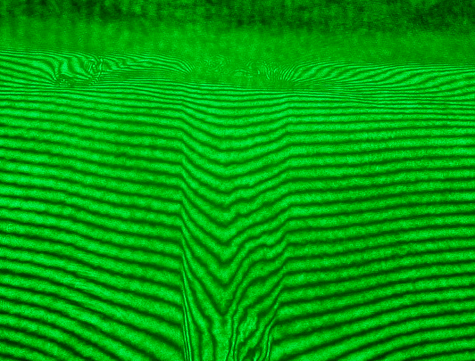
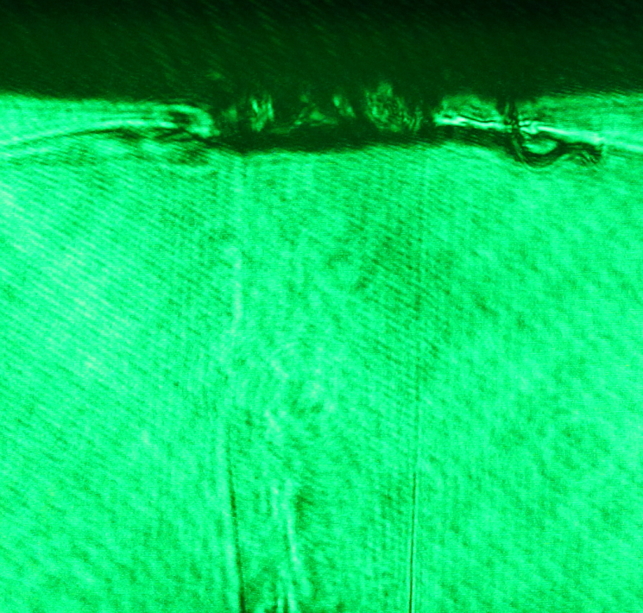
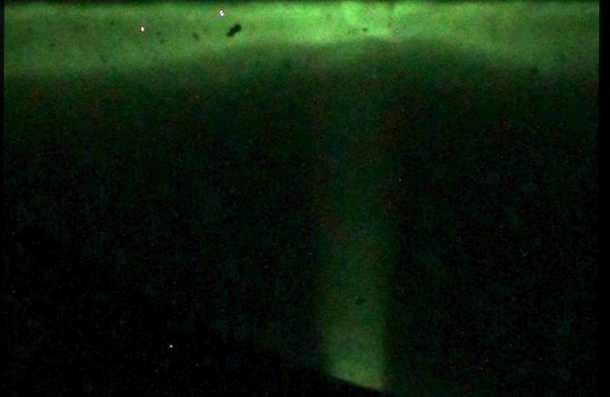

Reverse shock
CH foil
t_gr = 392ns
t_xuv=446, 476ns
laser shadowgraph, 233ns
Argon, n ~10¹⁷ cm⁻³
Plasma jet from radial foil
S0323B
Notes:
“independently control”

Slide 41


S0328 Al-Al 15mm
Argon, n ~10¹⁷ cm⁻³
t_XUV = 520ns, 550ns
s012508
S0328_XUV
Notes:
“independently control”

Slide 42
Thomson scattering: jet velocity and temperature
Axial profile of the flow velocity in the jet
Flow velocity from Doppler shift
Te and Z from broadening
t=445ns
Flow velocity: 50-60km/s at z=12-20mm
(jet tip at z>35mm, Vtip ~100km/s)
Te = 15-20eV (Z~4)
Cs ~ 2x10⁶ cm/s ➔ internal Mach # ~2.5-3
Opening angle of a free-expanding M=3 jet:
θ = tan⁻¹(1/M) ~ 20⁰ >> 2-5⁰ measured

