Slide 1







Studying astrophysical collisionless shocks with high power lasers
Presentation to
9th International Conference on High Energy Density Laboratory Astrophysics
April 30 – May 4, 2012
Tallahassee, FL
Hye-Sook Park
(on behalf of ACSEL collaboration)

Slide 2
ACSEL (Astrophysical Collisionless Shock Experiments with Lasers) team
LLNL (USA): H.-S. Park, N. Kugland, S. Glenzer, C. Plechaty, S. Prisbrey, B. Remington, S. Ross, D. Ryutov
Osaka University (Japan): Y. Sakawa, H. Takabe, Y. Kuramitsu, T. Morita
Oxford University (UK): G. Gregori, A. Bell, J. Meineke
Princeton University (USA): A. Spitkovsky
LLE, Univ. of Rochester (USA): D. Froula, J. Knauer, G. Fiskel
LULI (France): M. Koenig, A. Ravasio, A. Pelka, T. Vinci, C. Riconda, R. Yurchak
ETH Zurich (Switzerland): F. Miniati
York University (UK): N. Woolsey
Rice University (USA): E. Liang
University of Michigan (USA): M. Grosskopf, P. Drake, C. Kuranz
University of Nevada, Reno (USA): R. Presura
…
More to join

Slide 3
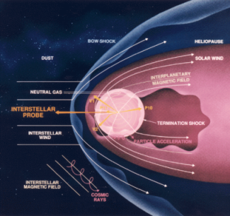
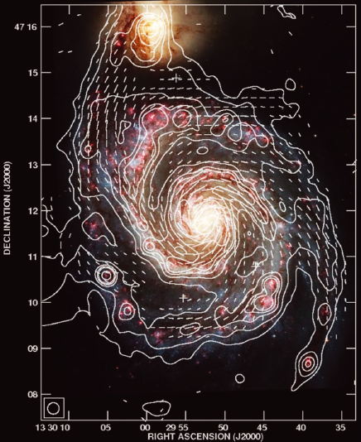
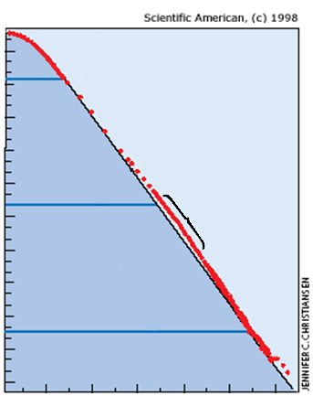
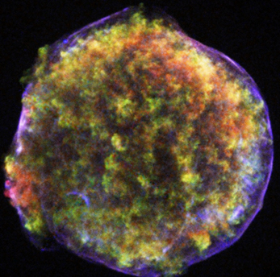
Collisionless shocks are ubiquitous in astrophysics and are believed to be responsible for many astrophysical phenomenon
(Presura, Kugland, Spitkovsky, Li, Grosskopf, Fiuza, Davis, Ryutov, Plechaty, Sakawa, Park, Hsu…)
Generate and Amplify magnetic fields
Accelerate particles
Solar
SNR1572 Tycho
1 Particle/m²/s
Particle Flux
knee
1 Particle/m²/yr
GRB
B-field vectors and optical image (Hubble) of M51
1 Particle/km²/yr
Fletcher, MNRAS, 2011
10¹⁰ 10¹² 10¹⁶ 10²⁰
E (eV)
Laser driven experiments can study microphysics of high mach number plasma flow interactions and collisionless shock formation

Slide 4
Questions about the collisionless shocks
Can the collsionless shocks be generated without pre-imposed magnetic fields?
Can the collisionless shocks create the self-generated magnetic fields?
  If so, how strong is the magnetic field?
  What is the characteristic spatial scale?
Under what conditions are collisionless shocks created?
  Plasma kinematics
How do collisionless shocks accelerate particles?
How can we create such condition in a laser experiment?

Slide 5
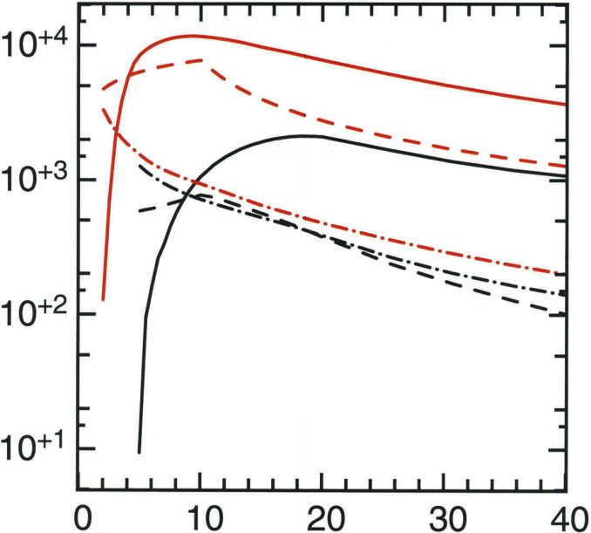
Collisionless shocks occur when the Coulomb mean free path is much larger than the characteristic shock width
Laser driven targets can generate high velocity plasma flows
The conditions for generating a collision shock require:
l* << l_{int} <<λ_{mfp}
Red = 10¹⁵ W/cm²
Black = 10¹³ W/cm²
L
α
l_{int}
n_{C}(10¹⁶ cm⁻³)
vel (x10² m/s)
T_{e} (eV)
l*, characteristic (electrostatic or electromagnetic) instability length
l_{int} intersection zone length
λ_{mfp}, Coulomb mean free path
Time (ns)
λ_{mfp}(cm)
l*(cm)
λ_{mfp}(cm), l*(cm)
(D. Ryutov, 2010)
Time (ns)
Notes:
Electrostatic is from

Slide 6
Our experiments are to study processes / microphysics of collisionless shocks
Required laboratory experimental measurements are:
  Plasma state (V, Ne, Ni, Te, Ti)
  Shock imaging (schlieren)
  Magnetic field measurements (Proton radiography, Bdot probe, Zeeman)
Several campaigns are on-going and planned
  Omega: measure plasma state using Thomson scattering diagnostic (Ross, PoP 2012, Park, HEDP, 2012)
  EP: proton radiography for field measurement (Kugland, RSI, 2012)
  Joint: magnetized shocks (Spitkovsky)
  Titan/LULI/Vulcan/Gekko: forerunner physics and diagnostic development (Gregori, Presura, Koenig, Sakawa)
  NIF: True astrophysical scaled experiments
The goals are to understand interpenetrating plasma condition and detect self generated magnetic fields
Notes:
Note that the positions of the peak is mainly determined by the ion temperature, while Te determines the intensity of the valley near the central wavelength. The laser wavelength is 266 nm, with 0.1 nm instrument width. The scattering angle (156.5 deg) corresponds to the current design for NIF (I got this number from Siegfried).
It seems that TS would be very useful to determine the plasma properties.

Slide 7
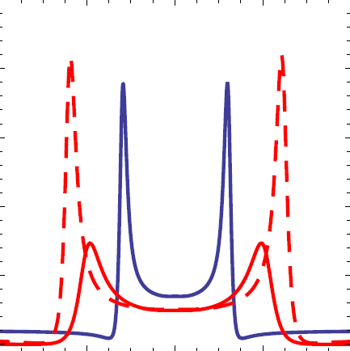
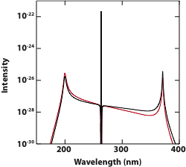
Thomson scattering measurements allow the plasma parameters to be determined
Thomson scattering is the scattering of an electromagnetic wave by electrons.
Intensity and magnitude of shifted signal measures plasma state
Optical Laser
0.5
Ε_{S}
0.4
Plasma wave
0.3
Scatter intensity (arb. units)
λ_{D}
0.2
0.1
0
262
264
266
268
270
Ion Feature
Wavelength (nm)
T_{i}, Z, V
n_{e}=10²⁰ cm⁻³; T_{e}=2000 eV; T_{i}=500 eV
n_{e}=5x10²⁰ cm⁻³; T_{e}=6000 eV; T_{i}=2000 eV
n_{e}=5x10²⁰ cm⁻³; T_{e}=2000 eV; T_{i}=2000 eV
T_{e}, n_{e}
Ross, 2010, RSI; Froula, 2006, RSI; Glenzer, 2009, RMP
Collective TS ( ) is where light is scattered from electron-plasma fluctuations.
Scattered spectrum reveals electron features
Electron Feature
Notes:
Scattering cross section contains contribution from both i-I and e-e correlations
Ion-ion correlations: scattering as a function of the scttering angle exhibits peaks that are representative of the structure (diffraction)
E-e single particle dynamics or coorelated pasmons
S(k,w) is the spectral density function
G(k,w) is the geometrical factor
In the high-frequency regime pi, the transition to
collective scattering is characterized by =1. When 1,
light is scattered from electron-plasma fluctuations with a
wavelength longer than the Debye length and the scattering
spectrum reveals the corresponding “electron feature.” For
1, light is scattered from electrons inside the Debye
sphere and the scattering spectrum resembles the electron
distribution function.
Pi is the incident power
A is the cross sectional area of the TS volumn
R0 is the classical electron radius
Ne is electron density
S(k,w) is the spectral density function
G(k,w) is the geometrical factor

Slide 8
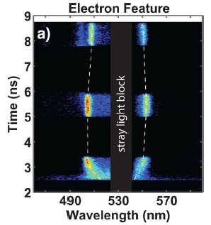
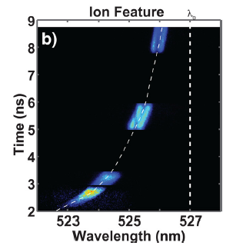
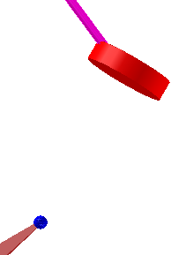
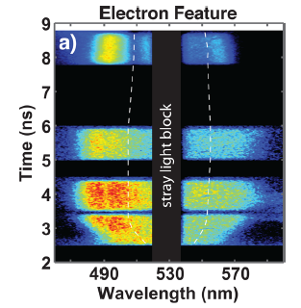
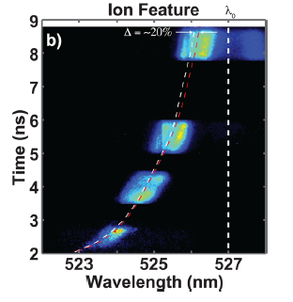
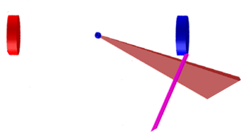
We began our OMEGA preparation experiments by studying the plasma conditions of single and double flows
Single foil configuration
Heater Beams
k_{a}
4 mm
TS volume
10 Heater beams per foil (~5 kJ per target)
Double foil configuration
Thomson Volume
CH Foil
4 mm
CH Foil
2ω Probe Beam

Slide 9
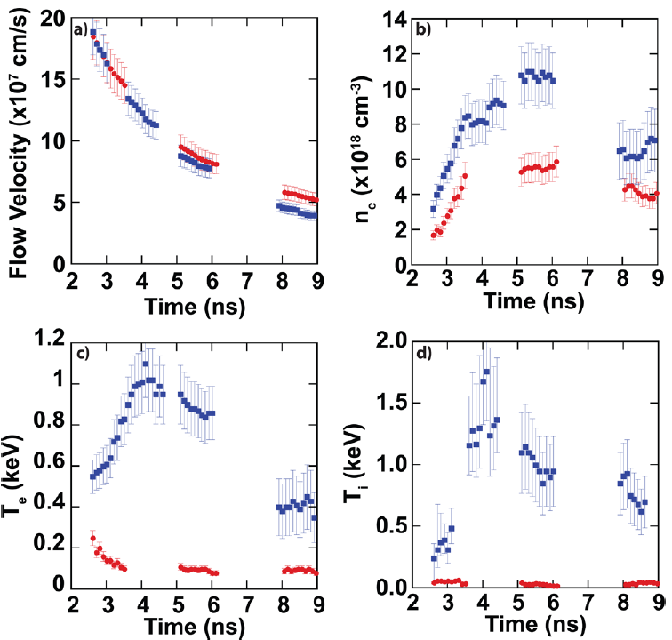
Omega experimental results show the first quantitative measurements of high-velocity plasma flows
Single foil
Double foil
Ross, PoP, 2012

Slide 10
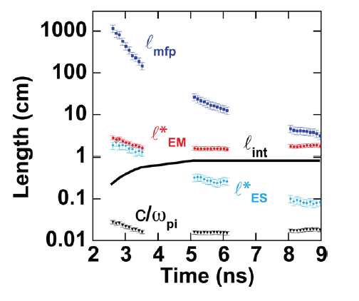
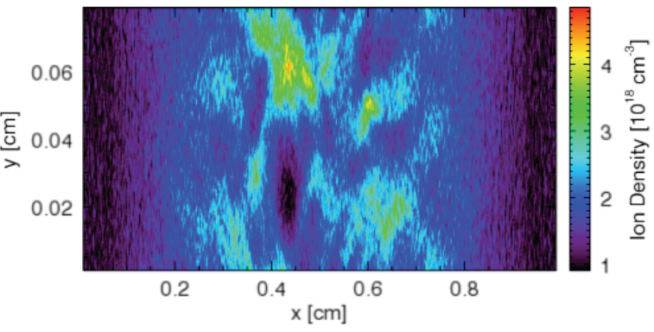
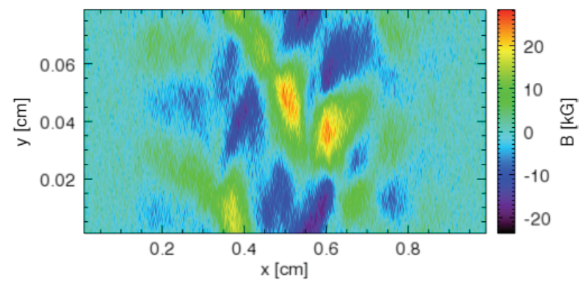
Our Omega experimental data indicate that we can create electrostatic collisionless shocks
l* << l_{int} <<λ_{mfp}
PIC simulation suggests that the shock was beginning to from but not fully developed
Ion density
Magnetic field
Fully formed shock require ~10x more ion density

Slide 11
Double flow data show large increase in electron and ion temperatures
Measured Te from double foil
Measured Ti from double foil
Ion-electron
scattering
No H_{ion}-C_{ion} energy transfer
Double foil
H_{ion}-C_{ion} energy transfer
Single foil
Ross, PoP, 2012
Ion slowing-down drag force by ‘resting’ electron gas explains the Te increase at early time.
Ion kinetic energy converting into thermal energy via C-C ions scattering may explain Ti increase.
(Intrajet collision mfp=3 um for Te=1keV, Ti=1 keV, Ryutov)
We will need to consider these effects on collisionless shock forming plasmas
(consider collisions in collisionless shocks)

Slide 12

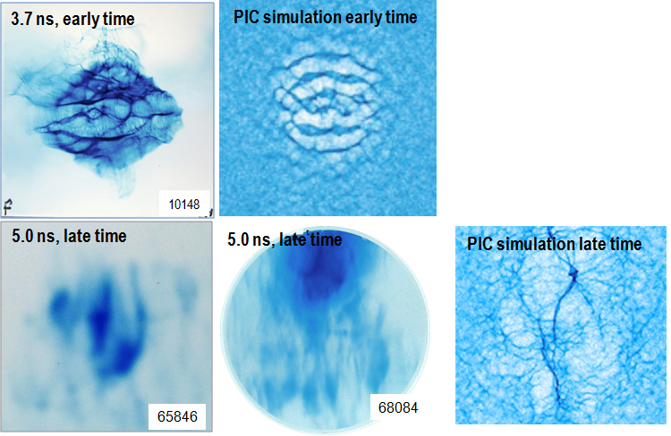
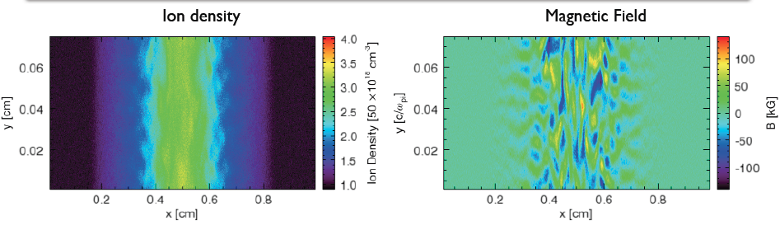
Measuring self-generated magnetic field is more challenging: we are exploring many possibilities
PIC simulation of collisionless shocks
Proton probe (Kugland, Spitkovsky, Monday)
2.0
1.5
Ion density (x10²⁰ cm⁻³)
1.0
0.5
Omega data show some filamentary structures at late times
100
50
B (kG)
We are also studying
0
-50
Faraday Rotation
-100
Zeeman Splitting (Presura, Monday)
Bdot Probe (Gregori)
(Spitkovsky)

Slide 13
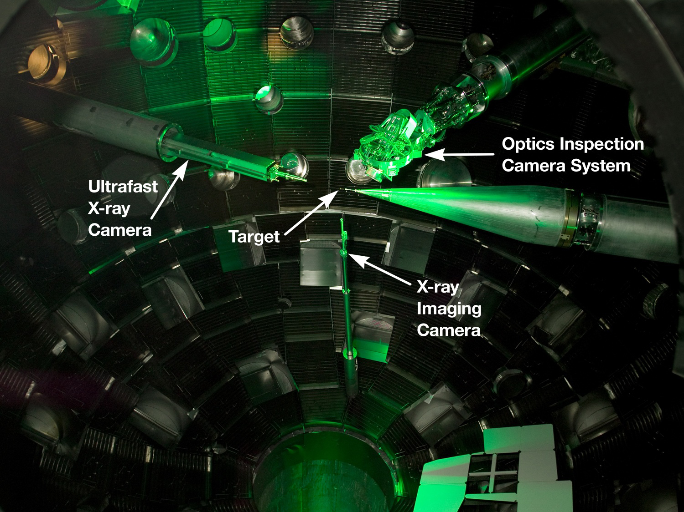
NIF
192 beams
1.8 MJ (1.2 MJ, 12/05/09)
500 TW (300 TW, 12/05/09)

Slide 14
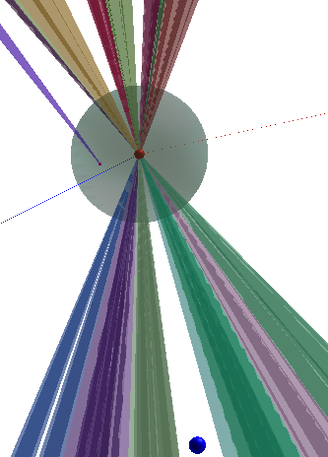
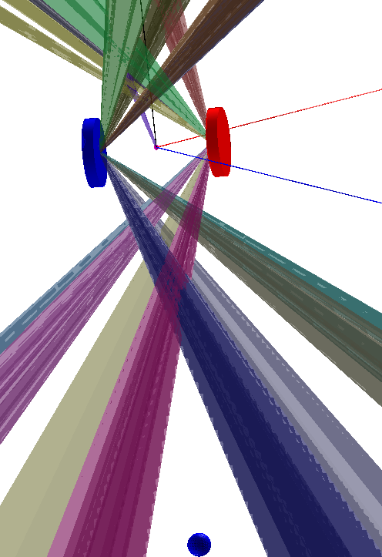
Two configurations are proposed for
NIF experiments
Counter-streaming plasma
flow experiment
Expanding plasma flow into
gas-filled chamber
Thomson Scattering
Polar DIM
RCF or CR39
NIF chamber filled with He gas at P~1e-4 atm
DIM90-78
GXD
DIM90-78
GXD
CH disks, 3 mm dia, 1 mm thick
DIM90-315
Optical diagnostics
DIM90-315
Optical diagnostics
600 μm dia micro sphere foam target
(Sakawa)
(Gregori)
Proton source either by DHe3 capsule or ARC
Proton source either by DHe3 capsule or ARC
200 kJ to 800 kJ laser energies with 5−20 ns pulse width will be used
Necessary diagnostics will be implemented

Slide 15
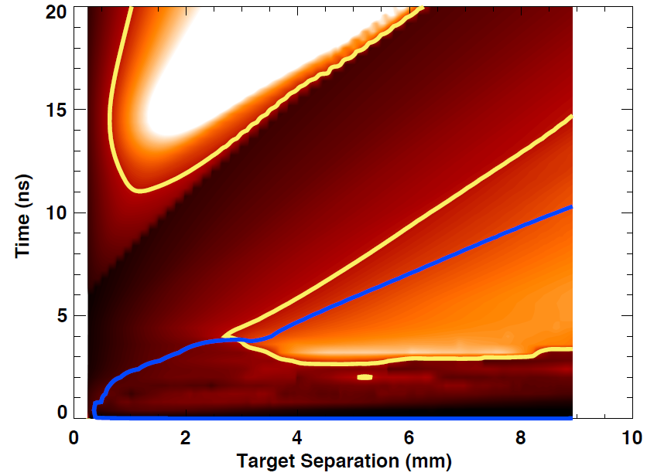
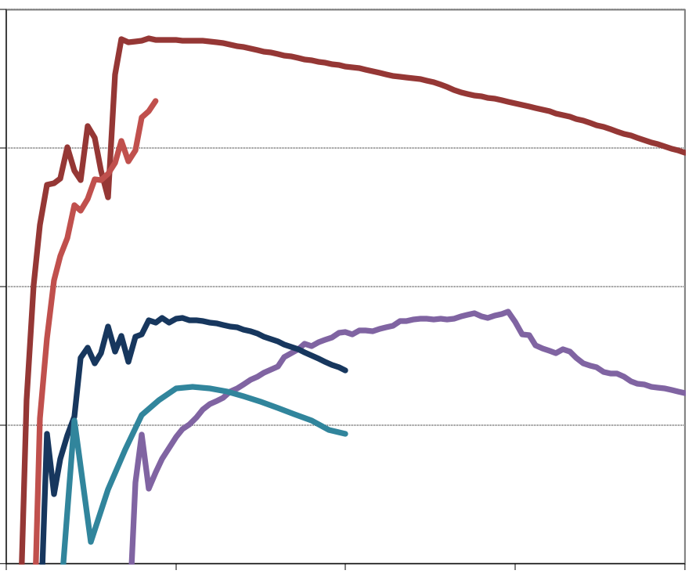
Simulations with the NIF laser conditions show much higher temperature and density flow
l* << l_{int} <<λ_{mfp}
NIF 500 kJ/target, 1ns case
Electron density
10²¹
500 kJ, 1ns, NIF
300 ion skin depth contour
500 kJ, 10ns, NIF
10²⁰
Ne (cm⁻³)
Omega, Titan
300 ion skin depth contour
10¹⁹
5 kJ, 1ns
0.5 kJ, 10ns
λ_{mfp}> 3 l_{int}
0.5 kJ, 1ns
10¹⁸
10¹⁷
0 5 10 15 20
Time (ns)
(M. Grosskopf, using CRASH code)
We are continuing optimizing NIF experimental condition.
NIF collisionless shock experiments will be performed FY13-15.

Slide 16
Summary and future work
Detection of self-generated electromagnetic fields from Weibel instability will be a break-through in laboratory astrophysics and may provide a generation mechanism of the seed magnetic fields in universe
Omega experiments measure quantitative plasma conditions for optimizing collisionless shock creation
Omega experiments suggests the existence of previously unknown mechanisms for electric and/or magnetic field generation in the counterstreaming plasma flows
We are continuing in our Omega and EP experiments to study collisionless shock formation under pre-existing magnetic fields as well as theory and experimental optimization
NIF experiments will begin when the required diagnostics are constructed
NIF experiments will lead to a truly scaled collisionless shock laboratory astrophysics experiment

Slide 18
Thomson scattering measured great data for each target material for a series of probe beam times
Be Target
1 ns Probe Length
60 J Probe Energy
Carbon Target
1 ns Probe Length
60 J Probe Energy
65753
65750
65747
65749
65744
65755
65754
Full analysis to determine n_{e} and T_{e} in progress

Slide 19
Thomson scattering from the ion feature is used to determine flow velocity and ion temperature
Be Target
1 ns Probe Length
60 J Probe Energy
Carbon Target
1 ns Probe Length
60 J Probe Energy
65753
65747
65750
65749
65744
65754
Full analysis to determine v and T_{i} in progress

Slide 20
The Gated Optical Imager (GOI) provided excellent images of the expanding plasma
CH₂ Target
20 ns Gate Delay
2 ns Gate Length
Pure Carbon Target
20 ns Gate Delay
2 ns Gate Length
Beryllium also measured for a series of times

Slide 21
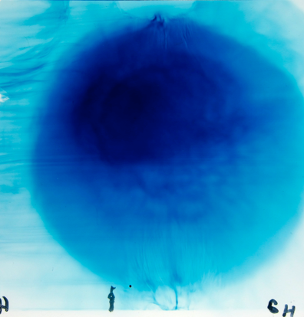
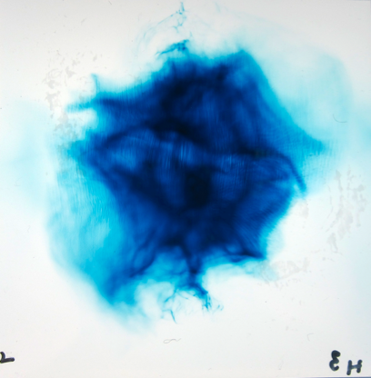
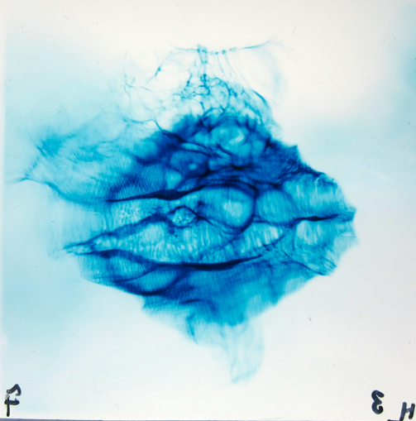
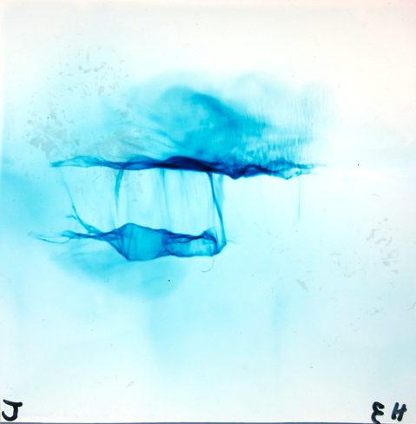
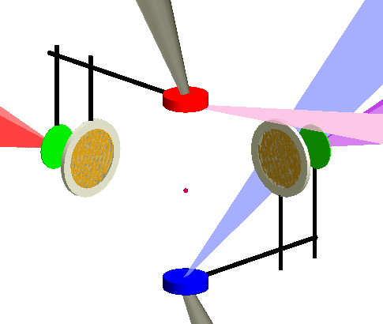
We use proton radiography / deflectometry to image shock formation and to measure magnetic fields
0.5 ns
2.2 ns
3.7 ns
5.2 ns
CH₂ Plasma
8 mm
CH₂ Plasma
10149
10151
10148
10150
EP experiment on Aug 30, 2011
Proton radiography time sequence shows eventual self-organization of the counterstreaming plasmas
Large bubble features may be from laser ablative RT instability growth or MHD instability
Planar features from electron temperature gradient
Striation features may be from electrostatic field generation
EP UV
EP SP
EP UV, 2kJ
EP SP
protons
protons

