Slide 2
DivSNRT Team
Tomasz Plewa (PI, FSU)
Hye-Sook Park (liaison scientist, LLNL)
Paul Keiter (lead experimenter, UM)
Markus Flaig (lead designer, UM/FSU)
Paul Drake (experimenter, UM)
Mike Grosskopf (designer, UM)
Tim Handy (designer, SN hydro, FSU grad)
Konstantinos Kifonidis (designer, SN hydro mixing)
Carolyn Kuranz (experimenter, UM)
Aaron Miles (designer, LLNL)
Frank Modica (designer, multiphysics RT, FSU grad)
Kumar Raman (designer, LLNL)
Bruce Remington (experimenter, LLNL)

Slide 3
Purpose
DivSNRT experiment is designed to study and reproduce by means of a well-scaled experimental design the extensive mixing observed in the exploding massive stars.
DivSNRT experiment will probe fundamental physics of
  inter-shell penetration outwards to surface via turbulent mixing;
  shell breakouts;
  growth of secondary instabilities;
  vorticity-enhanced mixing.

Slide 4
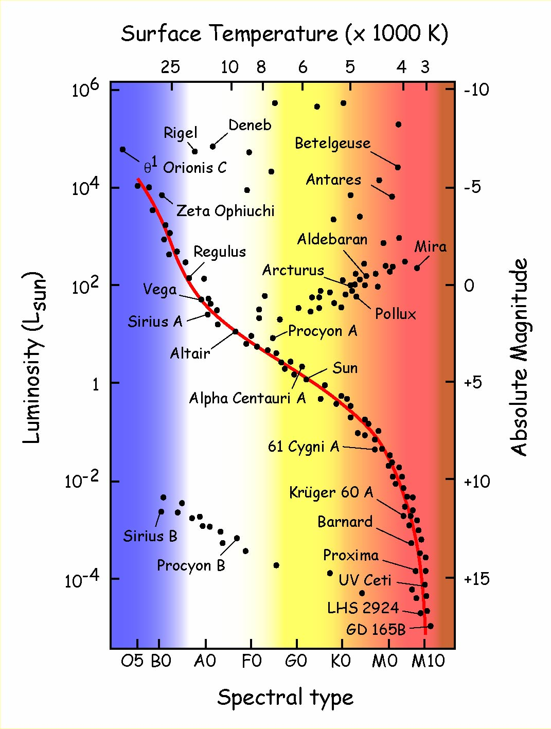
Our Stellar Neighbours
Type II
Massive
Single
H-rich
Type Ia
Medium mass
Binary
H/He-free
White Dwarfs
m < 1.4 Msun
Brown Dwarfs
m > 0.075 Msun

Slide 5


Slide 6
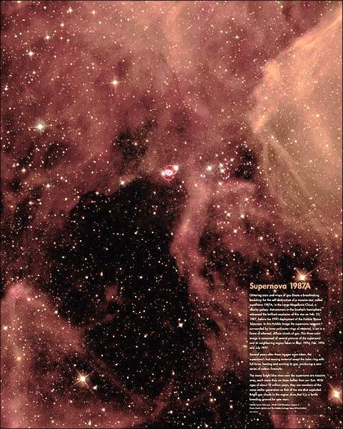
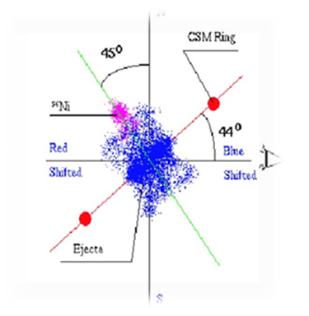

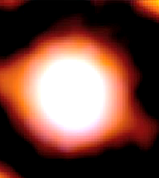

Slide 7
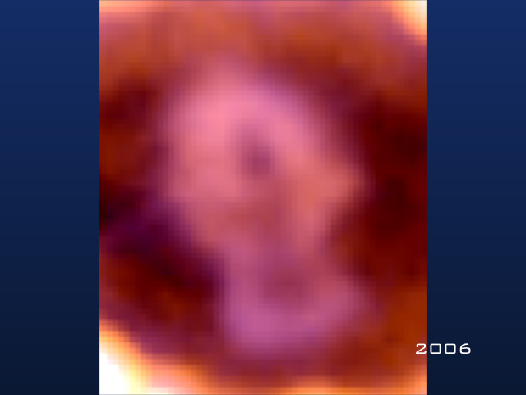
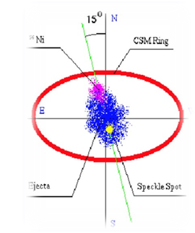

Slide 8
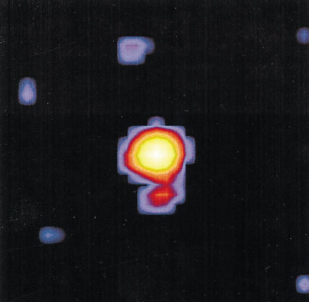
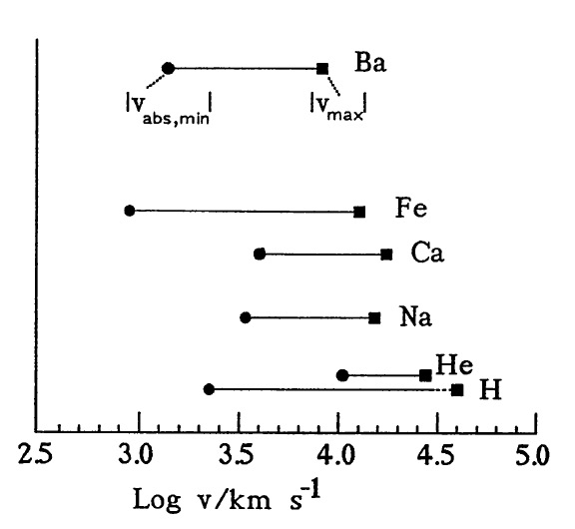

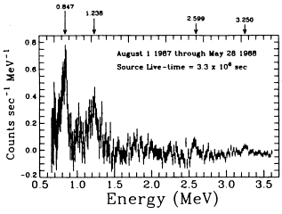
Observational Evidence of Mixing
speckle interferometry (imaging)
ejecta tomography (spectroscopy)
Niesenson & Papaliolios (1999)
Hanuschik et al. (1991)
Wang et al. (2002)
gamma rays (spectroscopy)
Leising & Share (1990)

Slide 9
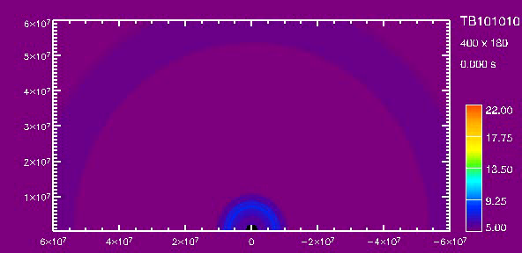
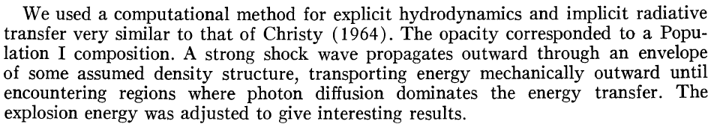
Core-Collapse SN Explosion Theory
Massive stars
Gravity bombs
Energy extracted by neutrinos
Accretion shock originally too weak
Revived by neutrino heating of the post-shock matter
Once the shock is launched…
Falk & Arnett (1973)

Slide 10
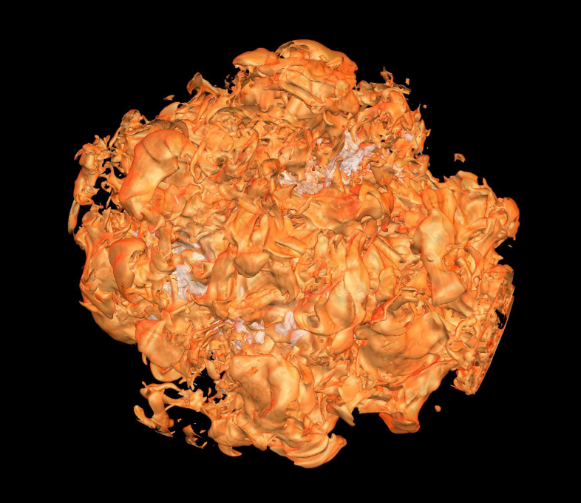
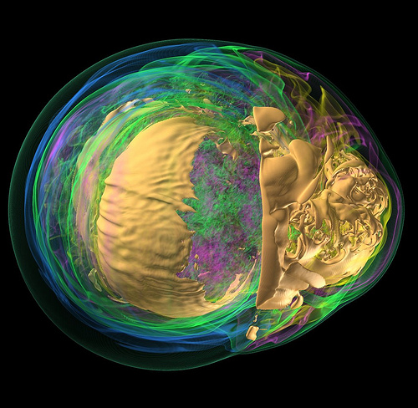
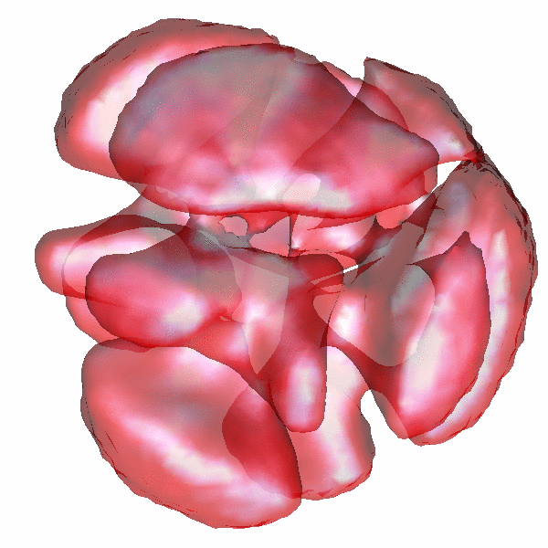
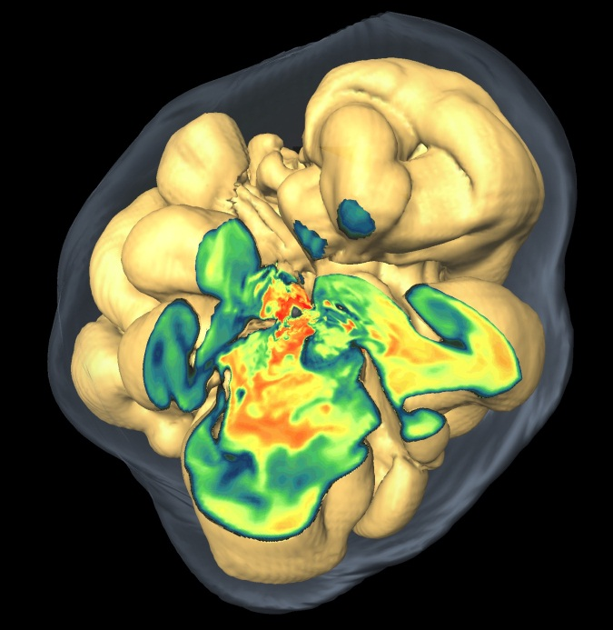
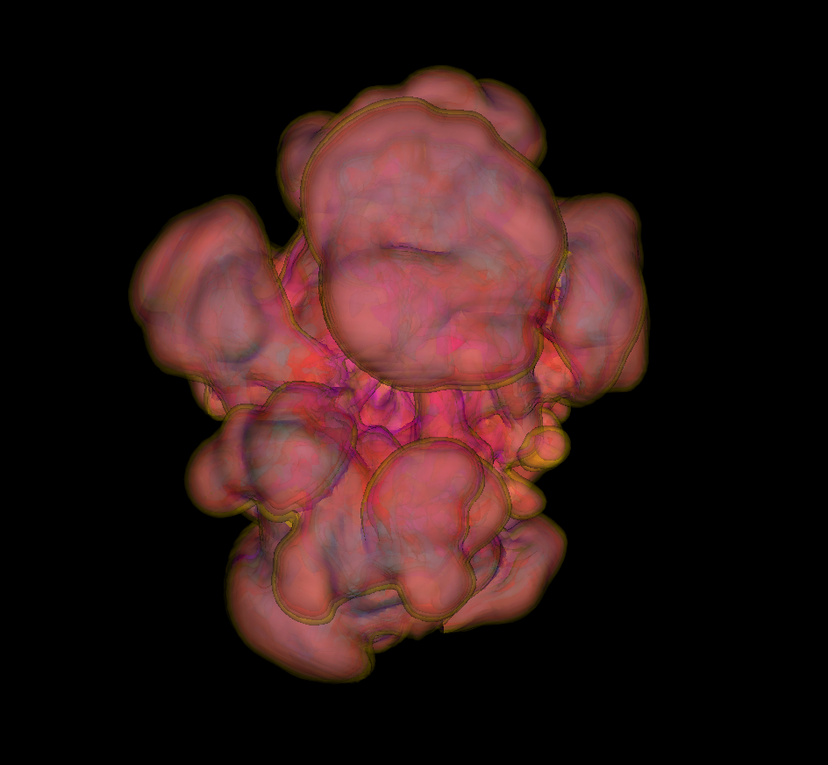
ccSN Shock Revival in 3D
Princeton
ORNL
LANL
FSU
MPA

Slide 11
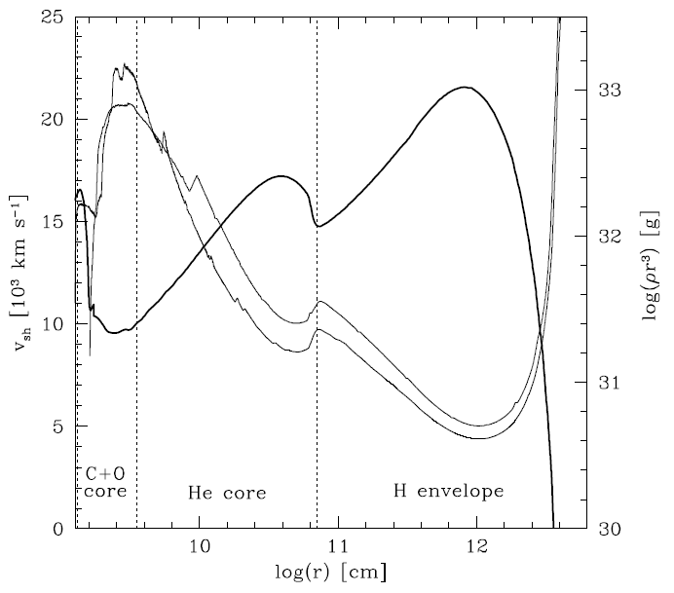
Origins of the ccSN RT Mixing
Time-dependent deceleration of dense layers due to unsteady supernova shock motion though the progenitor envelope
m(r)
v_{sh}(1D)
v_{sh}(2D)
Gawryszczak et al. (2010)

Slide 12
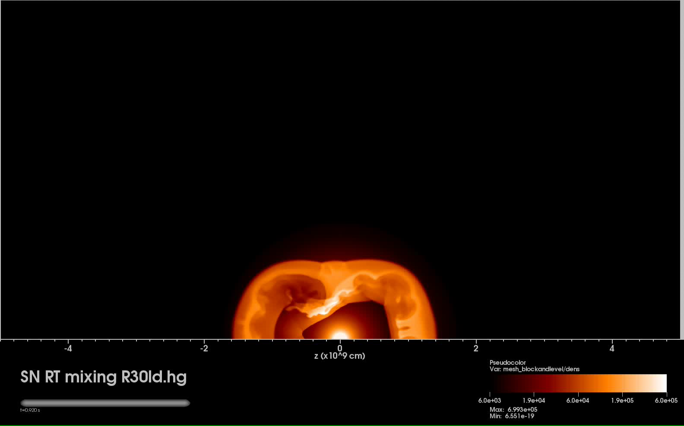
NIF DivSNRT: ccSN shock-envelope

Slide 13
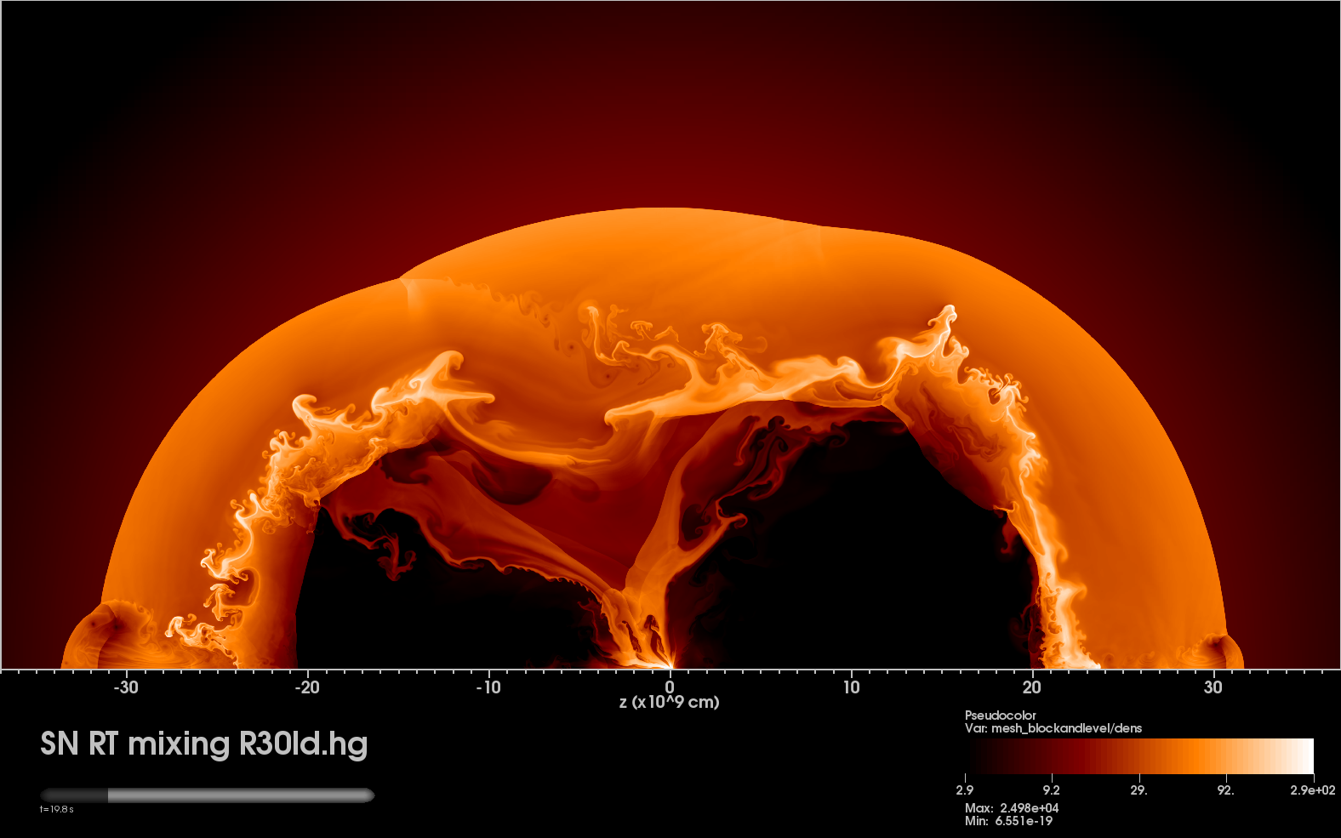
Complex Post-Explosion ccSN Dynamics
Triple Point
Kelvin-Helmholtz
Leading Shock Front
Triple Point
Rayleigh-Taylor
Rayleigh-Taylor
Reverse Shock
Reverse Shock
Kelvin-Helmholtz
Fallback

Slide 14
HED Connection to Supernovae
Initially motivated by SN 1987A
Theoretical foundations provided by HED scaling laws (D. Rytuov and collaborators)
Research directions
  SASI: ccSN explosion
  DivSNRT: ccSN post-explosion RT mixing
  RT: the Braginskii model
Handy et al. (HEDP, 2012)
this talk
Frank Modica’s Poster #29

Slide 15
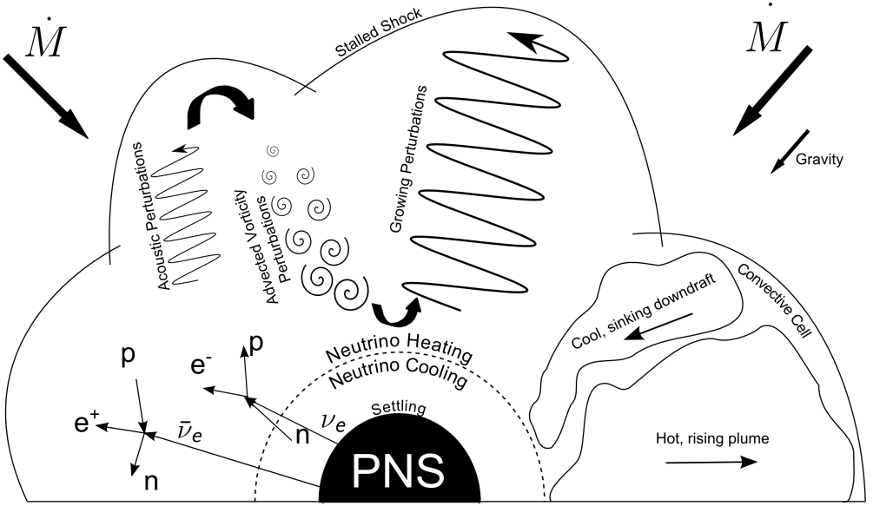
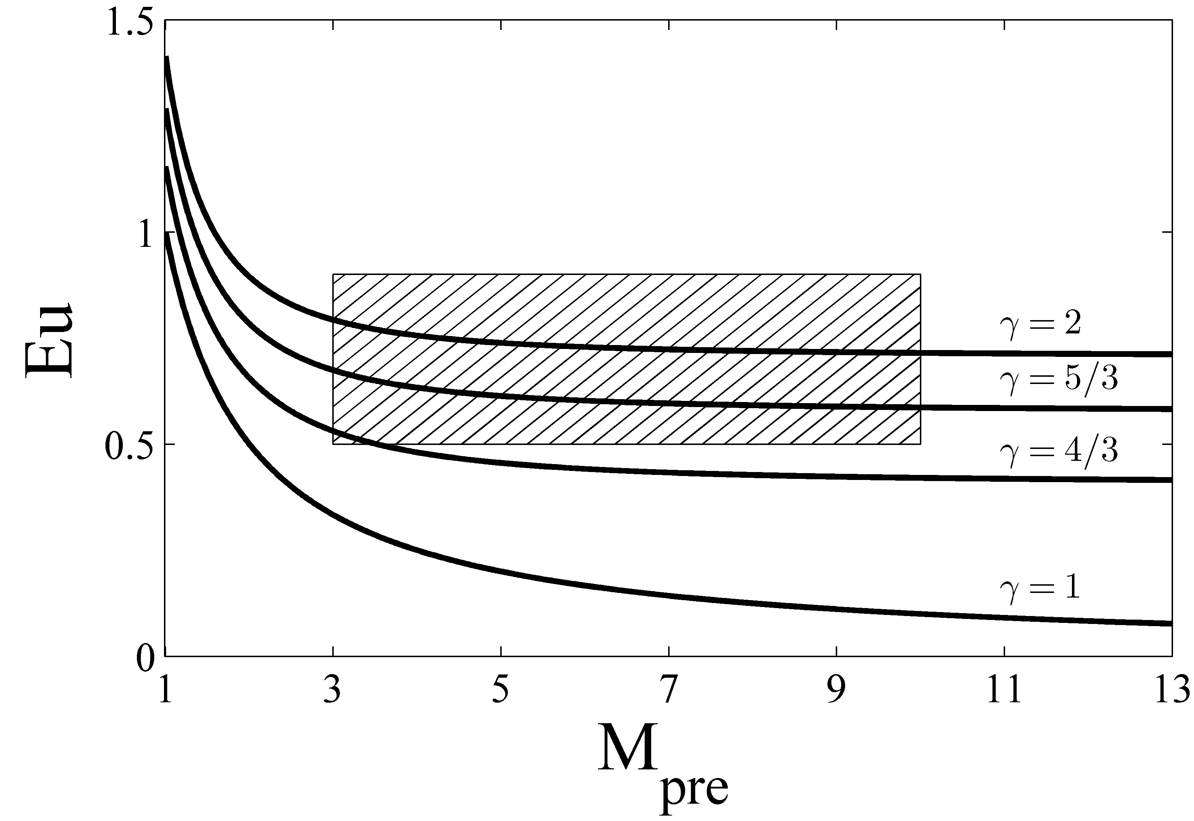
NIF SASI Study
Handy et al. (2012)
HED/SN scaling
experimentally
feasible region

Slide 16
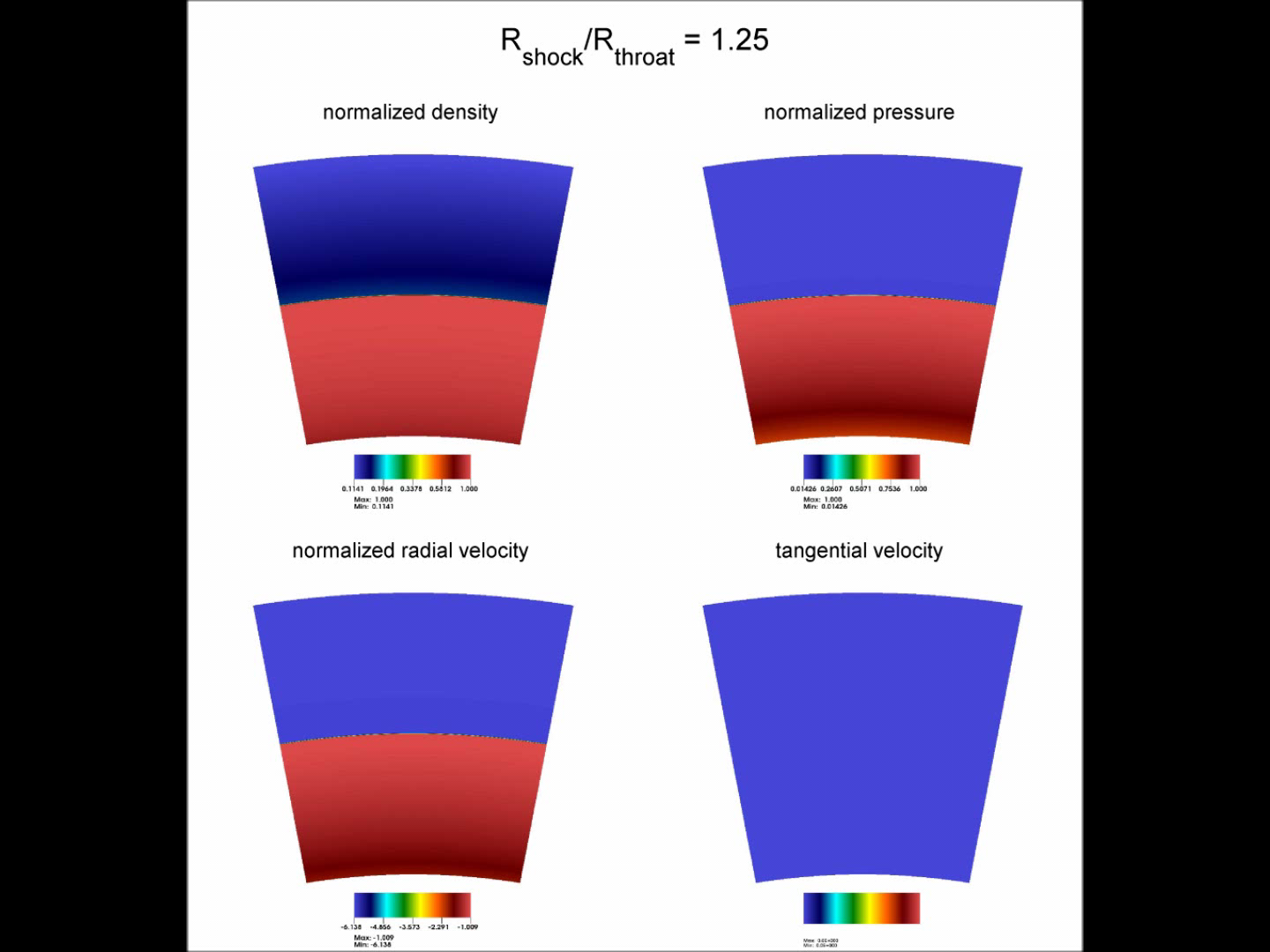
NIF SASI Study
Handy et al. (2012)
large amount of a highly stable, shocked HED plasma

Slide 17
Past HED ccSNRT Mixing Studies
Motivated by SN 1987A
Theoretical foundations provided by HED scaling laws (D. Rytuov and collaborators)
Most work devoted to planar, two-layer targets (classic RT configuration)
But SN are largely spherical… => spherical targets and diverging flow configurations, or DivSNRT
Much more mass involved than in the planar case, thus requiring much more energy to drive
Early attempts on Omega (Drake et al.) unsuccessful (shell breakup) => NIF!

Slide 18
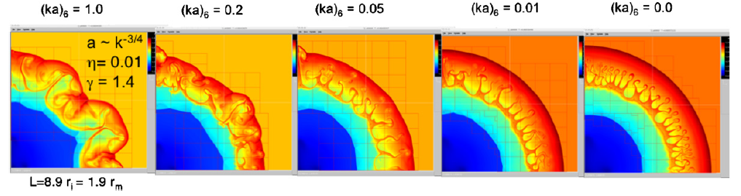
Theory for ccSNRT Target Design
Aaron Miles (2009) analysis of the blast wave instability problem provides analytic framework for target design
The model combines drag-buoyancy, bubble merger, and assumes (quasi) self-similarity to account for the flow divergence and compressibility effects
Demonstrates that the memory of the explosion is generally preserved by the system unless modes are very high (higher than considered typical in ccSN)
High-amplitude perturbations favor RM over RT, at least at early times, resulting in the shock proximity to growing spikes (if (ka₀) > 1/3 for adiabatic index 5/3; if (ka₀) > 0.2 for index 4/3).

Slide 19
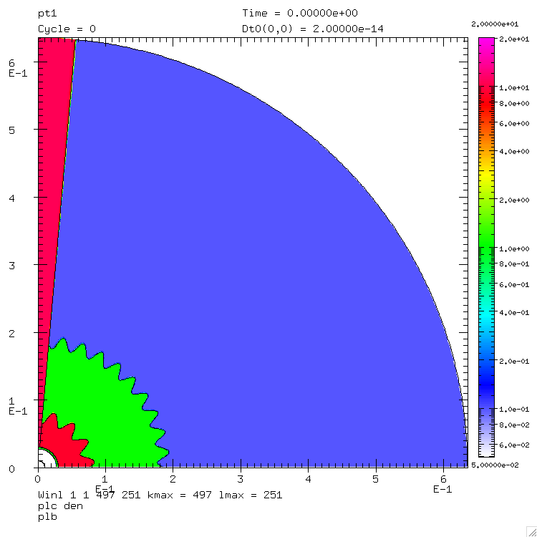
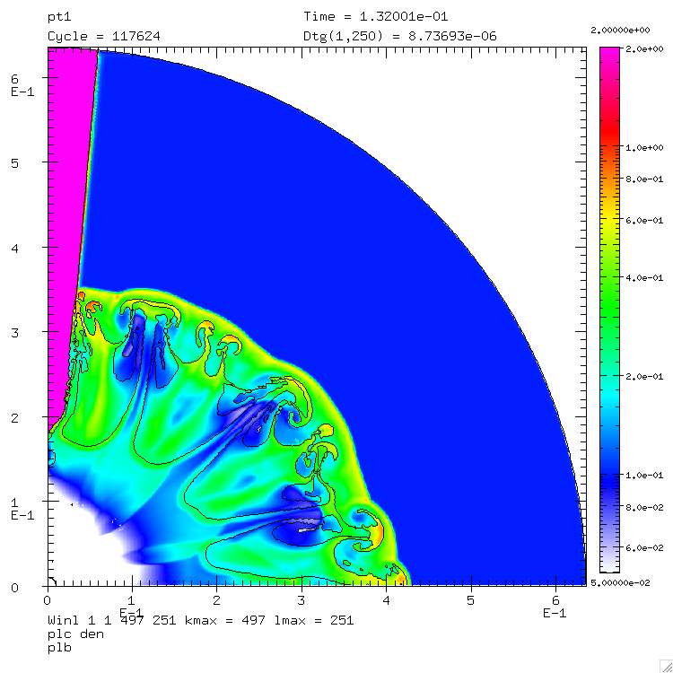
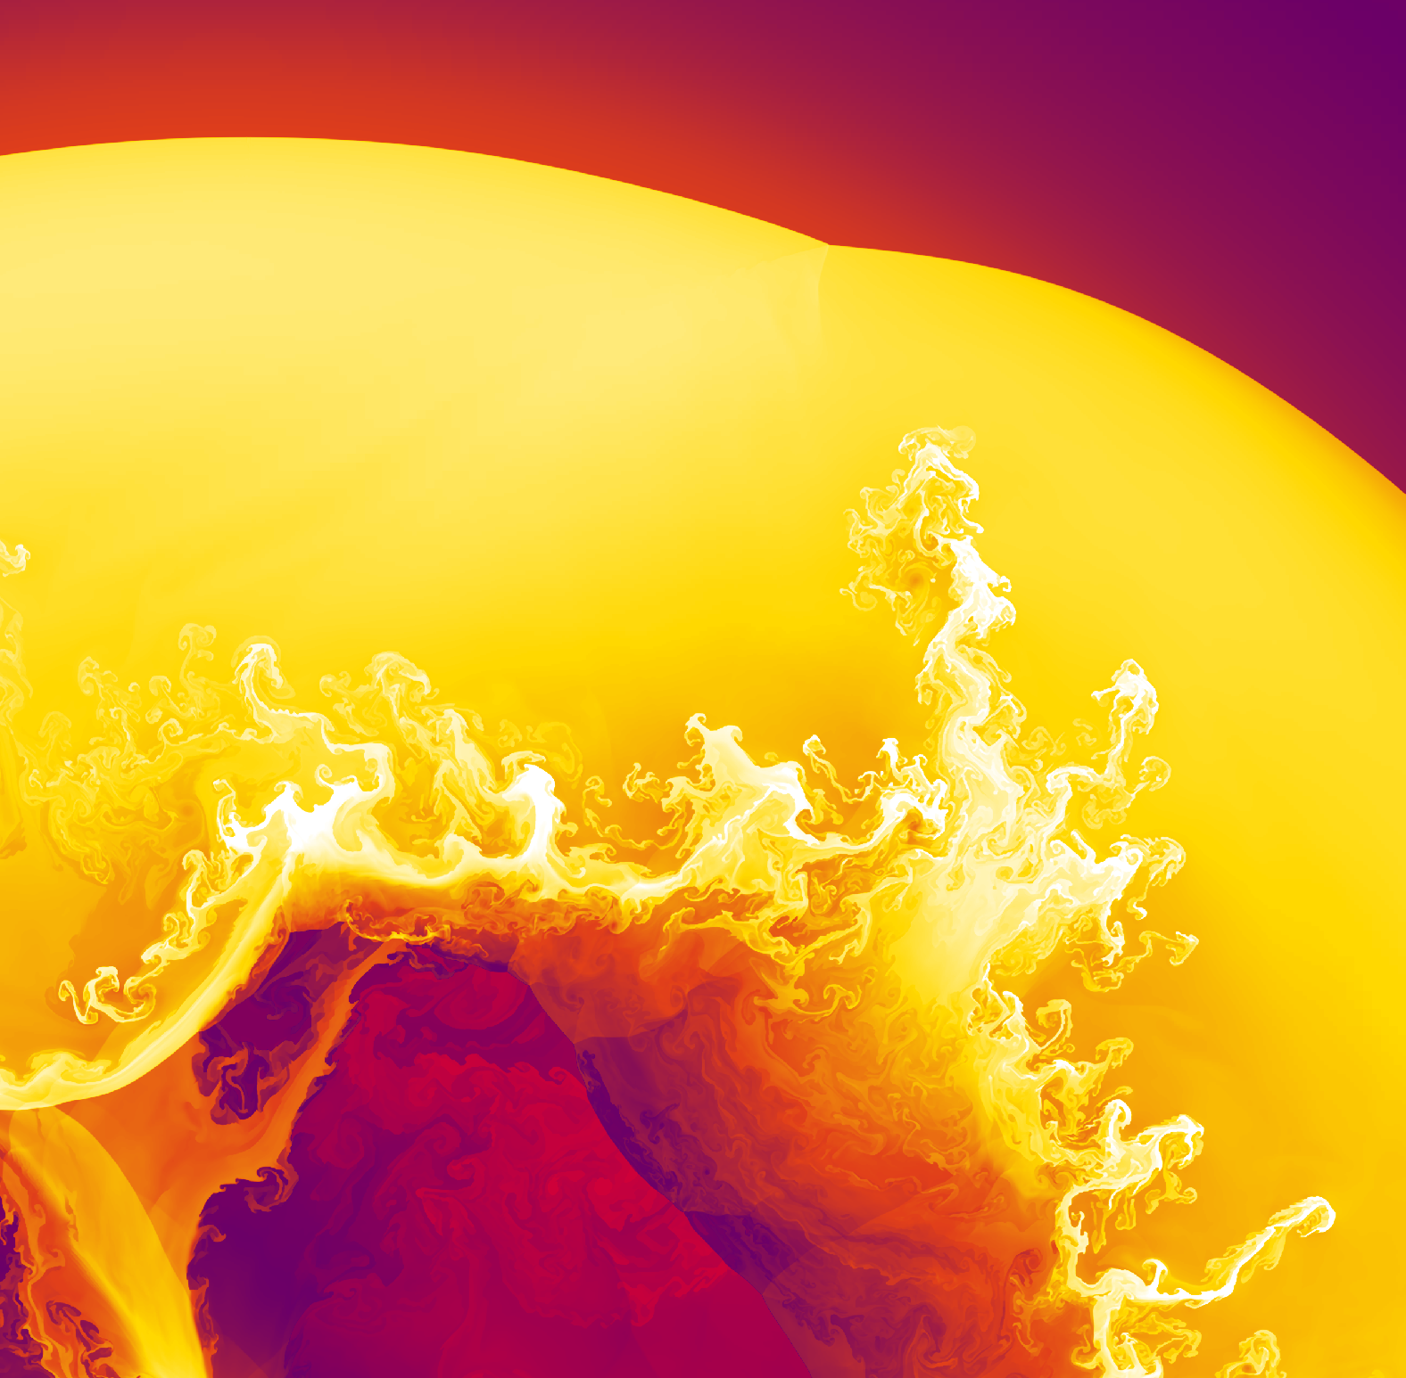

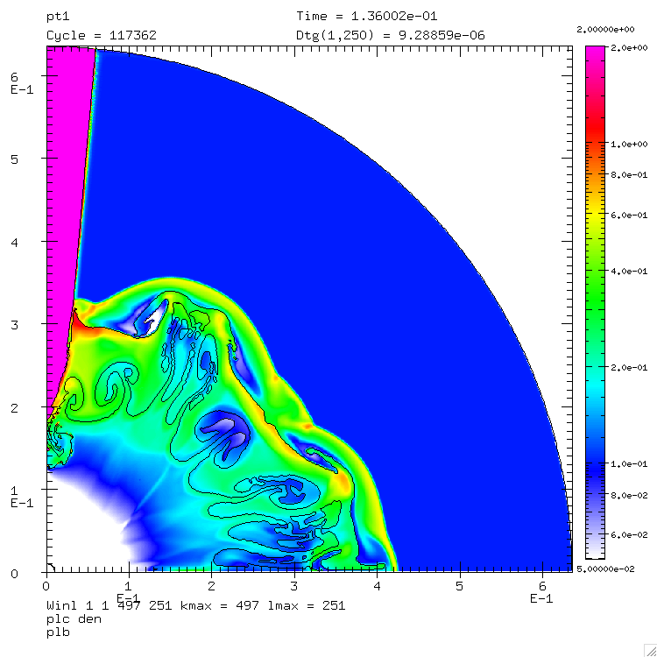
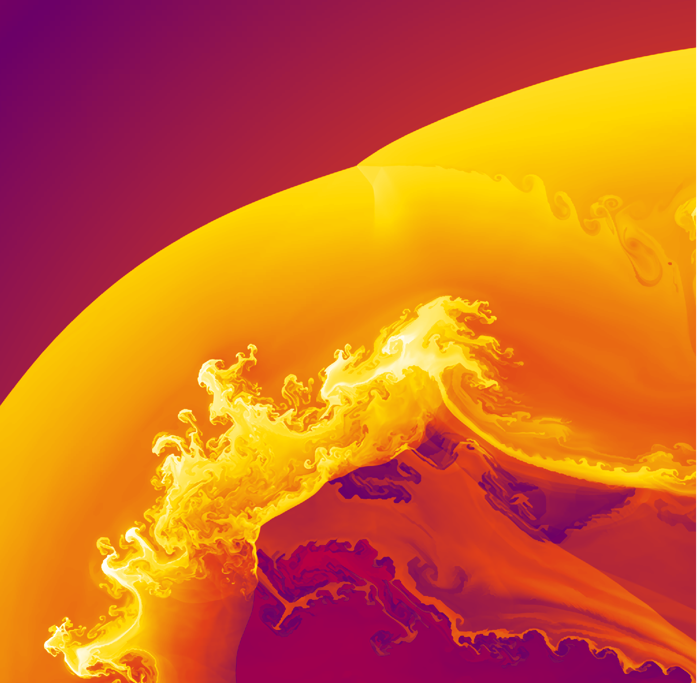
CALE Designs vs SN Model
inn: k=4,ka₀=2
out: k=10, ka₀=2
inn: k=10,ka₀=1
out: k=2, ka₀=2

Slide 20
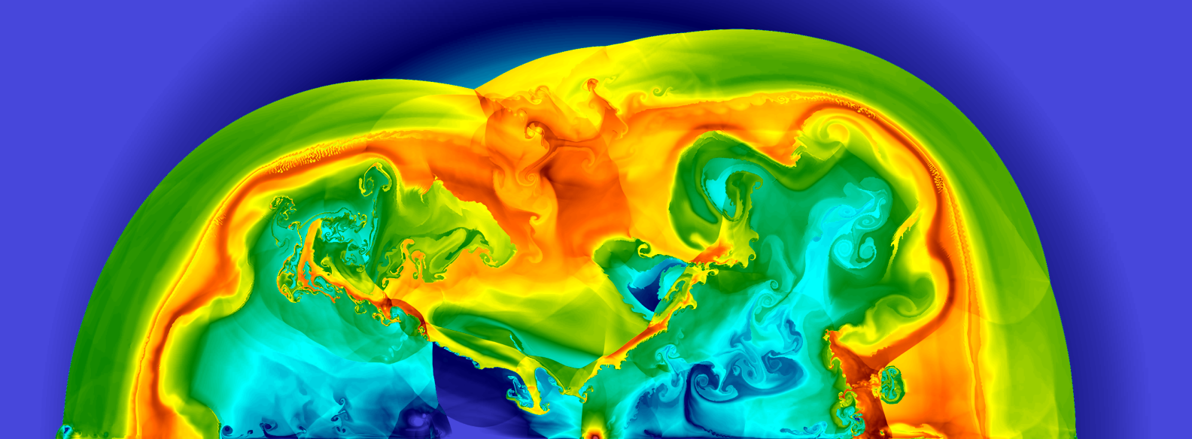
CALE Designs vs SN Model

Slide 21
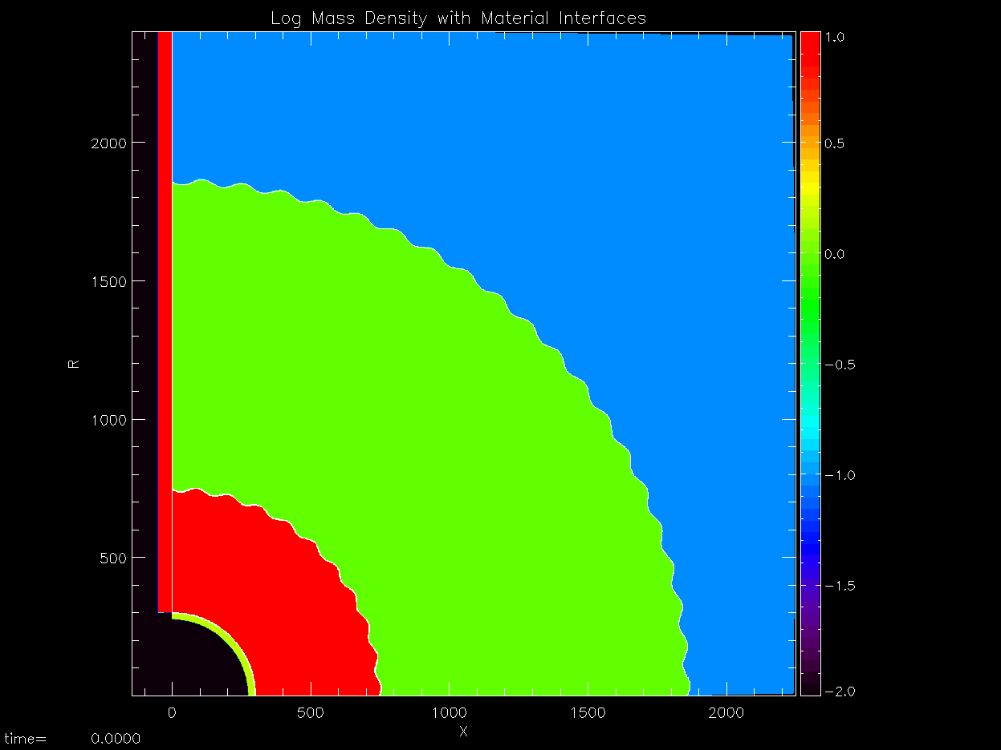
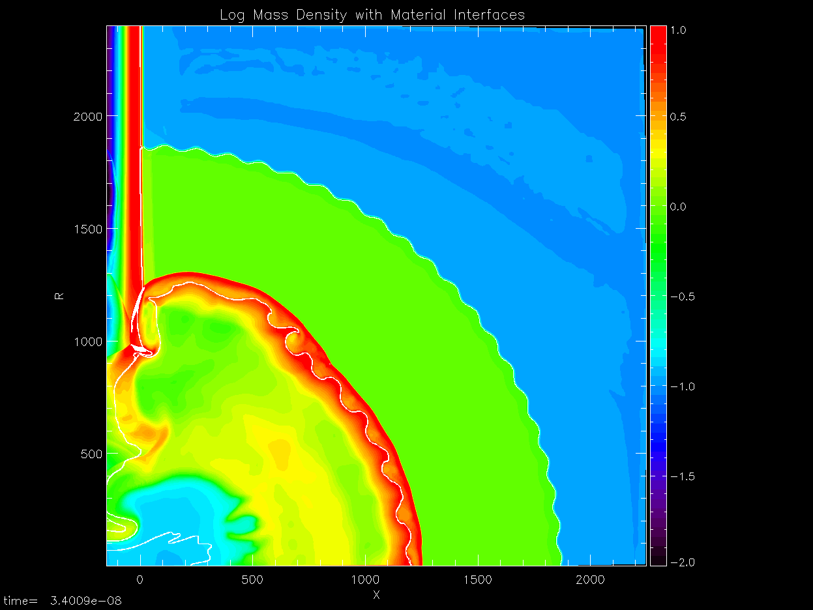
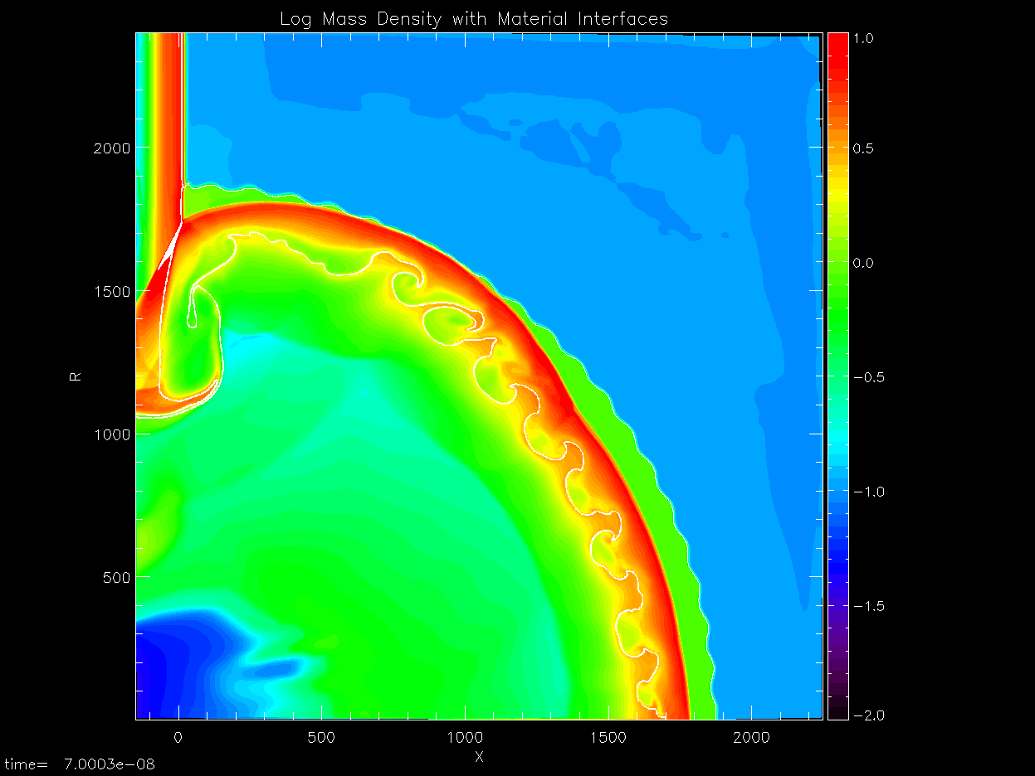
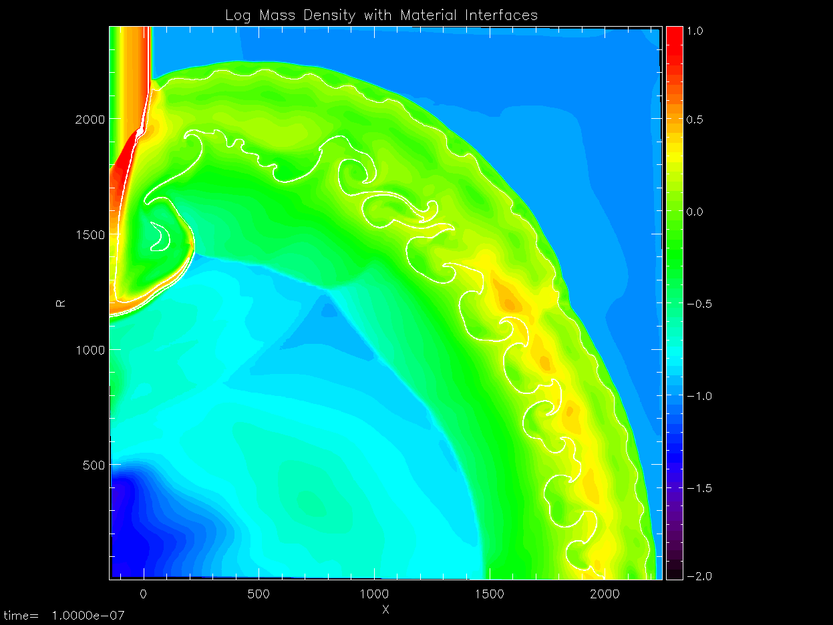
CRASH DivSNRT Model
by Mike Grosskopf
0 ns
34 ns
70 ns
100 ns

Slide 22
Surprises from HED RT Experiments
Smooth spike morphology
Spike mass extensions
Density profile analysis
Kuranz et al. (2009)

Slide 23
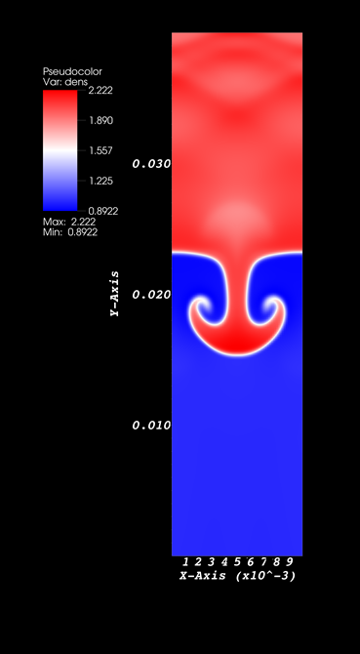
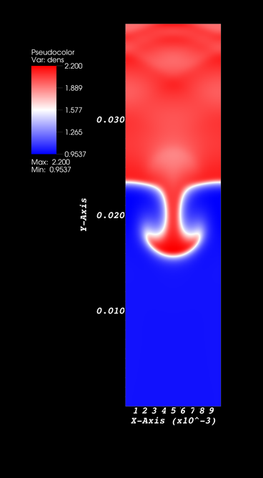
Extended Physics RT Model
Single mode RT
Generalized Ohm’s law with the Braginskii coefficients (see Frank Modica’s Poster #29)

Slide 24
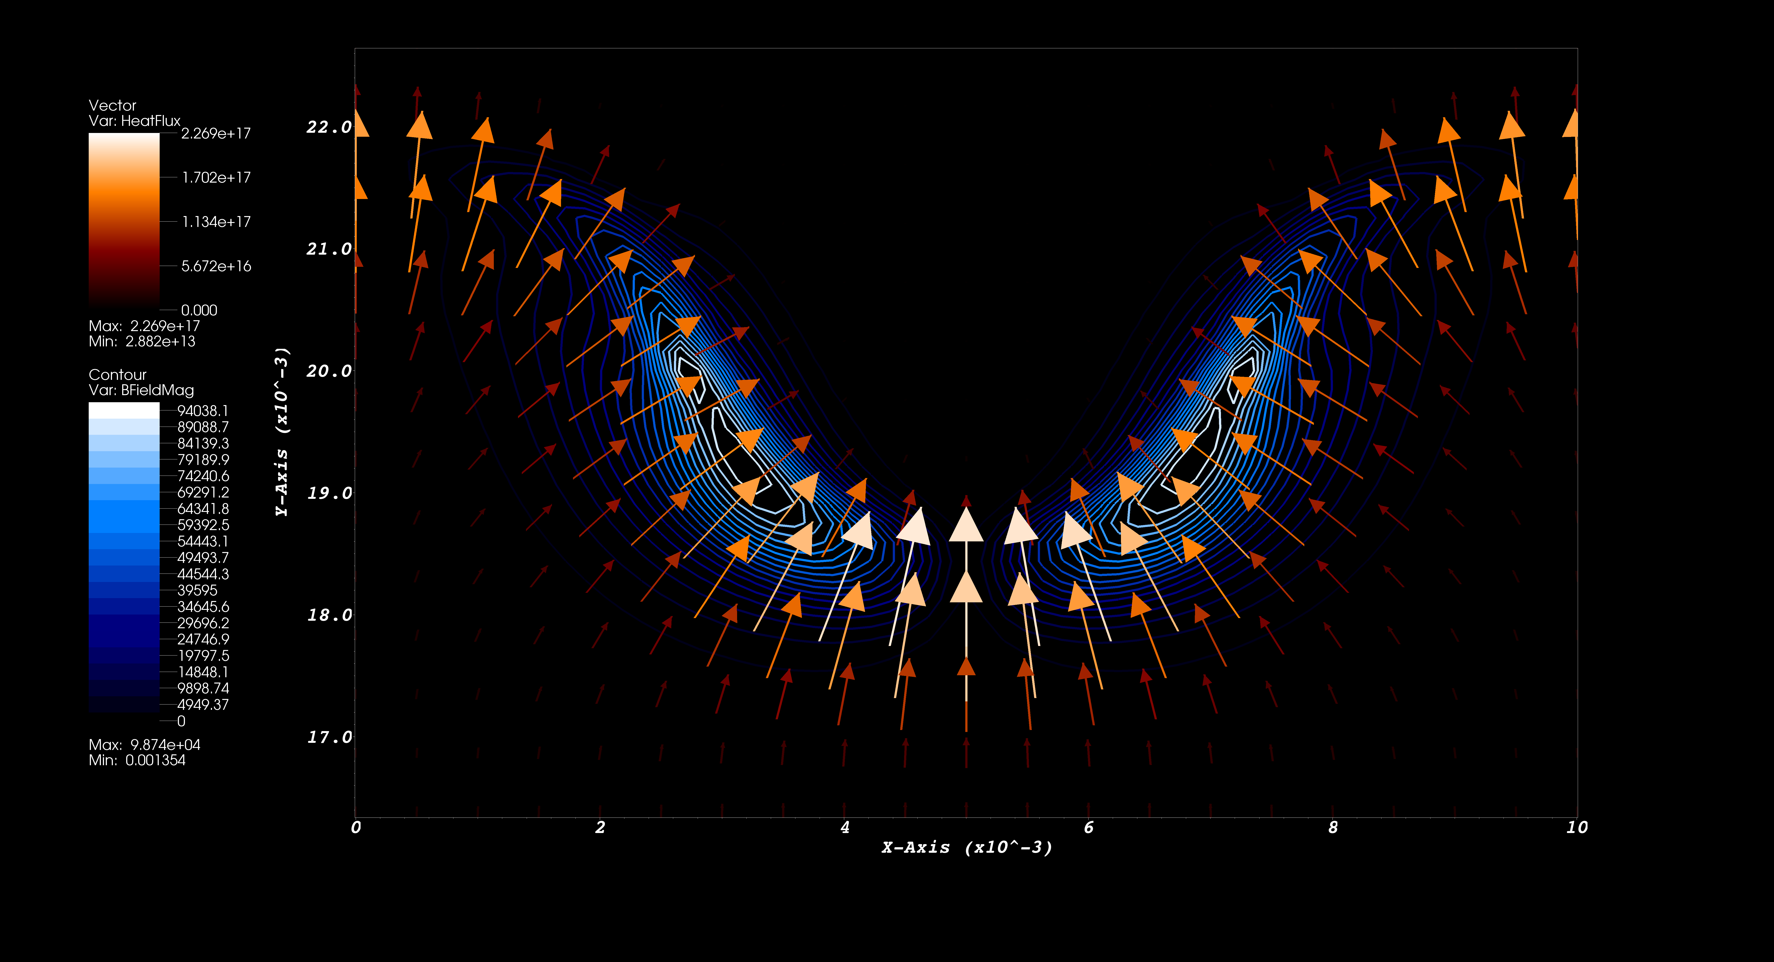
Braginskii’s RT Model (early time)

Slide 25
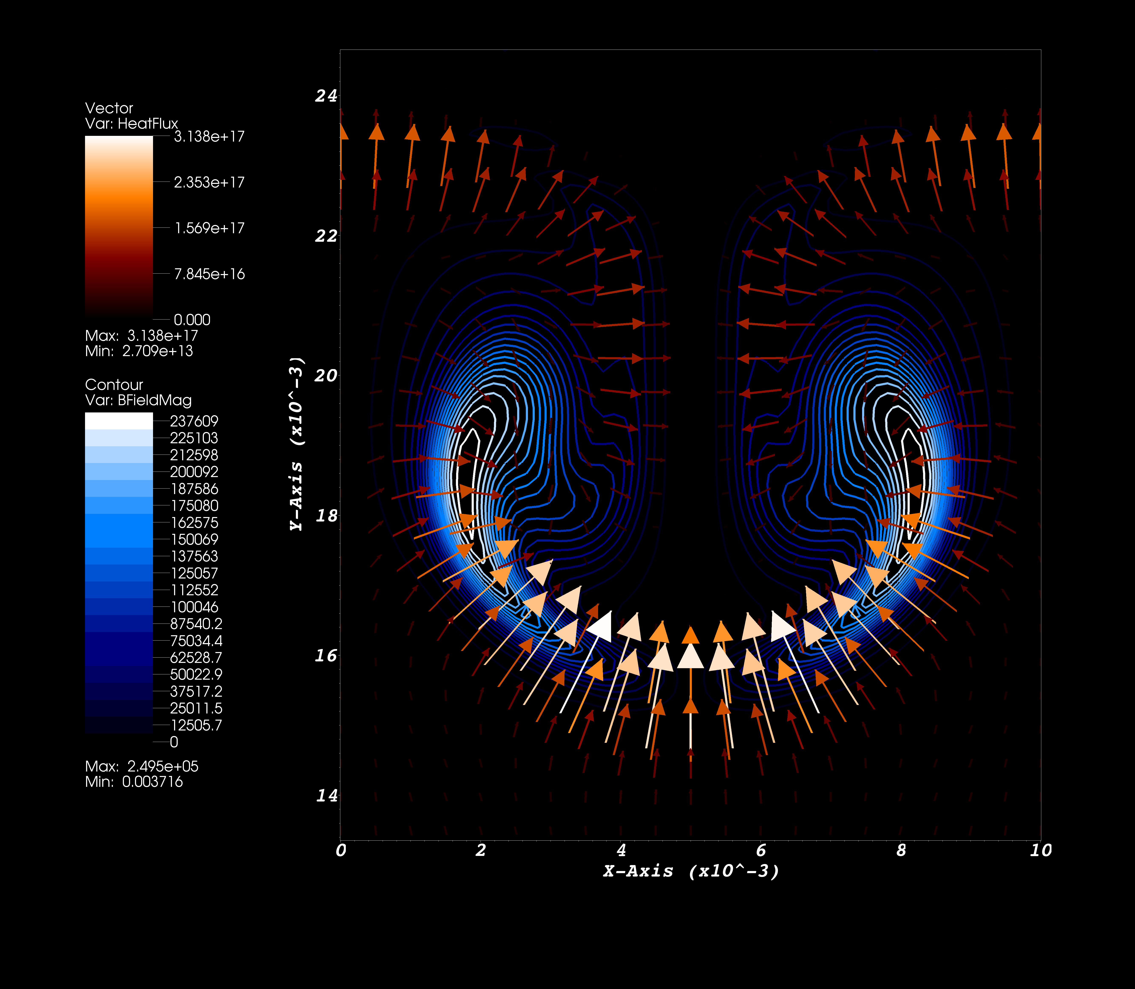
Braginskii’s RT Model (late time)

Slide 26
Diverging Supernova Explosion
Experiments on NIF
Purpose
This experiment attempts to observe extensive Rayleigh-Taylor driven mixing in the exploding massive stars.
Data will give physics insights of inter-shell penetration outwards to surface via turbulent mixing, shell breakouts, growth of secondary instabilities, vorticity-enhanced mixing.
Comments
NIF is the unique facility enabling studies with spherical targets (diverging flow geometry)
Natural continuation of the previous work on Omega
New diagnostics (IXTS, Dante, proton radiography…) in addition to standard diagnostics (x-ray radiography)
15 shots starting in FY 2013

Slide 27
Outline
Purpose
Method
Team
Observations of core-collapse supernovae
Theory of core-collapse supernovae
Experiment on NIF
Discussion

Slide 28
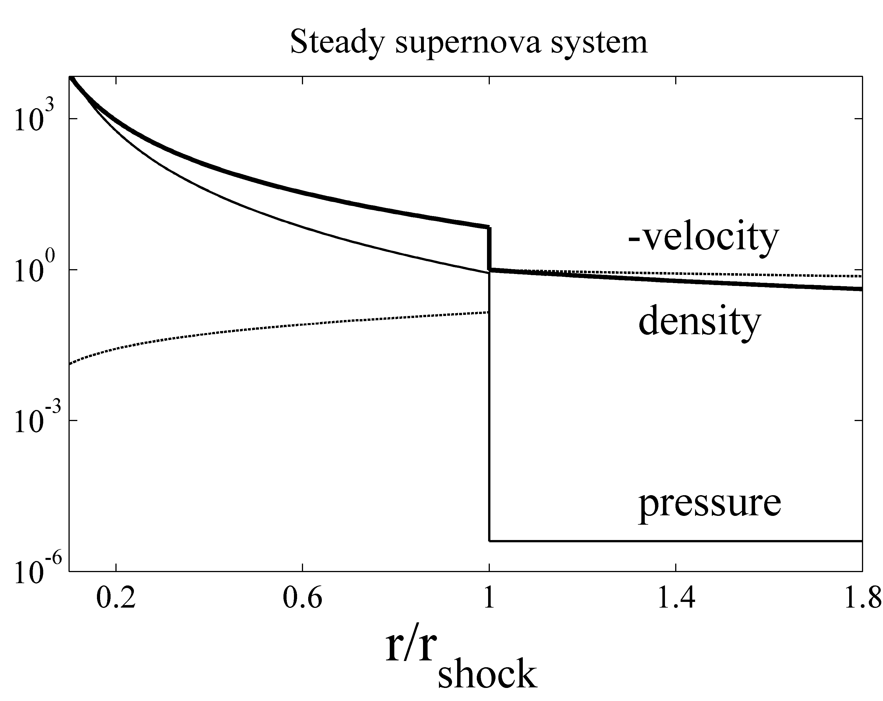
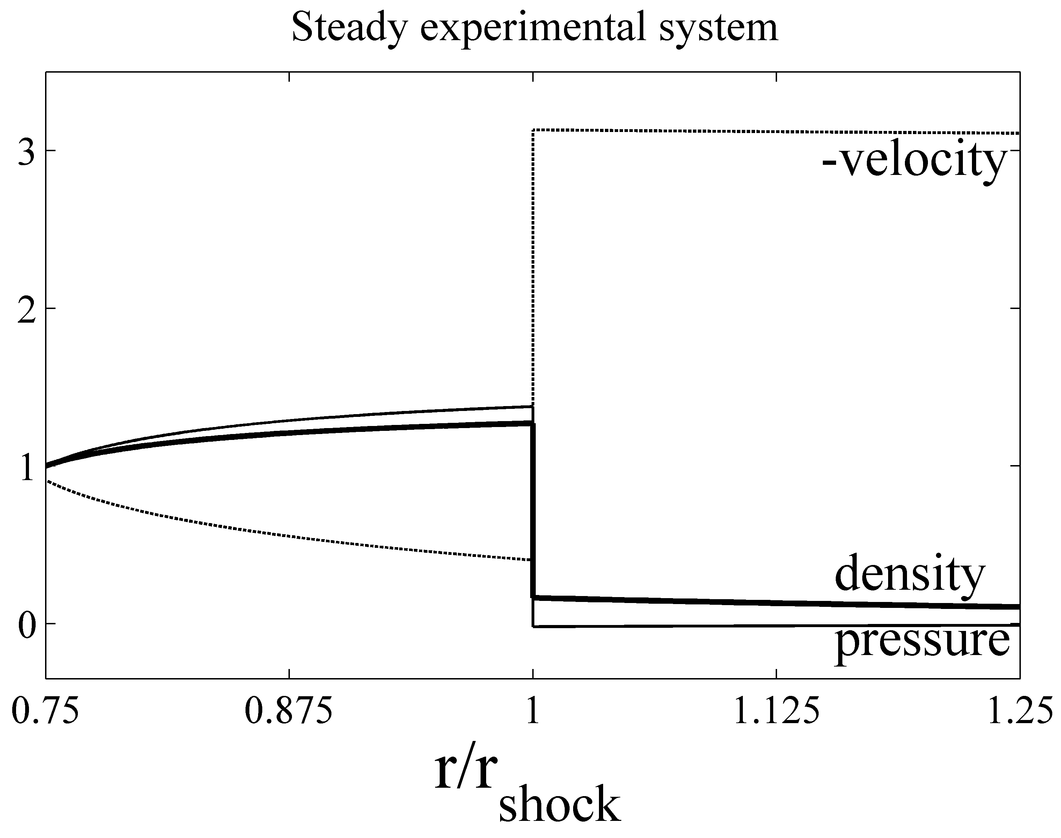
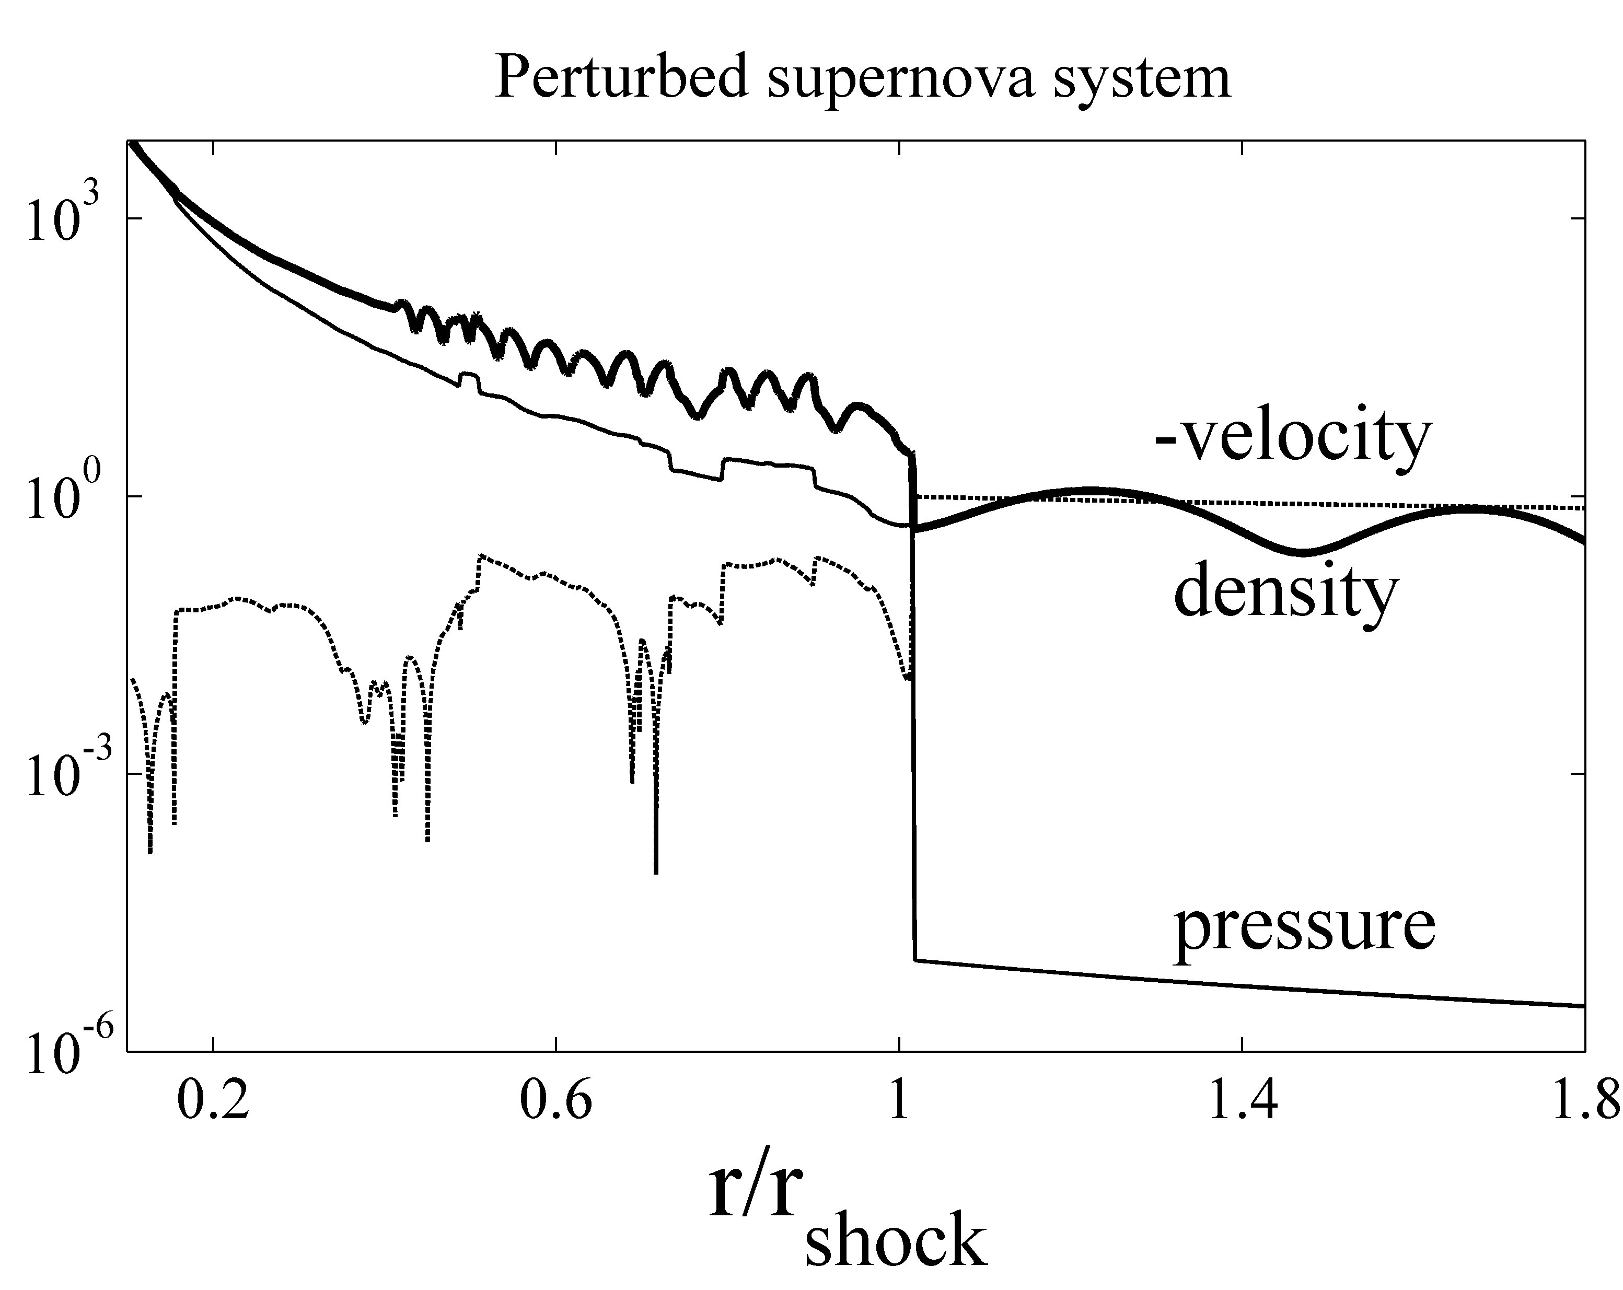
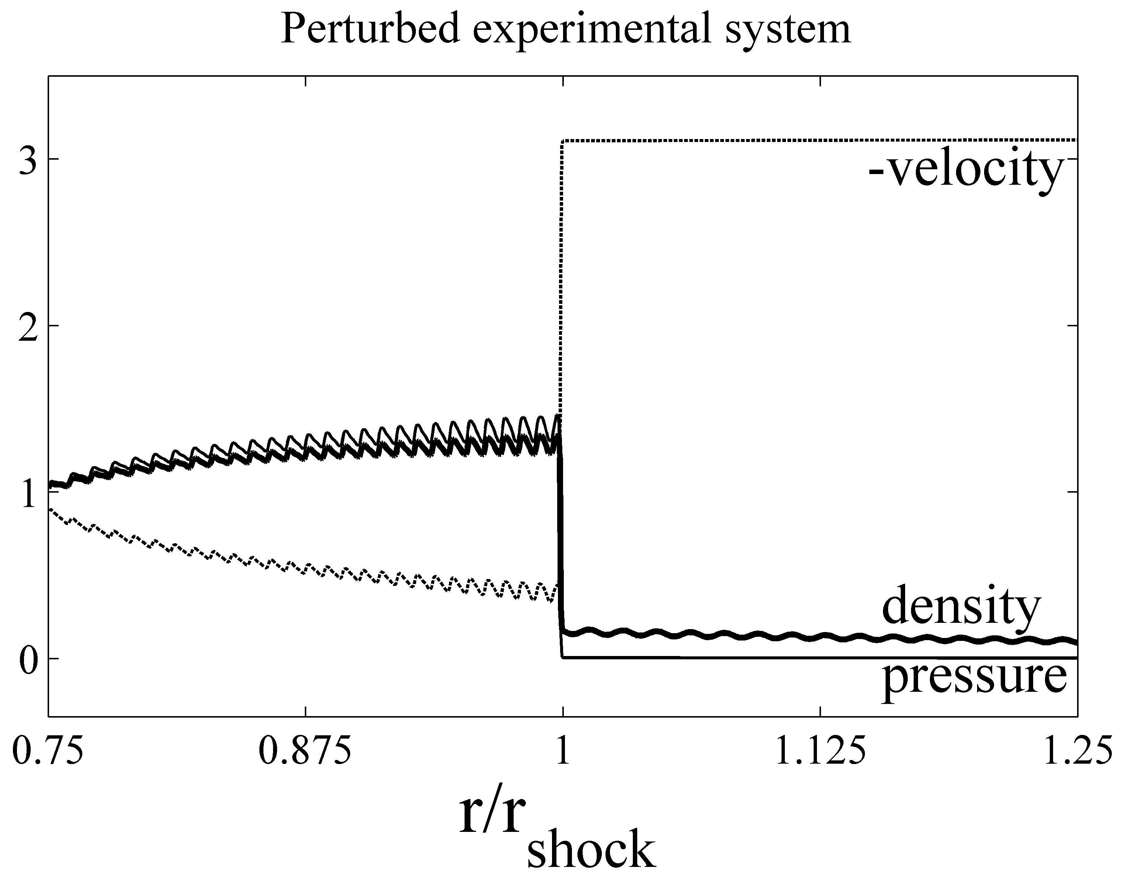
NIF SASI Study
Handy et al. (2012)

Slide 29
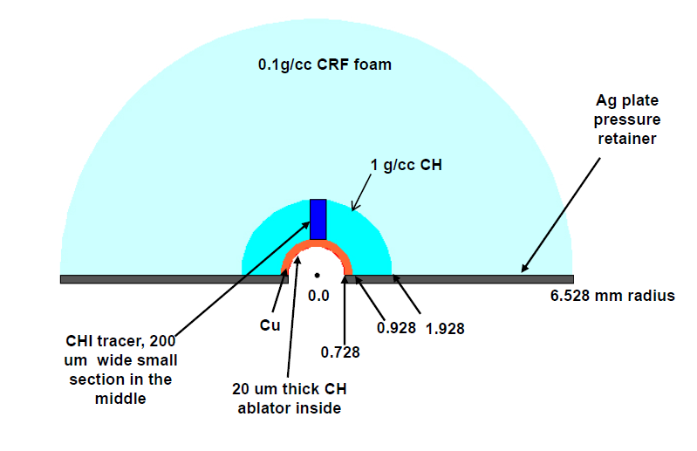
DivSNRT 3 Layer Target

Slide 30
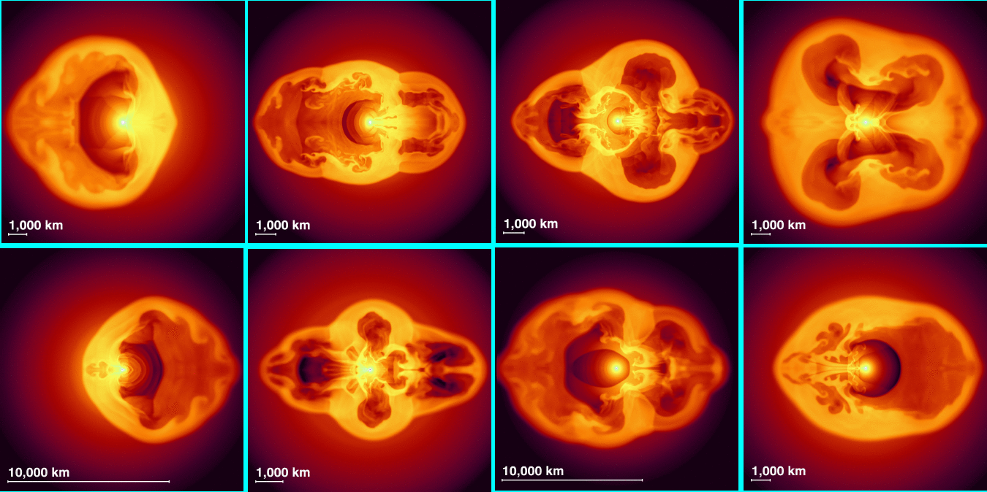
Standing Accretion Shock Instability
Janka et al. (2006)

Slide 31
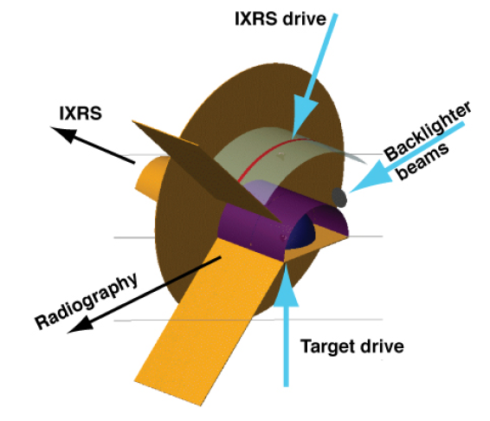
DivSNRT Diagnostics

Slide 32
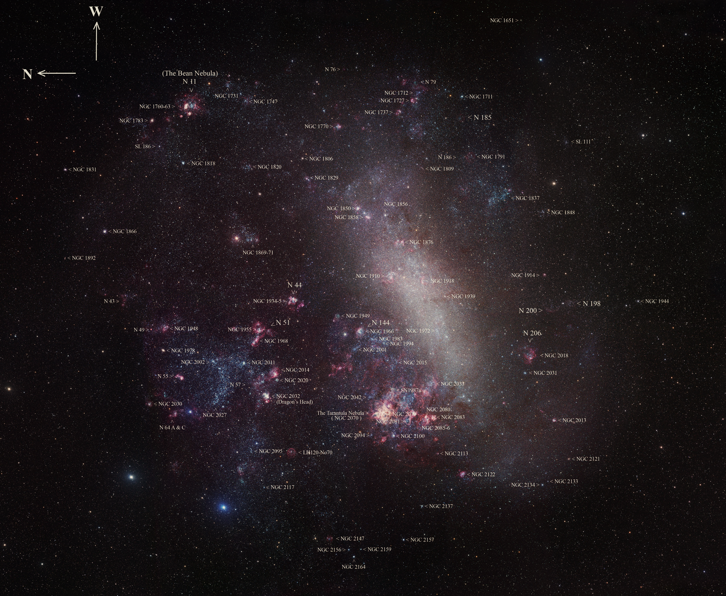

Slide 33
Proposed Schedule of Shots
FY13
FY14
  3 layer target studies, demonstrate Imaging X-ray Thomson Scattering technique
FY15
    3 layer target studies with aspherical shocks with radiography and IXTS
Shot Number | Target Type | Perturbation between interfaces | Drive | Diagnostic Technique | Note
1 | hemispherical 2 layers | none | 80-300kJ 3ns | radiography | drive test, RT/RM at a nominally smooth interface
2 | as above | (kA)₁ | as above | as above | RT/RM at high-Z/med-Z interfaces
3 | as above | (kA)₂ | as above | as above | as above
4 | as above | (kA)_{(1,2)} | as above | as above | reproducibility test
5 | hemispherical 3 layers | none | as above | as above | drive test, RT/RM at a nominally smooth interface

Slide 34
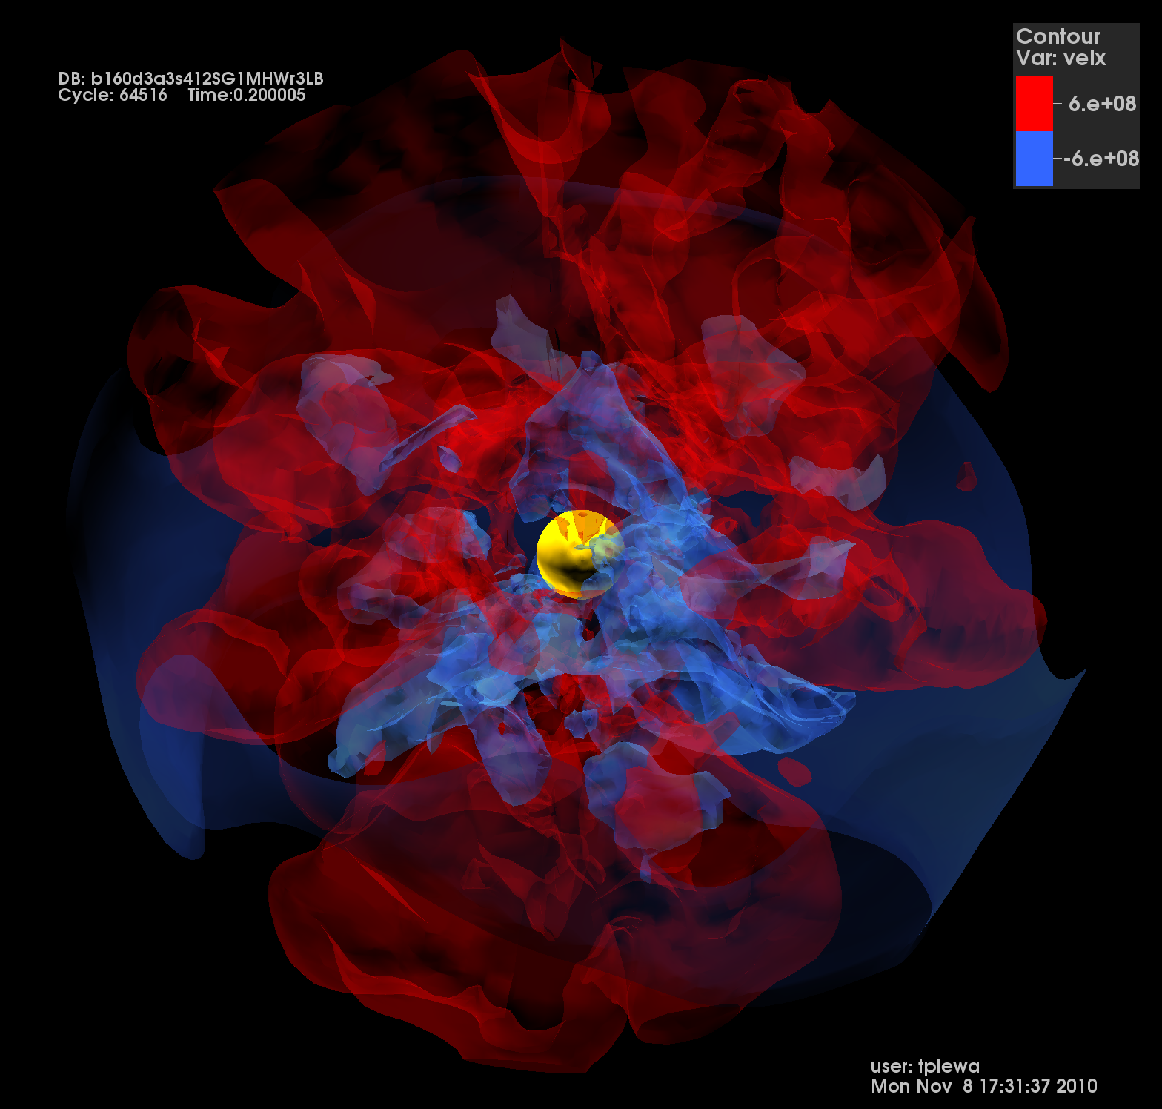
Questions and Discussion

