Slide 1
Spontaneous Deflagration-to-Detonation Transition in Thermonuclear Supernovae
Alexei Poludnenko
Naval Research Laboratory
Tom Gardiner (Sandia), Elaine Oran (NRL)

Slide 2
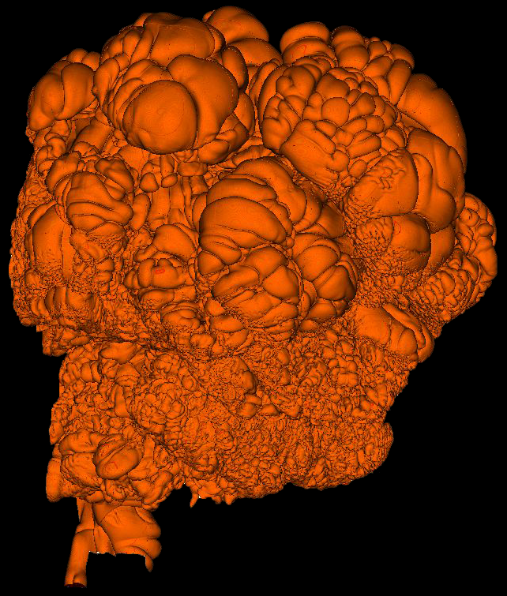
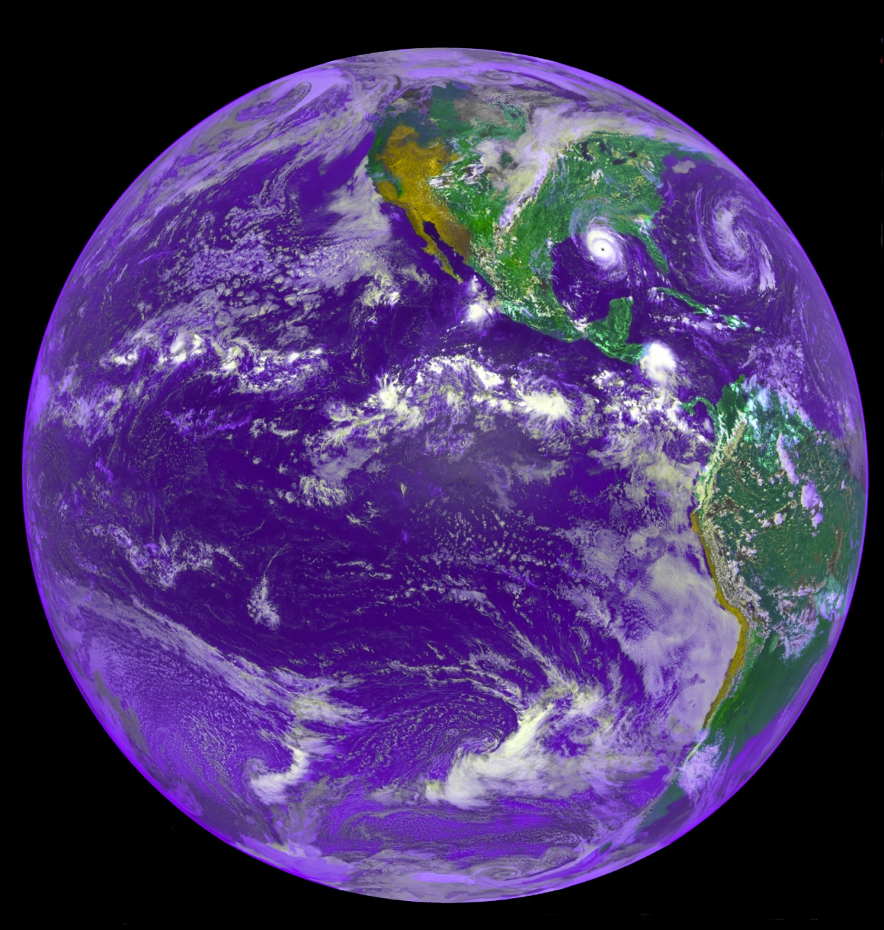
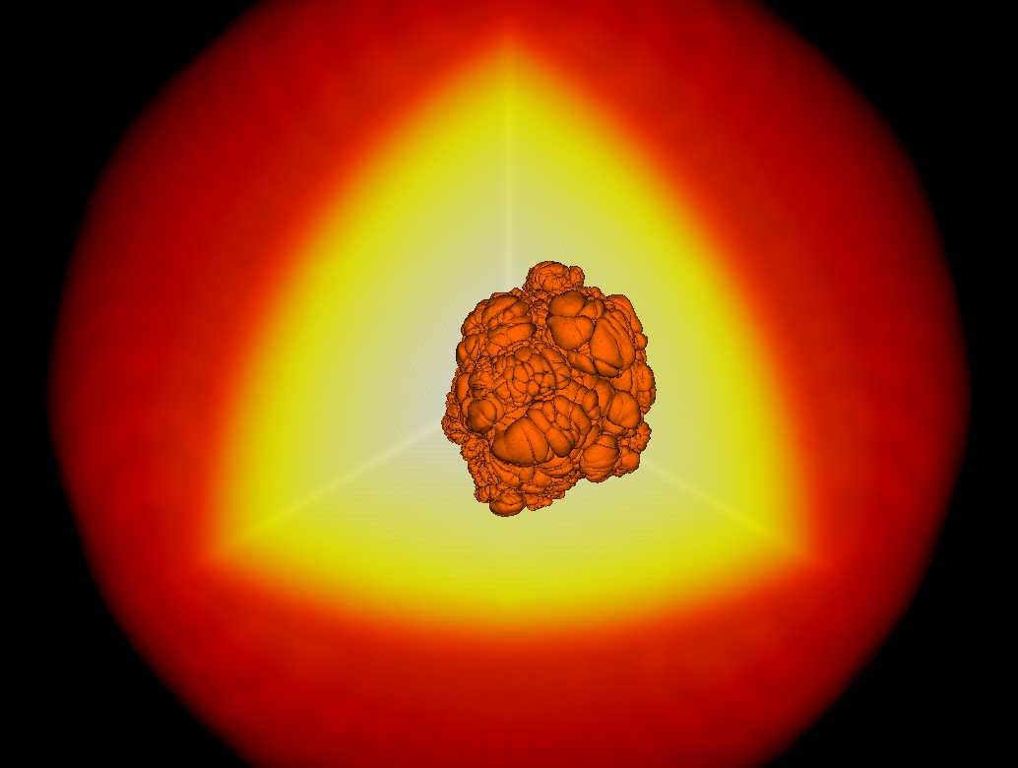
Unconfined Deflagration-to-Detonation Transition and the Delayed Detonation Model
L ~ 2000 km
~ 10⁷ – 10⁹ g/cc
S_{L} ~ 10 – 10⁵ m/s
NASA/NOAO

Slide 3
Unconfined Deflagration-to-Detonation Transition and the Delayed Detonation Model
Can a highly subsonic turbulent flow interacting with a highly subsonic flame produce a supersonic shock-driven detonation?
There are two key ingredients in this process:
Mechanism of pressure increase
Formation of a detonation
Can a highly subsonic turbulent flow interacting with a highly subsonic flame produce a supersonic shock-driven detonation?
There are two key ingredients in this process:
Mechanism of pressure increase
Formation of a detonation

Slide 4
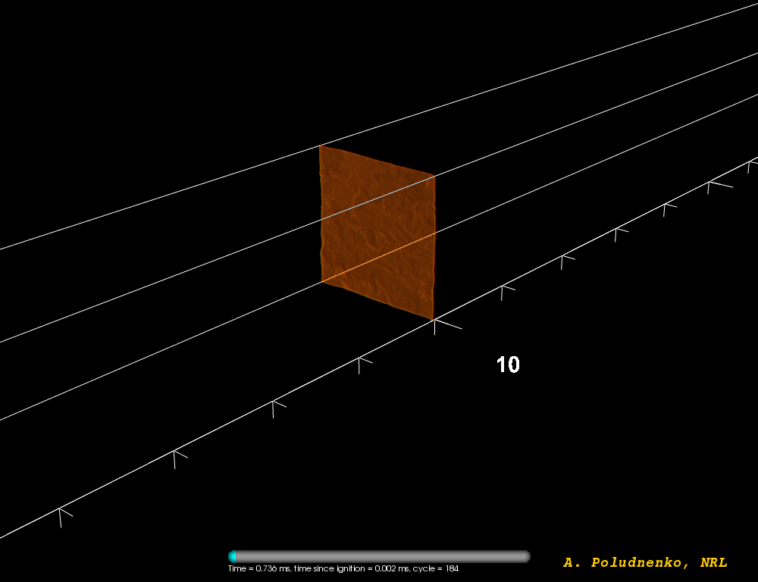
Spontaneous Transition of a Turbulent Flame
to a Detonation: Flame Structure
Can a different reactive system be found instead, which is both (a) realistic and (b) similar to thermonuclear flames in SN Ia, but which, at the same time, allows for a much smaller range of scales accessible in first-principles simulations?

Slide 5
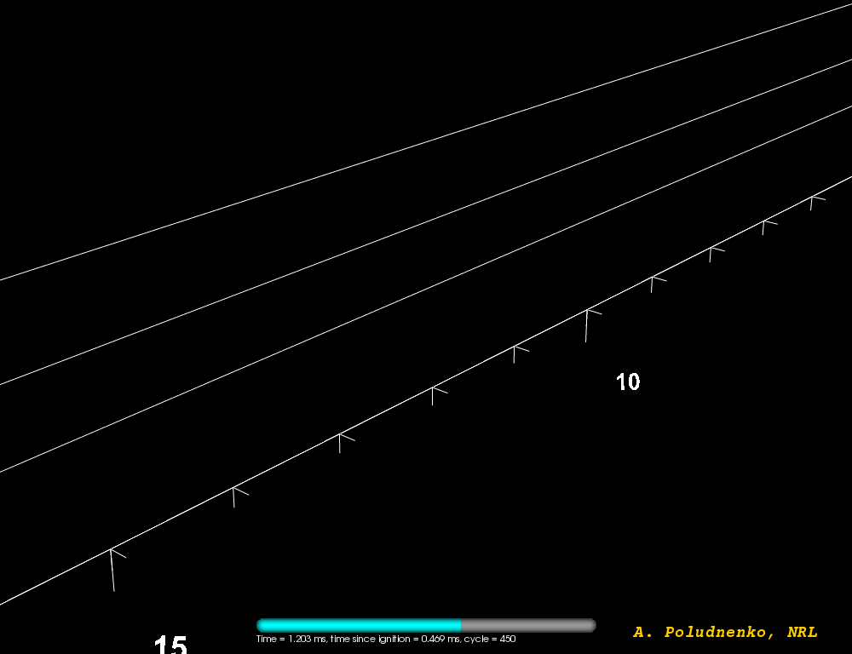
Spontaneous Transition of a Turbulent Flame
to a Detonation: Pressure Distribution

Slide 6
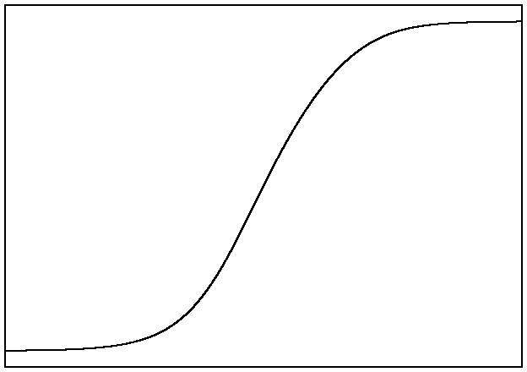
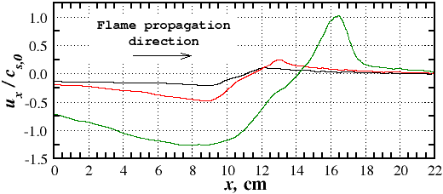
Mechanism of the Spontaneous Transition of a Turbulent Flame to a Detonation
For sufficiently large, but subsonic, S_{T} product will become supersonic
ρ_{p}
U_{p} = (ρ_{f} /ρ_{p})S_{T}
ρ_{f}
U_{f} = S_{T}
fuel
product
Chapman-Jouguet deflagration → maximum flame speed
This condition is equivalent to
δ_{T}
Flame generates on a sound-crossing time energy ~ its internal energy
Pressure build-up, runaway… and detonation

Slide 7
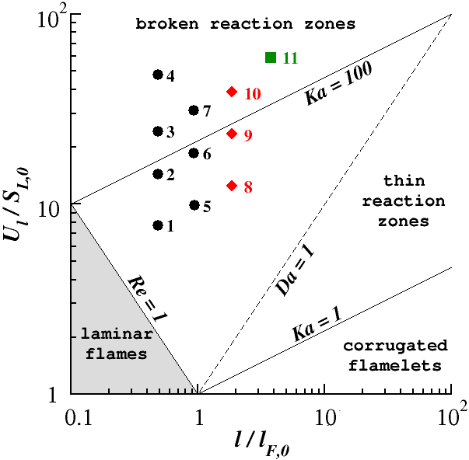
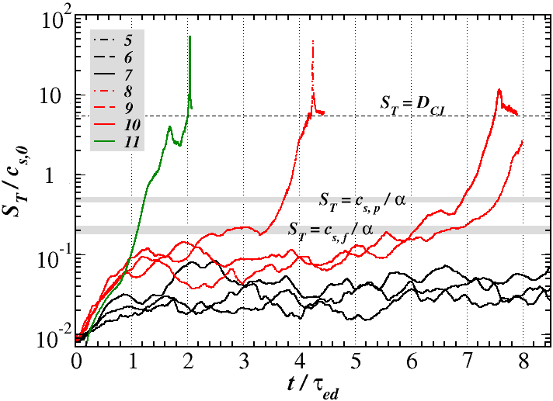
Dependence of the System Evolution on
the Turbulent Regime and Reaction Model
Transition criterion based on the Chapman-Jouguet deflagration speed accurately predicts the onset of DDT for a broad range of laminar flame speeds, system sizes, and turbulent intensities
No global spontaneous reaction waves (based on fuel temperature and flame structure)
Runaway takes place on a sound crossing time of the flame brush

Slide 8
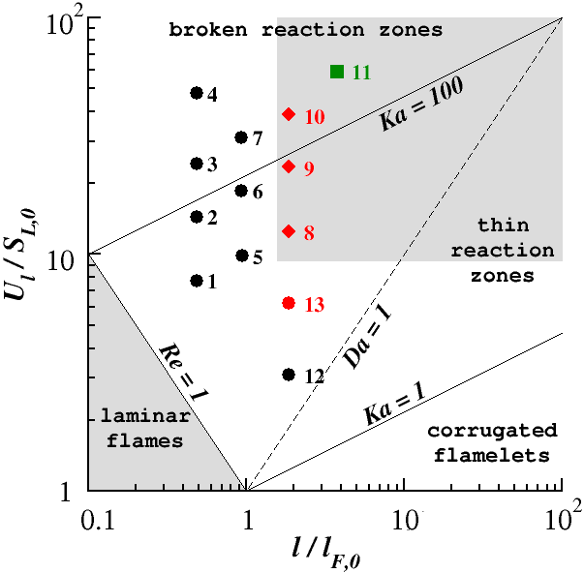
Dependence of the System Evolution on
the Turbulent Regime and Reaction Model
Minimum integral velocity
Minimum integral scale

Slide 9
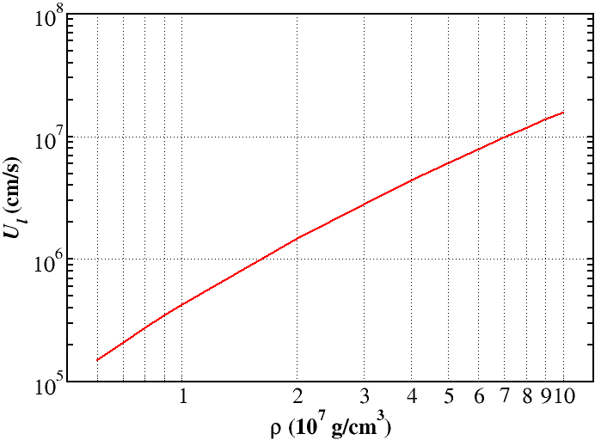
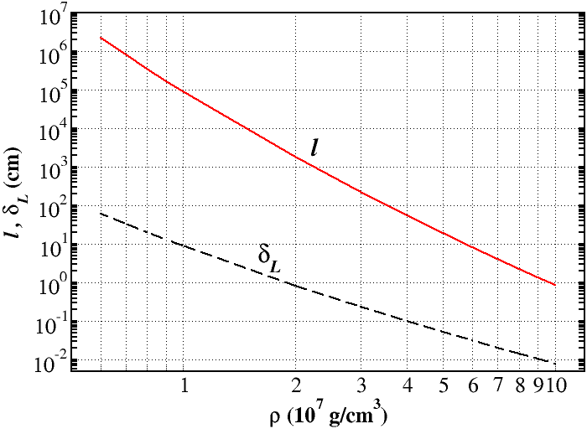
Implications for Type Ia Supernovae
Critical turbulent intensity
Röpke 2007
Minimum integral velocity
Minimum integral scale / flame width

Slide 10
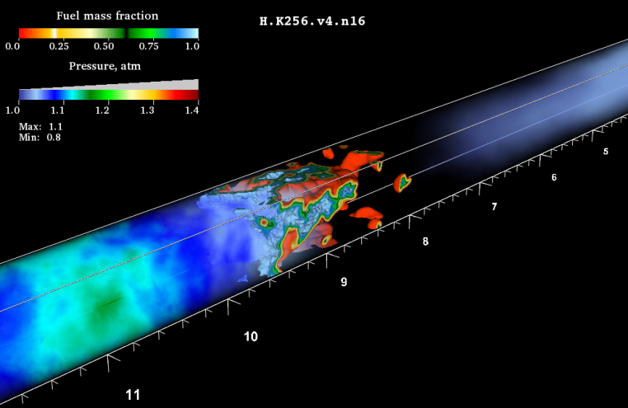
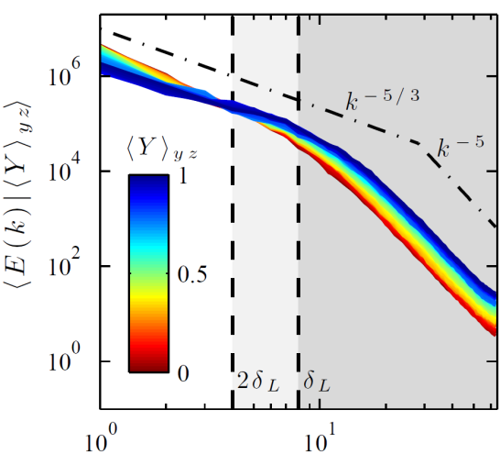
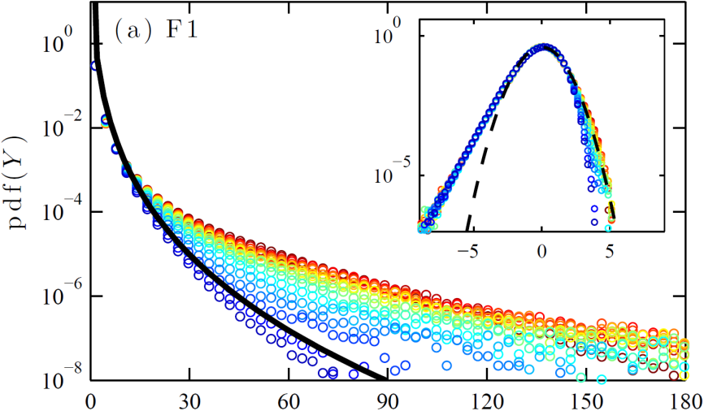
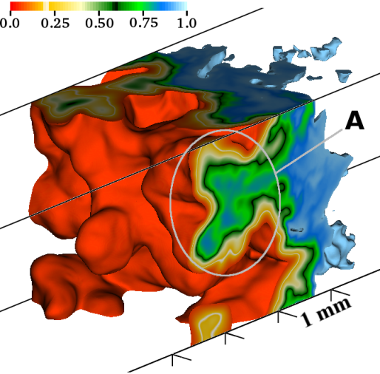
Nonmagnetized Reacting Turbulence:
It is different!
Pulsating instability
“Inverse” energy cascade
AYP et al. (2012), in preparation
Hamlington, AYP, Oran (2011) AIAA, Phys. Fluids
Anomalous intermittency
Flame sheet collisions
Hamlington, AYP, Oran (2012) Phys. Fluids, in press
AYP & Oran (2011) Comb. Flame

Slide 11
Summary
Poludnenko et al. Phys. Rev. Lett. (2011)
Highly subsonic reacting turbulence is inherently capable of spontaneously producing supersonic shock-driven reaction fronts
The underlying process relies on flame speed exceeding the Chapman-Jouguet deflagration limit. Unlike laminar flames, turbulent flames can become sufficiently fast
This process does not depend on the flame properties, reaction model, or EOS
This process does not rely on the classical Zel’dovich’s mechanism. Thus, it does not require the formation of distributed flames and, consequently, high turbulent intensities
At ρ < (1–3)×10⁷ g/cm³ practically any realistic turbulent intensity will lead to DDT
Acknowledgments

Slide 13
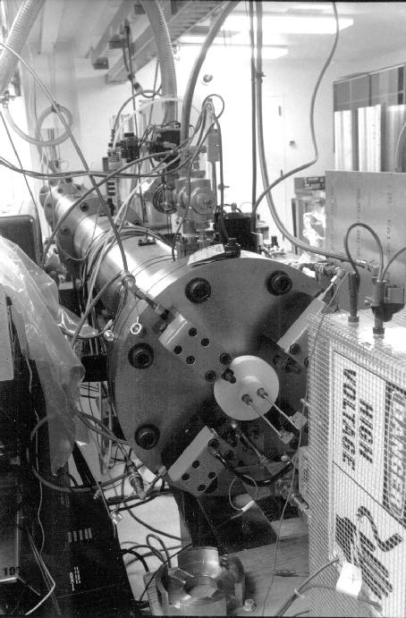
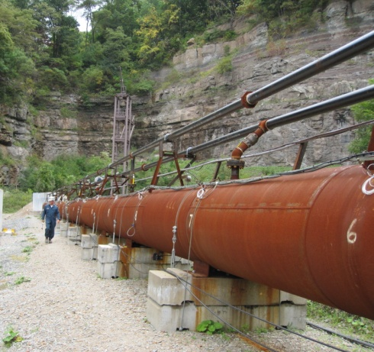
Summary
Poludnenko et al. Phys. Rev. Lett. (2011)
Highly subsonic reacting turbulence is inherently capable of spontaneously producing supersonic shock-driven reaction fronts
The underlying process relies on flame speed exceeding the Chapman-Jouguet deflagration limit. Unlike laminar flames, turbulent flames can become sufficiently fast
This process does not depend on the flame properties, reaction model, or EOS
NIOSH
J. Shepherd, CALTECH
This process does not rely on the classical Zel’dovich’s mechanism. Thus, it does not require the formation of distributed flames and, consequently, high turbulent intensities
At ρ < (1–3)×10⁷ g/cm³ practically any realistic turbulent intensity will lead to DDT
Acknowledgments

Slide 14
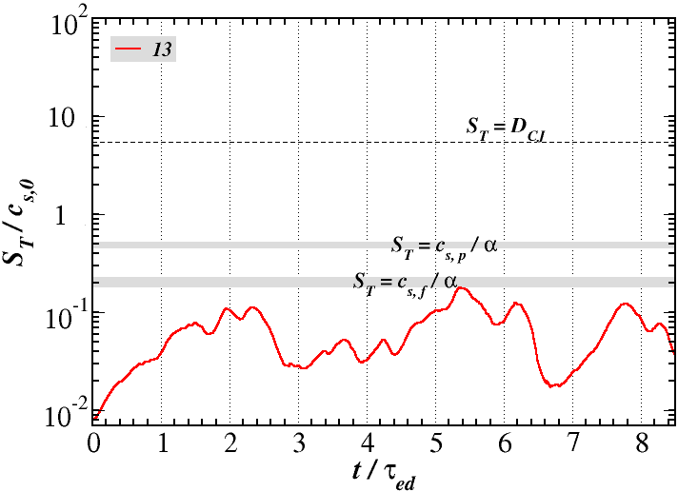
Critical Turbulent Conditions for
Spontaneous DDT
Minimum integral velocity
Minimum integral scale

Slide 15
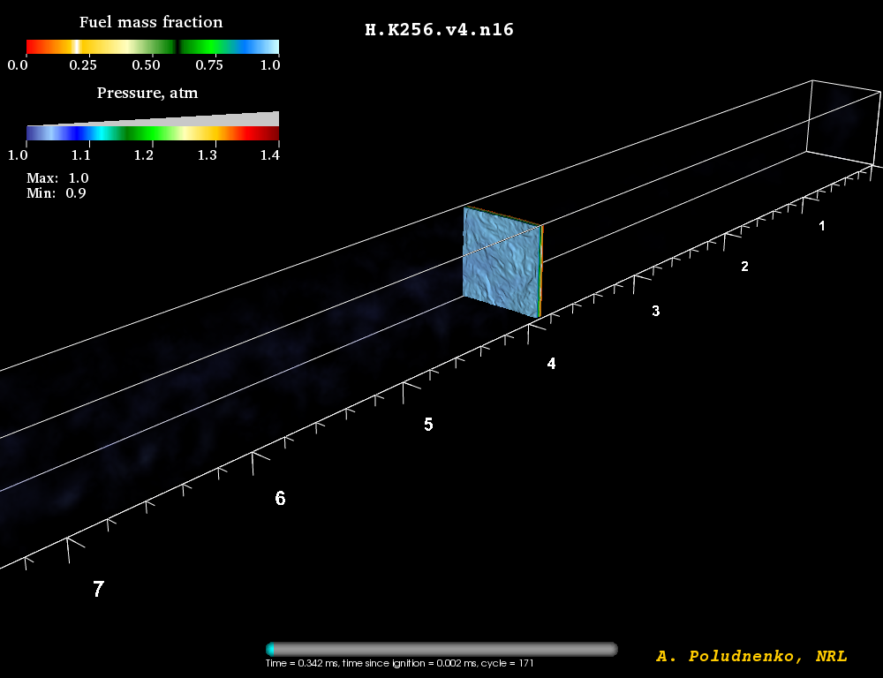
Pulsating Instability of a Fast Turbulent Flame:
Flame Structure and Pressure Distribution

Slide 16
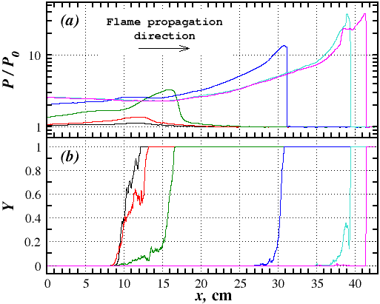
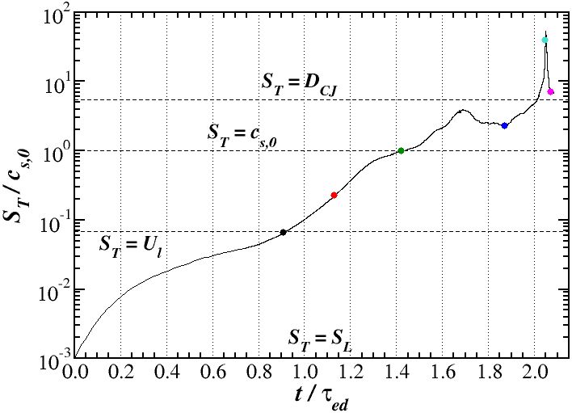
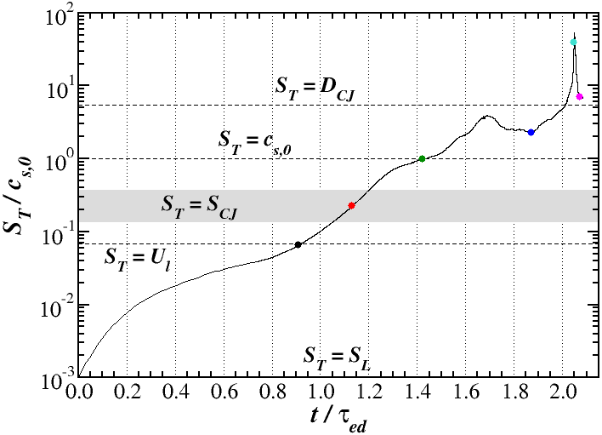
Mechanism of the Spontaneous Transition of a Turbulent Flame to a Detonation
No global spontaneous reaction waves (based on fuel temperature and flame structure)
Runaway takes place on a sound crossing time of the flame brush ~ 27μs ~ τ_{ed}

Slide 17
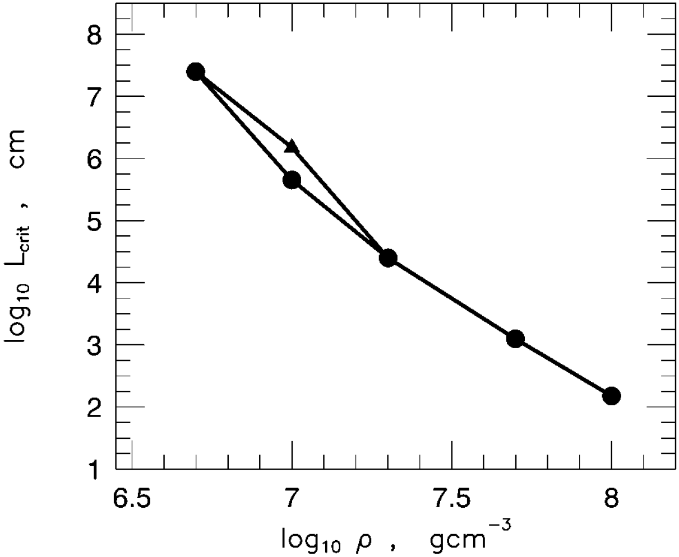
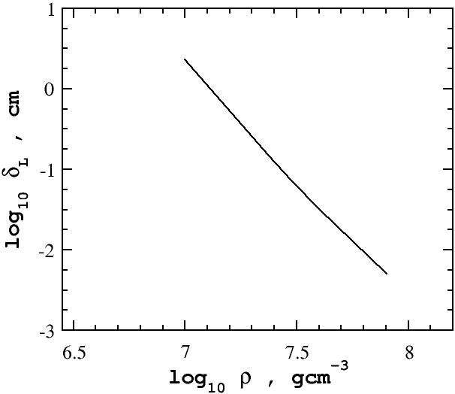
Unconfined DDT
Spontaneous reaction wave model
(Khokhlov 1995)
(Aspden et al. 2008)
Hot spot required for DDT is 4 – 5 orders of magnitude larger than the ¹²C burning scale
Can a different reactive system be found instead, which is both (a) realistic and (b) similar to thermonuclear flames in SN Ia, but which, at the same time, allows for a much smaller size of a hot spot?

Slide 18
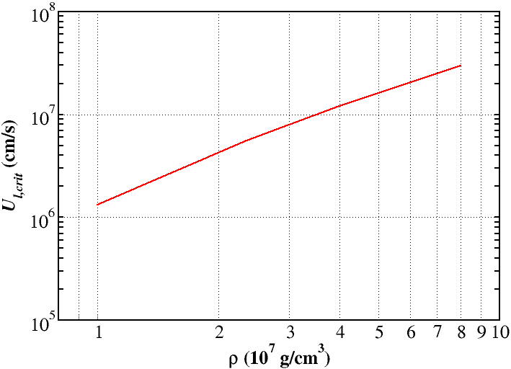
Implications for Type Ia Supernovae
Critical turbulent intensity
Critical turbulent flame speed is
Röpke 2007
On the other hand, in the flamelet regime
Turbulent flame surface area is
Average flame separation λ_{T} can be found as (Khokhlov 1995, AYP & Oran 2011)
Combining this all together gives

Slide 19
Unconfined DDT
Spontaneous reaction wave model

Slide 20
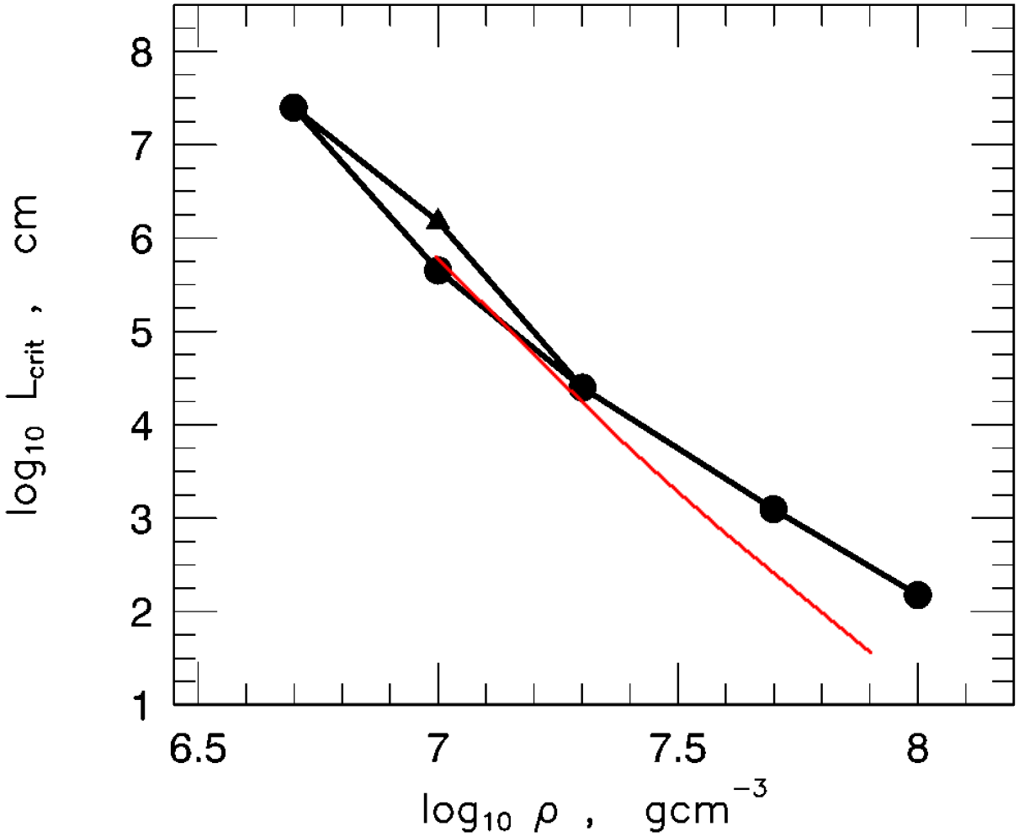
Implications for Type Ia Supernovae
Critical length scale
(Khokhlov 1995)
(Aspden et al. 2008)
Critical turbulent flame speed
Minimum flame separation cannot be smaller than the full flame width λ_{T} > δ_{L}

Slide 21
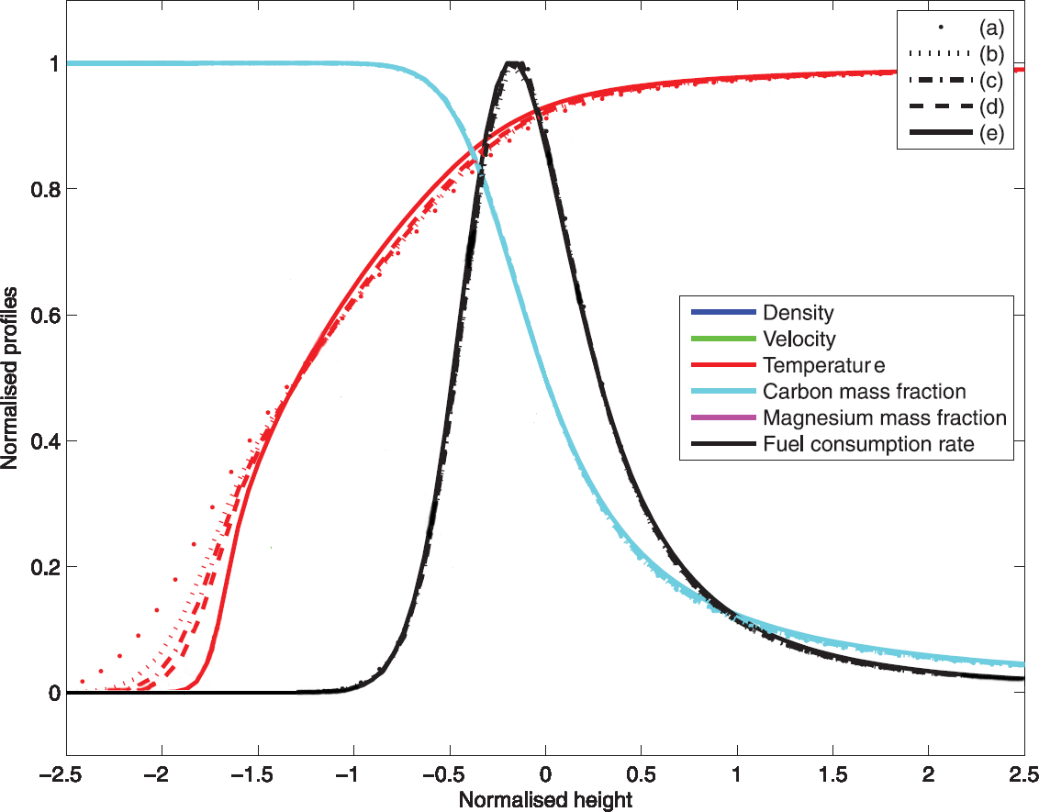
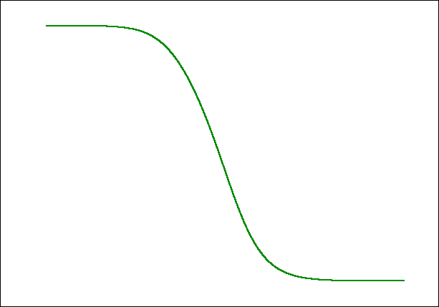
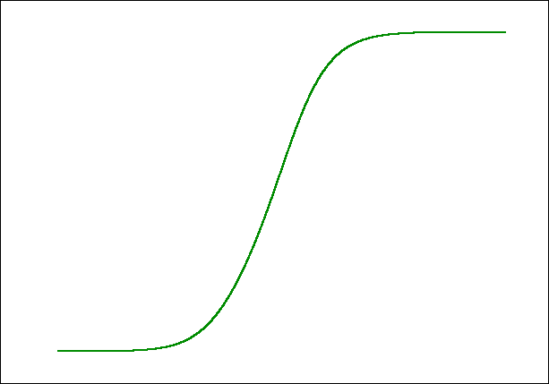
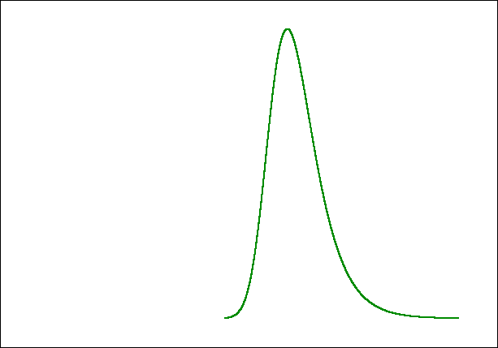
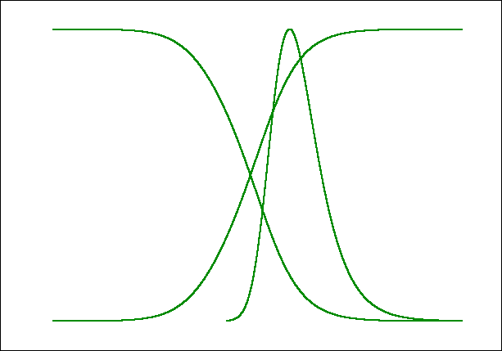
Structure of Thermonuclear vs.
Chemical Flame
Density:
a. 8×10⁷ g/cc
b. 4×10⁷ g/cc
c. 3×10⁷ g/cc
d. 2.35×10⁷ g/cc
e. 1×10⁷ g/cc
All quantities are normalized as
Aspden et al. (2008)

Slide 22
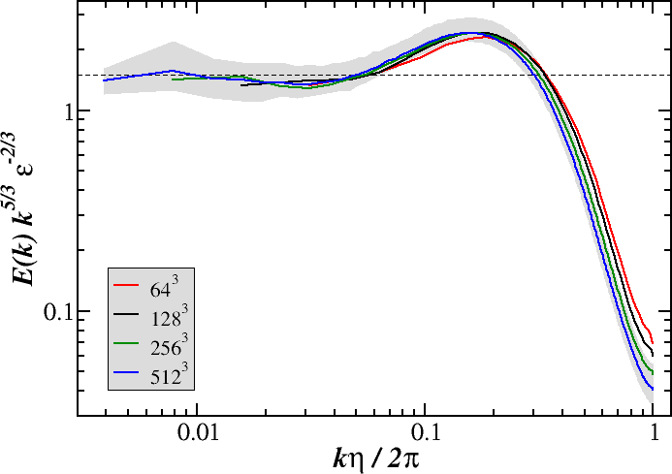
Method: Athena-RFX
Reactive-flow extension to the MHD code Athena (Stone et al. 2008, AYP & Oran 2010)
Fixed-grid massively parallel code
Fully-unsplit Corner Transport Upwind scheme, PPM-type spatial reconstruction, HLLC Riemann solver (2nd-order in time, 3rd-order in space)
Reactive flow extensions for DNS of chemical and thermonuclear flames, general EOS
Turbulence driving via spectral-type method (energy injection spectra of arbitrary complexity)

Slide 23
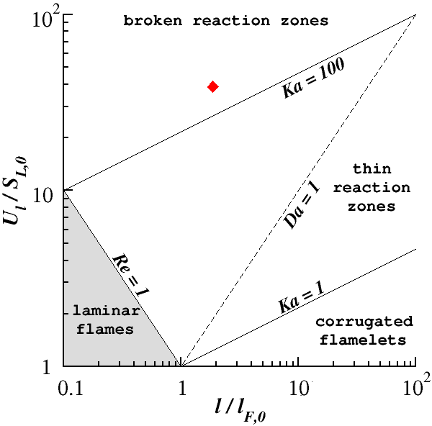
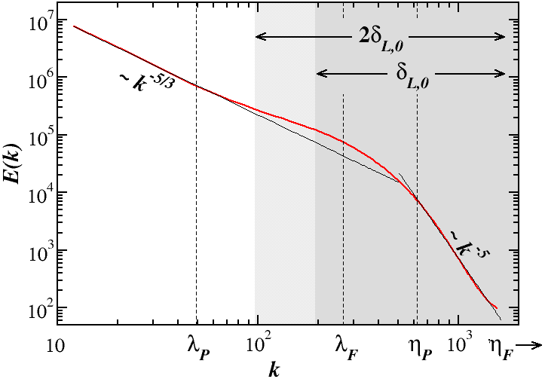
Spontaneous Transition of a Turbulent Flame to
Detonation in Stoichiometric H₂-air Mixture
Domain width, L Mesh Cell size, Δx Laminar flame width, δ_{L,0} ≈ l_{F,0}/2 Laminar flame speed, S_{L,0} L / δ_{L,0} δ_{L,0} / Δx | 0.518 cm 256 × 256 × 4096 2 × 10⁻³ cm 0.064 cm 302 cm/s 16 16
Integral scale, l Integral velocity, U_{l} R.M.S. velocity, U_{rms} Velocity at scale δ_{L}, U_{δ} Ma_{F} Gibson scale, L_{G} Damköhler number, Da | 0.12 cm ≈ 2δ_{L} 117.6 m/s ≈ 39S_{L,0} 218.8 m/s 75.5 m/s ≈ 25S_{L,0} 0.52 6.4 × 10⁻⁵ δ_{L} 0.05
Integral scale, l Integral velocity, U_{l} R.M.S. velocity, U_{rms} Velocity at scale δ_{L}, U_{δ} Ma_{F} Gibson scale, L_{G} Damköhler number, Da | 0.12 cm ≈ 2δ_{L,0} 117.6 m/s ≈ 39S_{L,0} 218.8 m/s 75.5 m/s ≈ 25S_{L,0} 0.52 6.4 × 10⁻⁵ δ_{L,0} 0.05

Slide 24
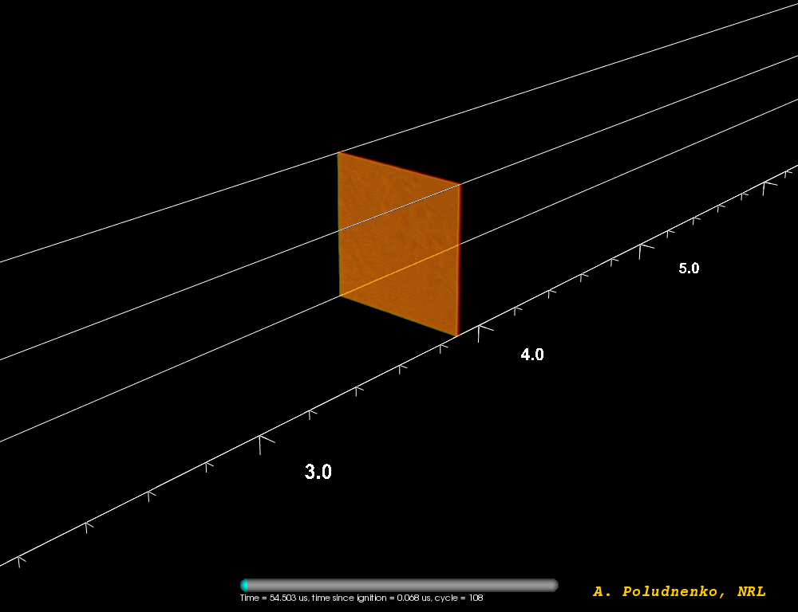
Spontaneous Transition of a Turbulent Flame to
a Detonation in Stoichiometric H₂-air Mixture

Slide 25
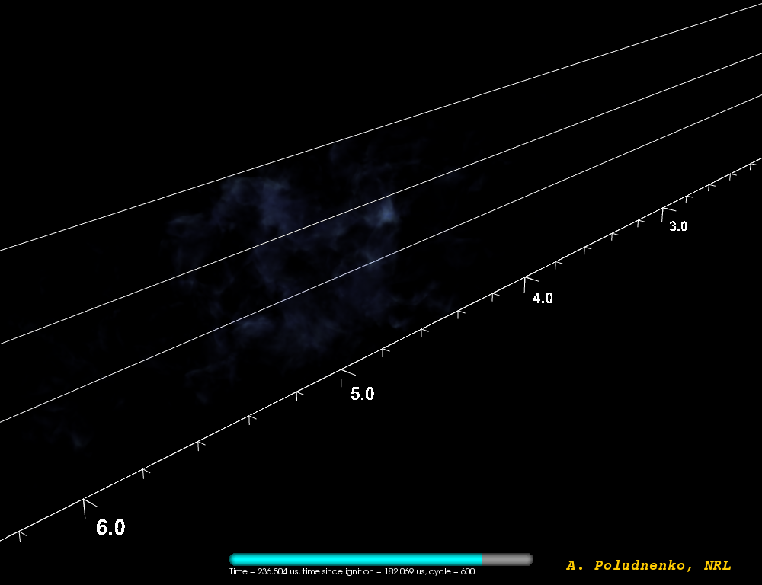
Spontaneous Transition of a Turbulent Flame to
a Detonation in Stoichiometric H₂-air Mixture

Slide 26
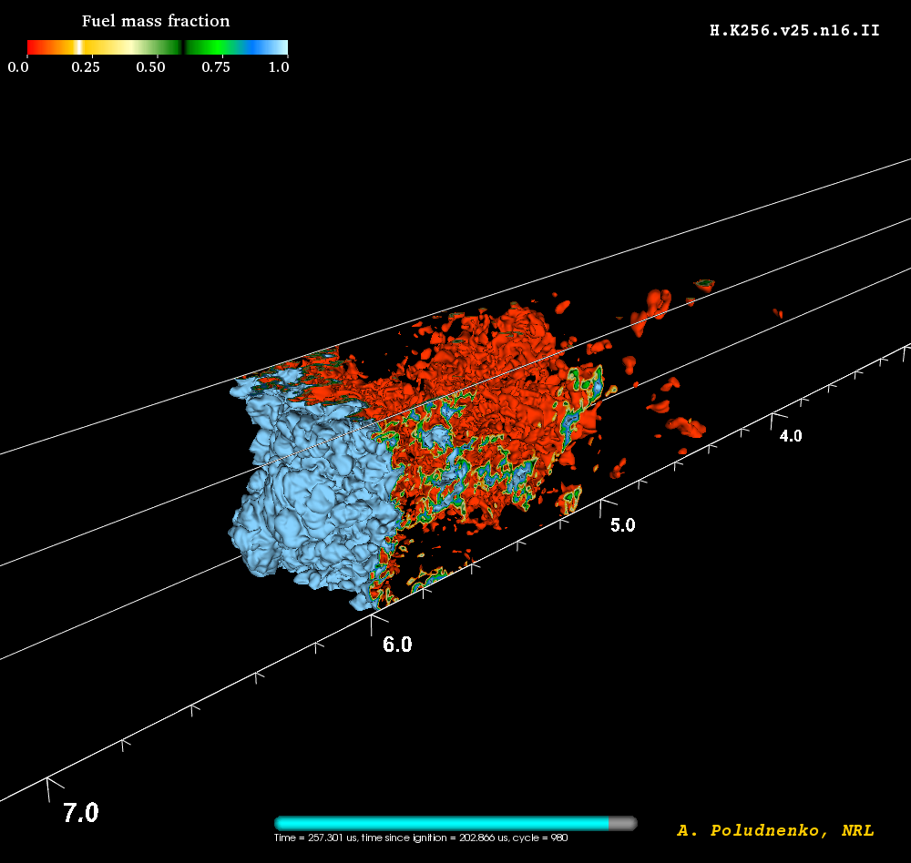
Detonation Ignition in Unconfined
Stoichiometric H₂-air Mixture

Slide 27
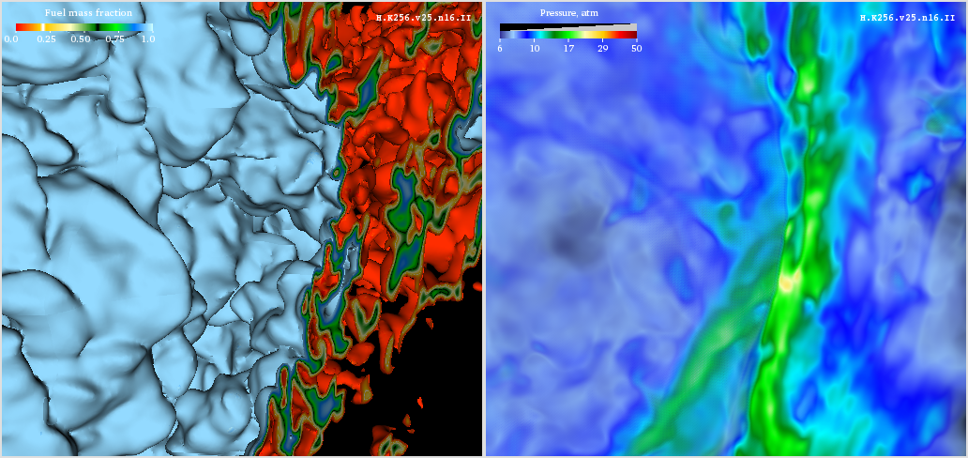
Detonation Ignition in Unconfined
Stoichiometric H₂-air Mixture

Slide 28
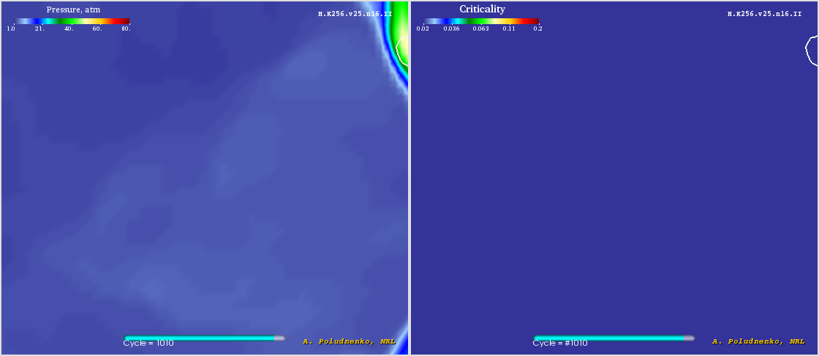
Detonation Ignition in Unconfined
Stoichiometric H₂-air Mixture

